Slide 1


UNDERSTANDING THE NOVEMBER PROPERTY TAX AMENDMENT
The Cuts You Won't See on the Ballot
Notes:
Greet the room, State how long you’ve been in your role. Set expectation for the next 15 to 20 minutes: this is informational, not advocacy.
Acknowledge what people may have already heard. Cable news, mailers, neighbor at the coffee shop.
The goal today is to make sure that when this ends up on your November ballot, you know what you're actually looking at.
A note: FAC members can't take a formal position on the amendment. But we can walk through what it does.

Slide 2
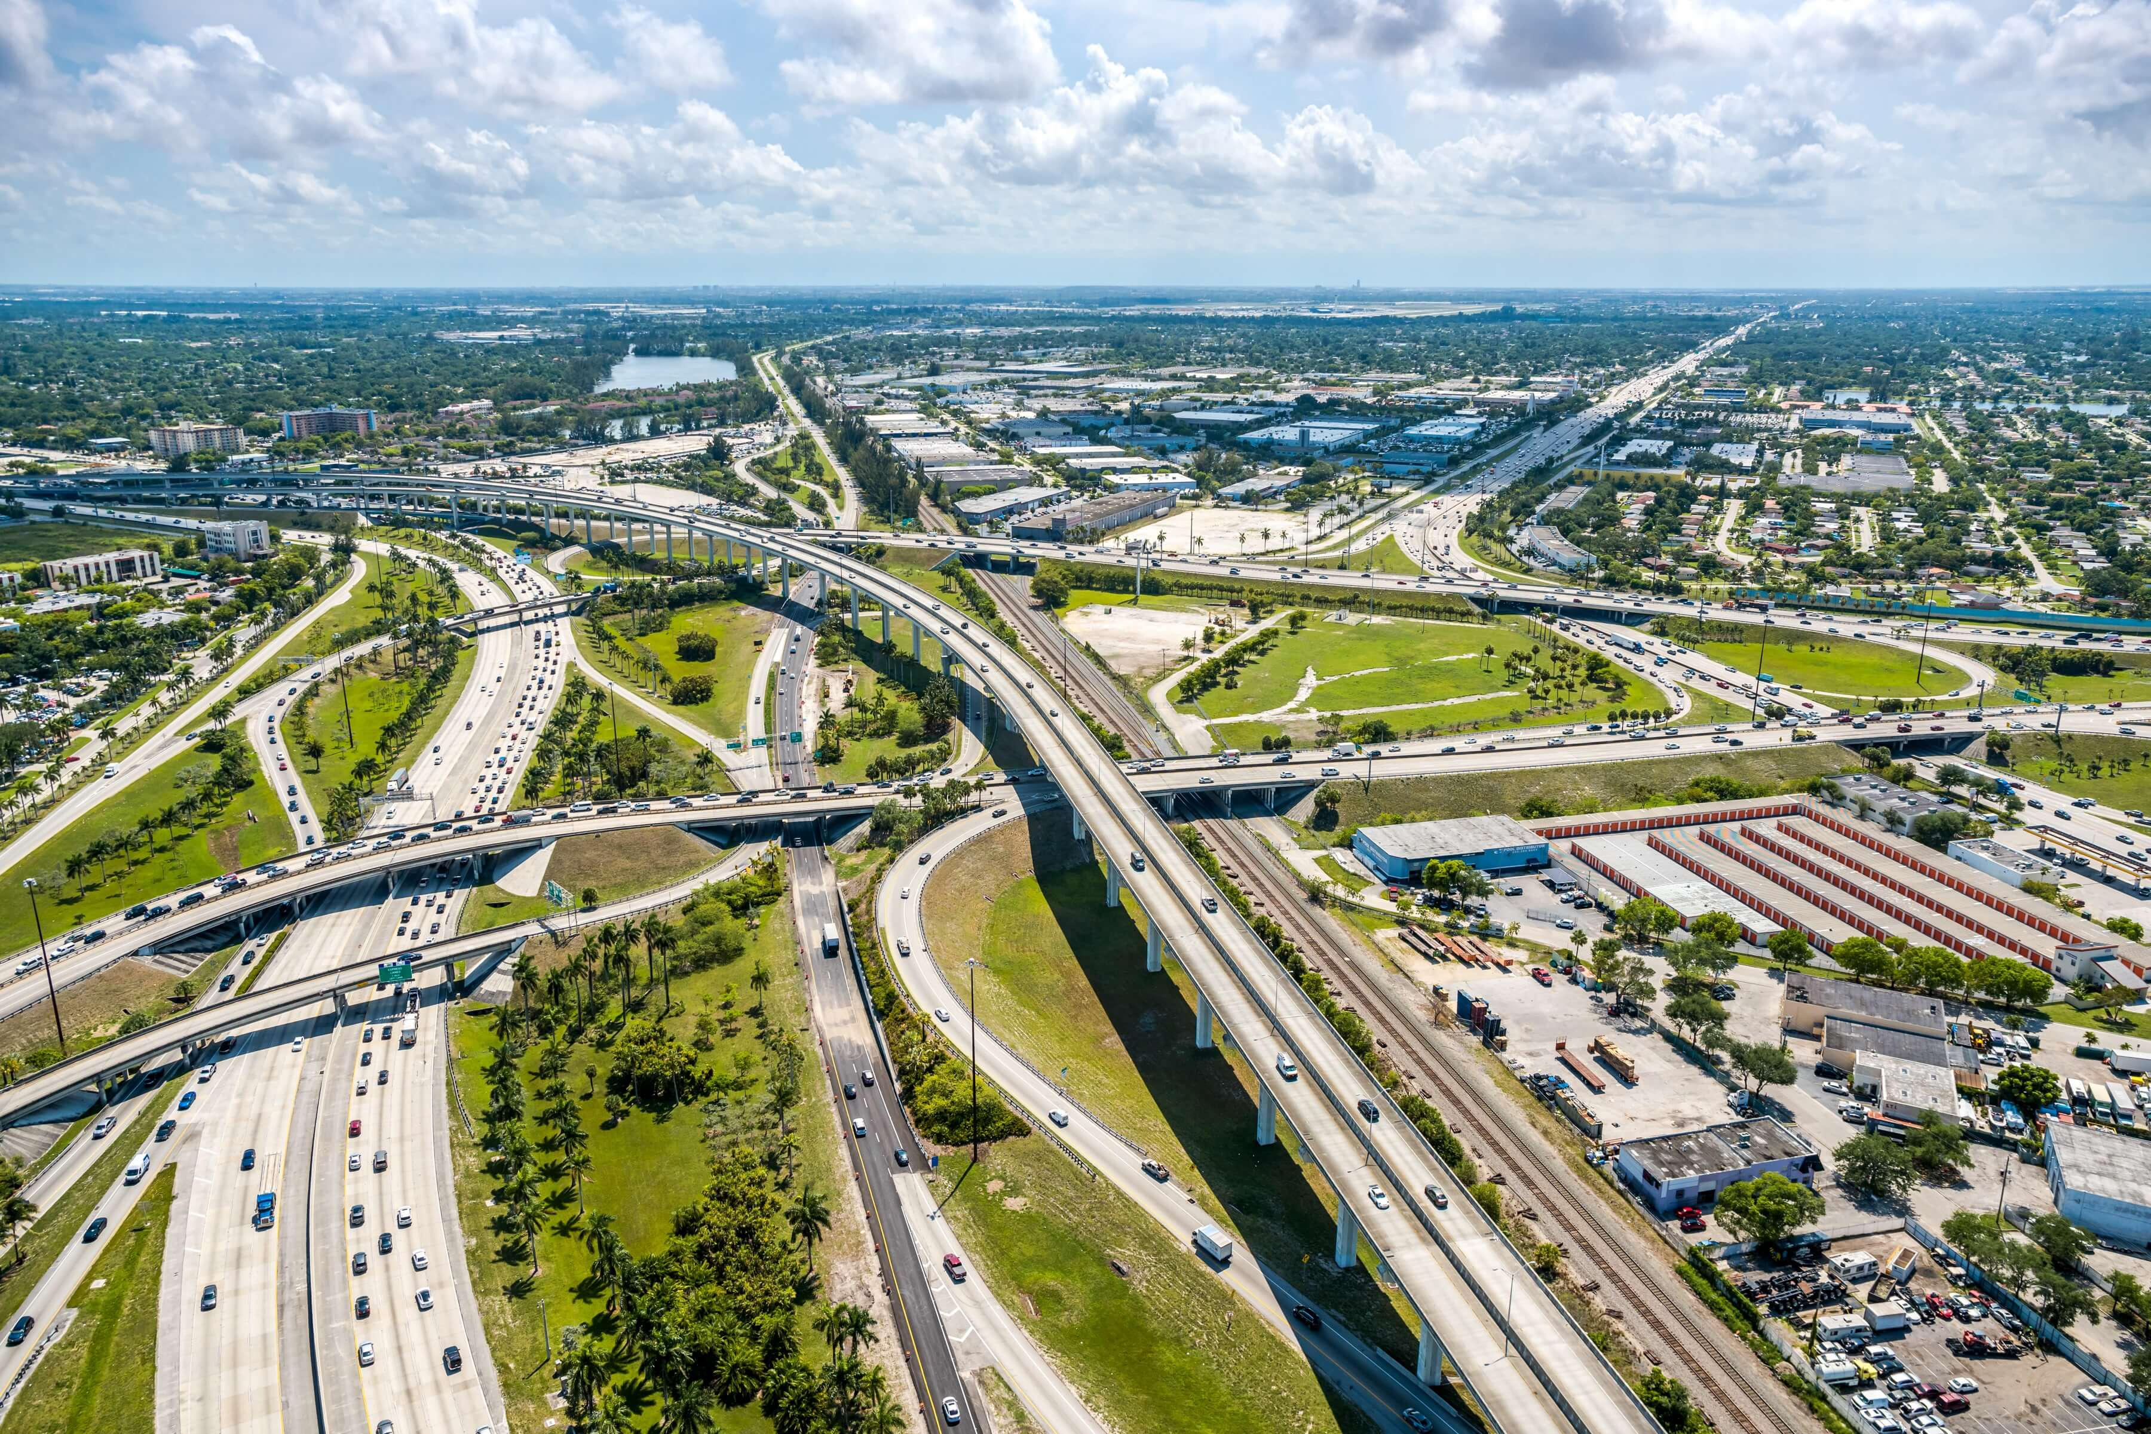
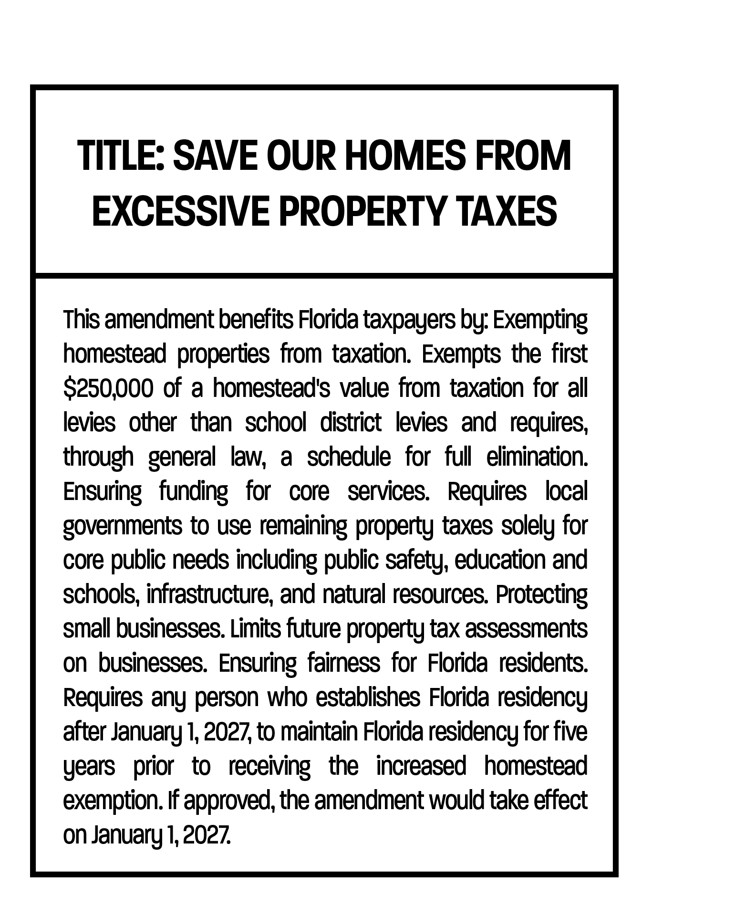
WHAT’S ON THE BALLOT
Title: "Save Our Homes from Excessive Property Taxes"
WHAT THAT MEANS IN PRACTICE:
1
The amendment cuts the largest source of funding for local services.
It provides no replacement revenue.
Counties remain legally required to deliver the same services.
2
3
Notes:
That's the title voters will see. Read it out loud the way it'll show up on the ballot, then pause.
Worth saying plainly: the title sounds like relief. And for some Floridians, in some years, it may feel like relief.
But there's a gap between what the title says and what the amendment does. That gap is what we're walking through today.
The amendment cuts the funding. It does not change what counties have to do with the money that's gone.
That's the math problem. Everything else flows from there.

Slide 3
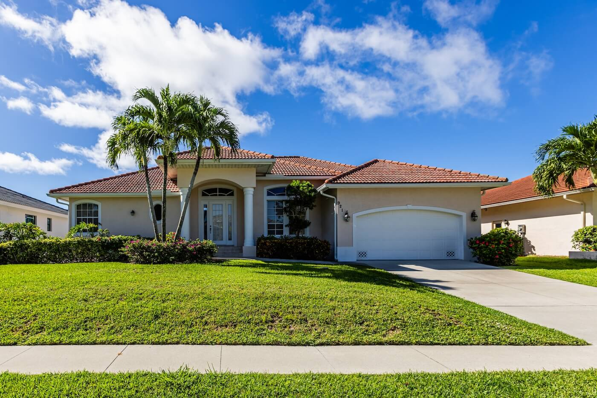
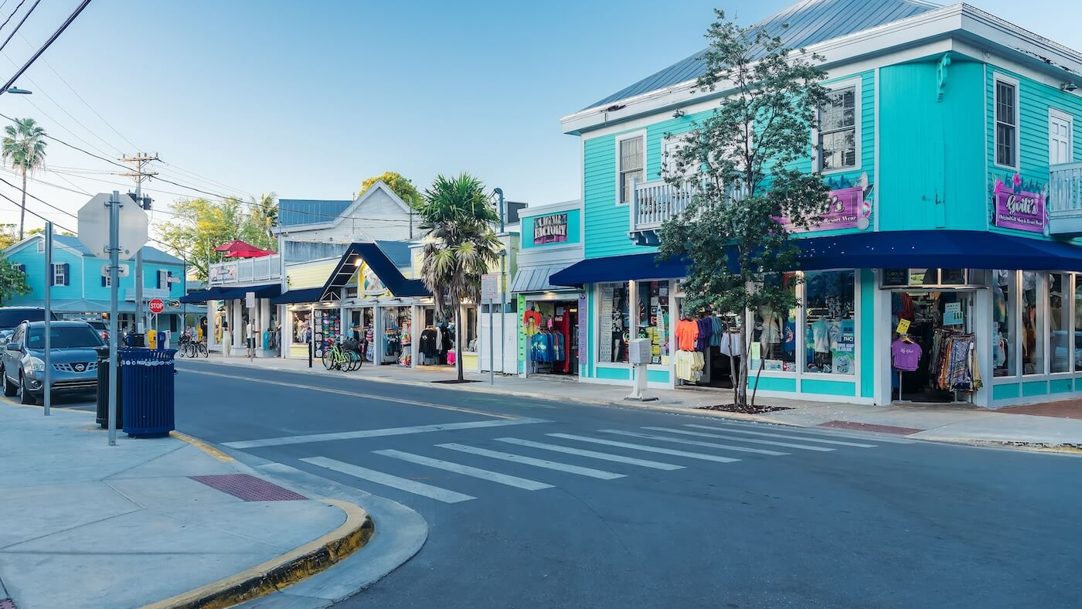
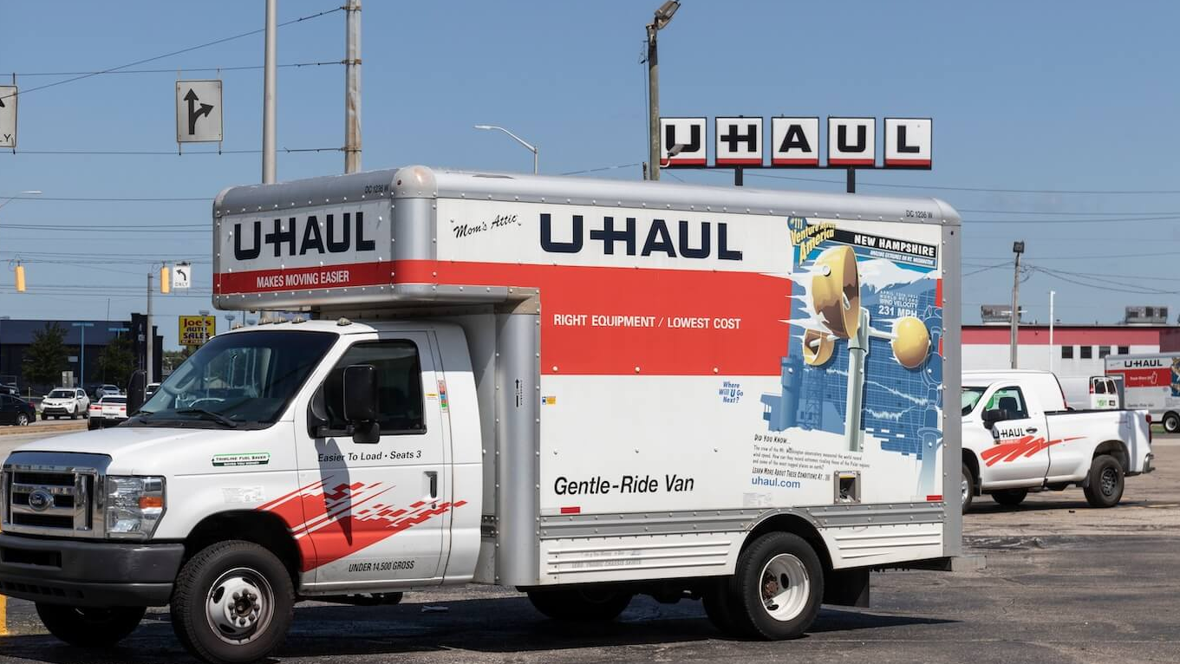

BIGGER HOMESTEAD EXEMPTION
SLOWER GROWTH ON OTHER PROPERTY
$150K in 2027. $250K in 2028. Phased out further on a future Legislature's schedule.
Non-homestead assessment cap drops from 10% to 5%.
WHAT THE AMENDMENT DOES
FIVE-YEAR RESIDENCY REQUIREMENT
NO REPLACEMENT REVENUE
New residents wait five years
before qualifying.
The amendment takes the money. It does not say where the replacement comes from.
Notes:
Four pieces. Walk through them in order.
The homestead exemption today is $50,000. The amendment triples it in year one. Quintuples it the year after. Then a future Legislature is told to keep phasing it out.
The non-homestead piece covers second homes, vacation homes, and commercial property. Their tax growth slows by half.
The residency requirement is one to flag. Anyone who wasn't a permanent Florida resident on December 31, 2026, waits five years. We'll come back to who that affects.
The last piece is the one that should keep you up at night. The amendment doesn't say where the missing money comes from. It just takes it.

Slide 4
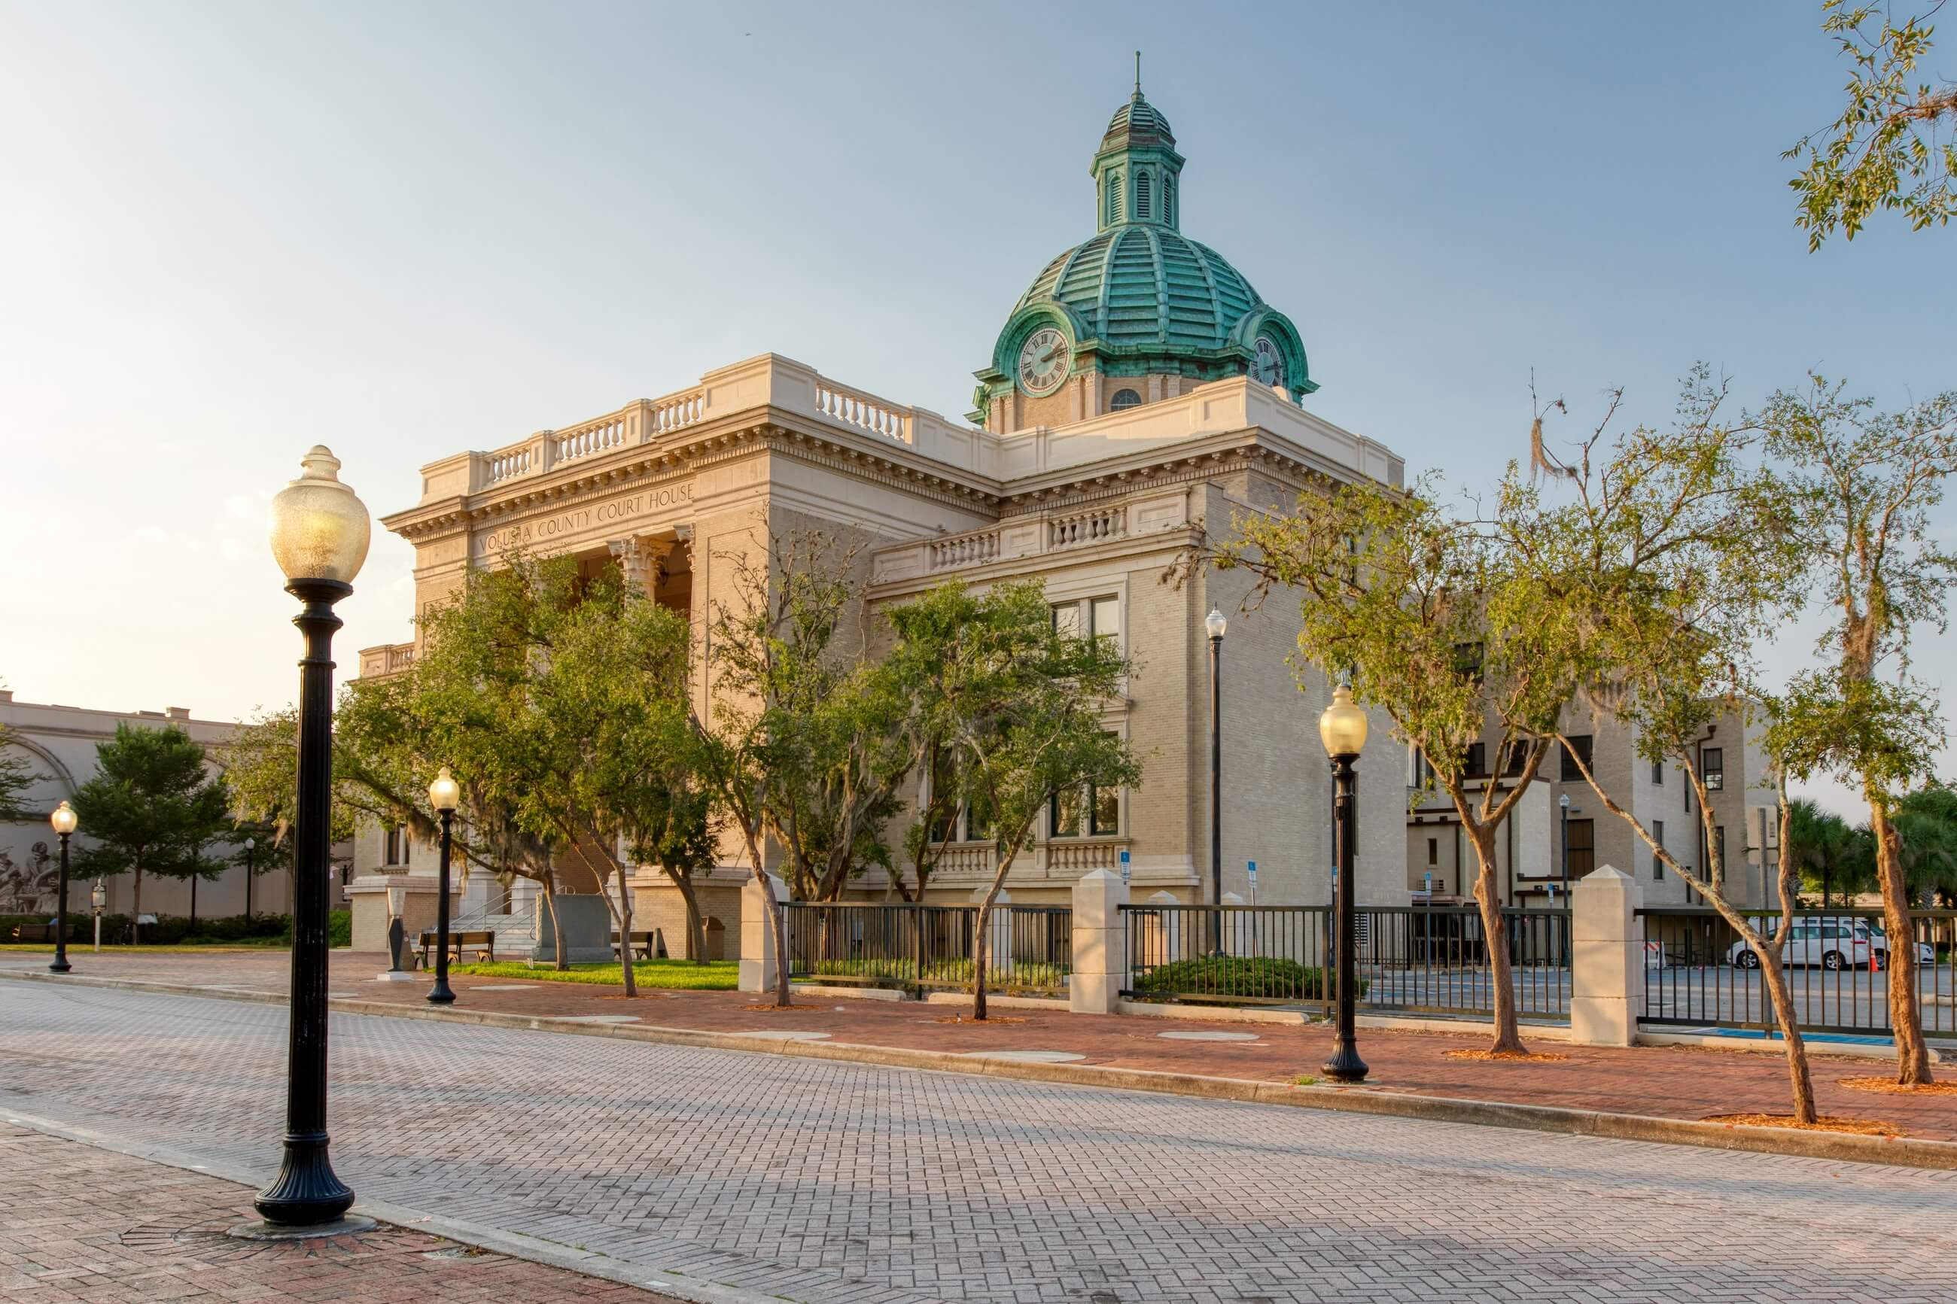
THE MATH, STATEWIDE
$2.7
BILLION
$5
BILLION
85%
Florida counties already spend the equivalent of 85 cents of every property tax dollar on public safety.
Annual revenue loss for counties in year one.
Annual revenue loss by year two.
Notes:
Pause on the dollar figures. Let them register.
These aren't FAC numbers being thrown around for effect. They come from FAC's own analysis, and the FAC Reader Guide is online for anyone who wants to check.
The 85 percent figure is the one I'd encourage you to remember. Florida counties already spend the equivalent of 85 cents of every property tax dollar on public safety. Sheriff's deputies. Fire. EMS.
Worth pointing out: in 55 of Florida's 67 counties, public safety is the single biggest line item in the whole budget.
So when someone tells you counties can just trim the fat to absorb these cuts, here's what they're saying without saying it: trim the fat from public safety. Because that's where the money is.

Slide 5
THE MATH, IN OUR COUNTY
[COUNTY NAME] Property Tax Picture
$X.Y
ANNUAL PROPERTY TAX REVENUE
X%
SHARE OF THAT REVENUE SPENT ON PUBLIC SAFETY
$X.Y
PROJECTED ANNUAL REVENUE LOSS IN YEAR ONE
Notes:
This slide gets localized before you present. Pull your county's specific numbers from the FAC County Revenue Impacts Analysis at fl-counties.com.
Walk the audience through what their property taxes actually fund in your county. Be specific. Name your sheriff. Name your fire chief if it makes sense.
The statewide picture is one thing. The picture in this county is what people in this room actually care about.
A line worth saying out loud: "$[X] million is what we'd lose here in [County Name] in the first year of this. Year two, it gets worse."

Slide 6
WHAT THAT CUT LOOKS LIKE HERE
CURRENT PUBLIC SAFETY FOOTPRINT
WHAT THE AMENDMENT REMOVES
XYZ Sheriff's deputies on patrol
XYZ Fire stations
XYZ EMS units
[X] minutes Average response time
Deputy positions that would go unfilled
Equipment replacement cycles deferred
Specific service capacity reduced
Notes:
Before this presentation, get the numbers from your budget director, sheriff, and fire chief. The FAC contingency budget exercise from earlier this year has the methodology if you need it.
Don't soft-pedal it. If the number is real, say it.
A line worth saying: "When I'm at the county talking to our sheriff about what this would look like, here's what they tell me."

Slide 7
A TAX SHIFT, NOT A TAX CUT
THE COST OF SERVICES
DOESN'T DISAPPEAR WHEN THE FUNDING DOES.
SOME PLACES:
Cuts to core services.
OTHER PLACES:
Higher taxes
and fees.
MOST PLACES:
BOTH
WHEN COUNTIES RUN OUT OF LOCAL OPTIONS,
THE PRESSURE MOVES TO TALLAHASSEE.
Notes:
Here's the thing the amendment doesn't tell you. The amendment removes one tax. It does not change the cost of running a county.
The bill still comes due. Somebody pays. The question is who.
Some places cut services. Some places raise other taxes and fees. Most places will need to do both because the cut is too big to absorb either way.
And when counties run out of local options, the conversation moves to Tallahassee. That usually means a statewide sales tax hike.
Worth being clear here: I'm not telling you what's going to happen. I'm telling you what the math leaves room for.

Slide 8
WHO PAYS UNDER A
TAX SHIFT
HOMEOWNERS ABOVE $250K:
Higher rates on a smaller base.
HOMEOWNERS BELOW $250K:
Save on one bill. Pay more on sales taxes, fees, rent, and prices.
SMALL BUSINESSES:
Higher commercial taxes, fees, and rent. Costs land on customers.
RENTERS:
Don't get the homestead benefit. Rent climbs with landlord taxes.
MILITARY FAMILIES
REPLACING PROPERTY TAXES STATEWIDE WOULD REQUIRE A SALES TAX OF 15.34% — AND UP TO 32.5% IN RURAL COUNTIES.
ordered to Florida after 2026:
Wait five years to qualify.
YOUNG FLORIDIANS
returning home to buy a first house:
Treated like new arrivals.
Source: Tax Foundation, October 2025.
Notes:
Walk through these quickly. Don't linger on any one.
The point of this slide isn't to convince anyone of any one impact. It's to show the cumulative weight. The cost lands somewhere, and almost everyone ends up paying.
The military families one is worth pausing on. A service member ordered to MacDill or NAS Jacksonville in 2027 doesn't qualify for the expanded exemption for five years. They serve here. They pay taxes here. They don't qualify here.
Young Floridians also worth a pause. They grew up here, left for college, come home to buy a first house, and are treated like they've never set foot in the state.
Close on the Tax Foundation number. This is a conservative source. Not a county group. Not a city group. The kind of organization that publishes papers favorable to the tax-cut argument. They're the ones saying replacing property taxes would mean a 15 percent statewide sales tax.

Slide 9
Many voters don’t think services
will be cut.
Lawmakers assume counties can just “trim the fat.”
LOCAL ACCOUNTABILITY, GONE
29
38
COUNTIES
COUNTIES
would be unable to fund core services on their own. Every year, they'd come to Tallahassee asking for help.
would become donor counties. Their taxpayers would absorb the difference.
"THE BILLS DON'T GO AWAY. THEY JUST GET SENT BY POLITICIANS IN A DISTANT CAPITAL."
Notes:
Twenty-nine of Florida's sixty-seven counties are already fiscally constrained. Under this amendment, they can't make it work locally. Every year, they're sending people to Tallahassee asking for state subsidies to keep deputies on patrol.
The other thirty-eight counties become donor counties. Their residents pay more so the state can redistribute revenue elsewhere.
Here's the part that matters most to me, and I think to anyone who's been around local government for any length of time. Right now, if you don't like how your county is being run, you know exactly where to go. You know who your commissioners are. You can vote them out.
Under this amendment, those decisions move to Tallahassee. The bills don't go away. They just get sent by politicians who don't live here.

Slide 10
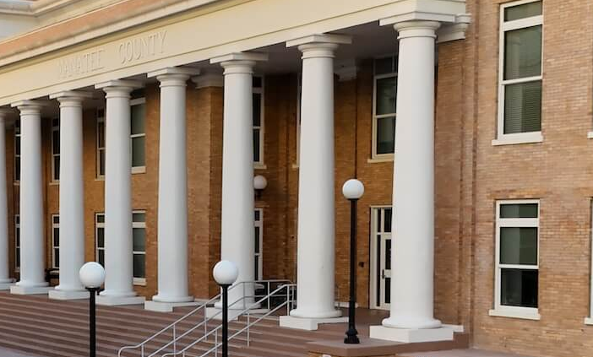
SERVICES WON'T DISAPPEAR. THEY'LL GET RATIONED.
PUBLIC
SAFETY
CONSTITUTIONAL OFFICERS
EVERYTHING ELSE
Named as "protected." No constitutional minimum on what counties must spend. Hiring slows. Equipment ages. Response times stretch.
Sheriffs, tax collectors, property appraisers, supervisors of elections, clerks of court compete for a shrinking share of remaining dollars.
Hurricane response, drainage, clean water, roads. Not constitutionally named. Easiest to defer.
Notes:
The word "protected" in the amendment is doing a lot of work that doesn't hold up under inspection.
Public safety is named as a priority category. But the amendment sets no minimum on what counties have to spend. So "protected" doesn't mean "fully funded." It means "named."
The result isn't a sudden collapse. It's slow erosion. A deputy retires, the position goes unfilled. A fire truck ages out, the replacement gets delayed. Hurricanes come every year. Response times stretch.
Our constitutional officers — sheriff, tax collector, property appraiser, supervisor of elections, clerk of court — get squeezed too. They can't stop doing the work the state requires. They just won't have the resources to do it well.
And anything not constitutionally named — hurricane response, drainage, clean water, roads — those are the first places counties have to find room. The everyday infrastructure of Florida life.

Slide 11
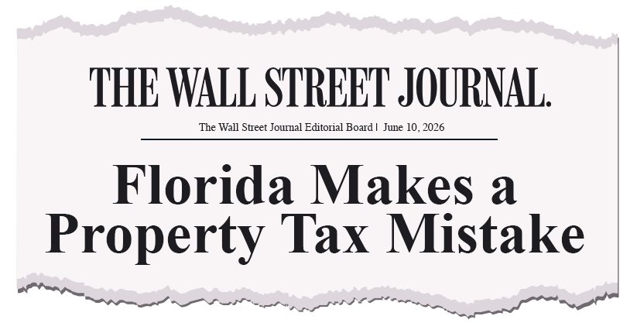


WHAT OTHERS ARE SAYING
Notes:
Three external voices, all in the same week.
The Wall Street Journal editorial board called it a mistake. Worth reading the full piece if you haven’t.
S&P and Fitch both flagged credit quality concerns. Their view is straightforward: a smaller tax base means less capacity to service debt.
That affects bonding for roads, infrastructure, and capital projects.
These aren't advocacy organizations. They're financial institutions doing their jobs.

Slide 12


WHERE TO LEARN MORE
EVERYTHING IN ONE PLACE.
KeepFloridaThriving.com
Notes:
Everything I've walked through today is downloadable from KeepFloridaThriving.com.
The one-pager is there. The county-by-county data is there. The sources are there.
If you leave with nothing else from this session, leave with that URL.

Slide 13
READ THE AMENDMENT
CAREFULLY
BEFORE YOU VOTE.
KeepFloridaThriving.com
Notes:
Close measured. Don't tell anyone how to vote. Don’t say “Vote No.”
The amendment is on the November 2026 ballot. Floridians will decide.

