Slide 1
Fl. Association of Counties
Dr. Andra Johnson – Dean for UF/IFAS Extension
November 20, 2025

Slide 2
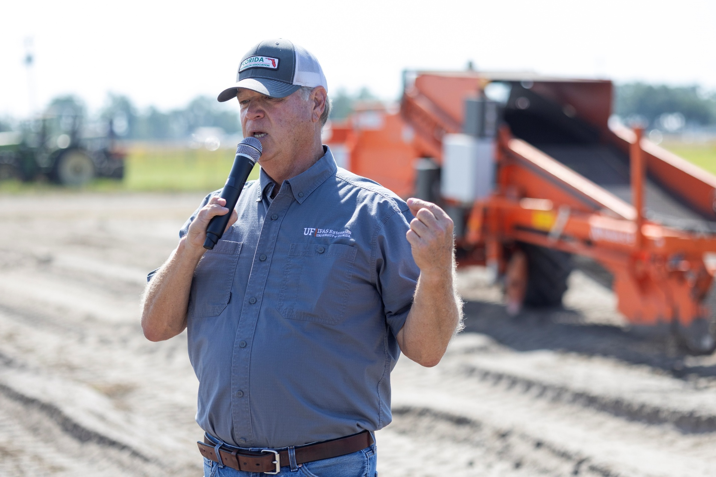
Mission & Vision
Vision:
“To be a leading provider of research-based solutions that empower individuals, families, and communities to improve their quality of life, while creating a sustainable future.”
Mission:
“Florida Cooperative Extension partners with communities to provide quality, relevant education, and research-based expertise to foster healthy people, a resilient environment, and a strong community.”

Slide 3
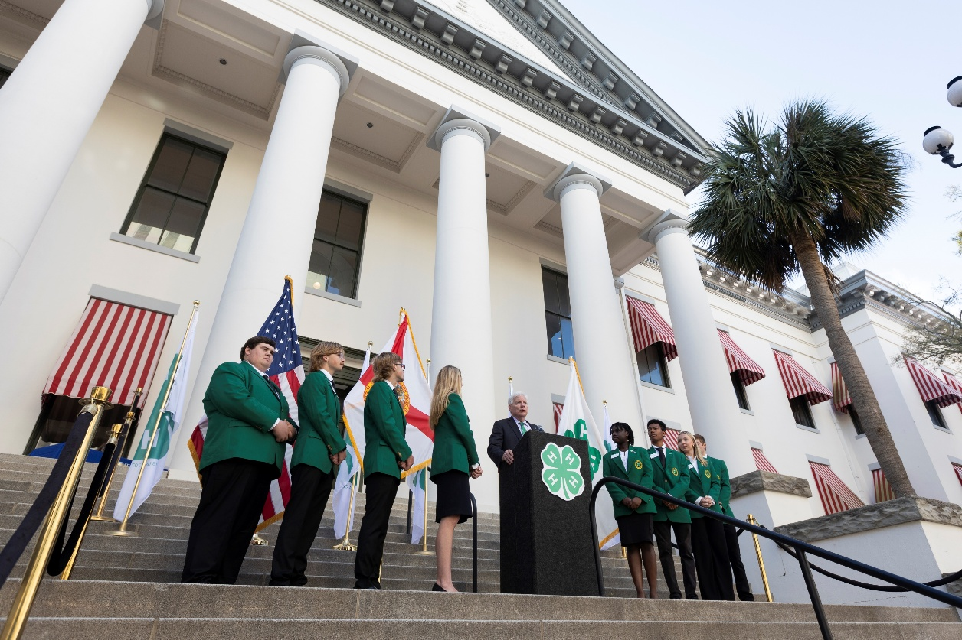
2025 Florida State Statutes
1004.37 County or area extension programs
(1) The Florida Cooperative Extension Service is administered through the University of Florida and is supported programmatically by the University of Florida and Florida Agricultural and Mechanical University in collaboration with individual county governments. County or area extension programs will be developed, based on local situations, needs, and problems, supported by scientific and technical information developed by the University of Florida, Florida Agricultural and Mechanical University, the United States Department of Agriculture, and other sources of research information. This information will be made available through the local program, with the aid of research scientists and extension specialists of the University of Florida Institute of Food and Agricultural Sciences and Florida Agricultural and Mechanical University
(2) Financial Participation
County boards annually decide their financial contribution to cooperative extension work.
(3) Approval of Extension Positions
County boards approve or disapprove candidates for extension positions.
(4) Employment & Policies
County extension agents are jointly employed by state universities, federal, and county governments.
University of Florida or FAMU personnel policies apply unless federal law or memorandum overrides.
(5) University Responsibilities
UF provides supervision, planning resources, and programming support.
Florida Cooperative Extension Service supplies program materials and technical expertise.
Continuous in-service training ensures staff competence.
(6) Reporting & Communication
County extension director reports program progress and results to the county board.
Boards develop plans to stay informed and integrate local needs into educational work.
Plans include a way for boards to communicate satisfaction with programs to the director and extension service.

Slide 4
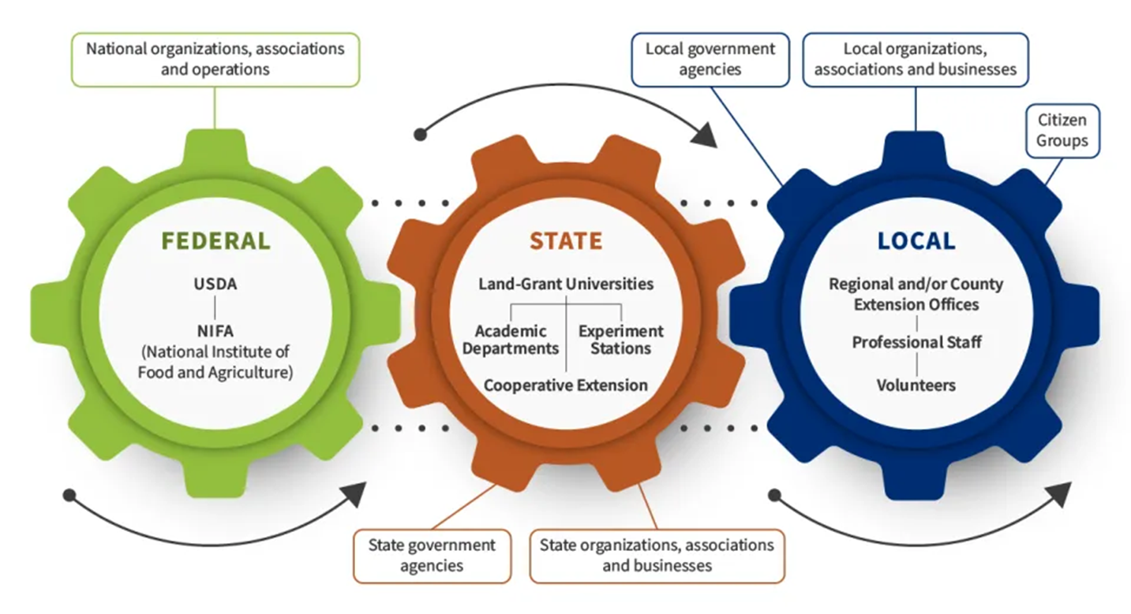
Overview: Florida Cooperative Extension Funding Model
Federal, State and County Partnerships
Three-Tiered Partnership Model: The Florida Cooperative Extension Service is funded through a collaborative model involving federal, state and county governments. Ensuring diverse support and shared governance.
Federal Level- Support: The USDA’s National Institute of Food and Agriculture (NIFA) provides baseline funding via Smith Lever Act allocations, focusing on national priorities and innovation
State Government Role: State funding, primarily through the University of Florida (UF/IFAS) and Florida A&M University, supports faculty salaries, research facilities and academic infrastructure.
County Government Involvement: Local governments contribute through staffing, office space and operational support – ensuring that extension programs are tailored to local community needs.

Slide 5
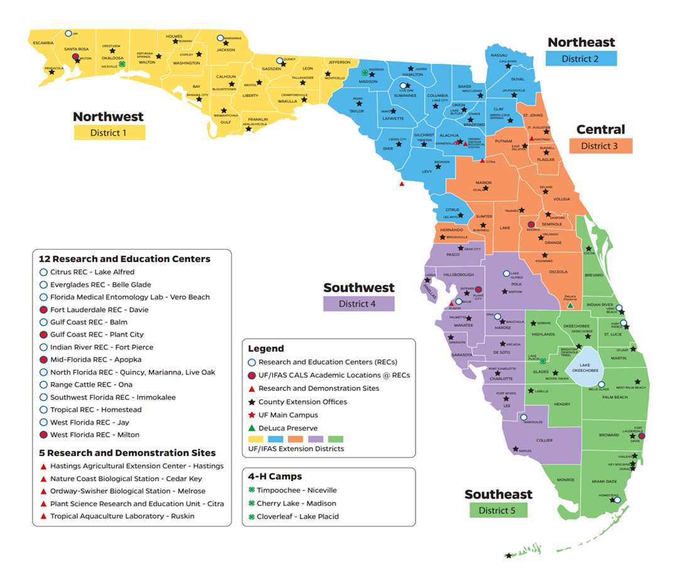
County Level Contributions
County Contributions Fund office space, agent salaries and program support
Formal Agreements (MOU) define cost shares, staffing and performance benchmarks
Localized Programs tailor Extension efforts to local priorities
Offices in 67 FL Counties & Seminole Indian Tribe
Three 4-H Camping Facilities
396 County Faculty located throughout the state

Slide 6








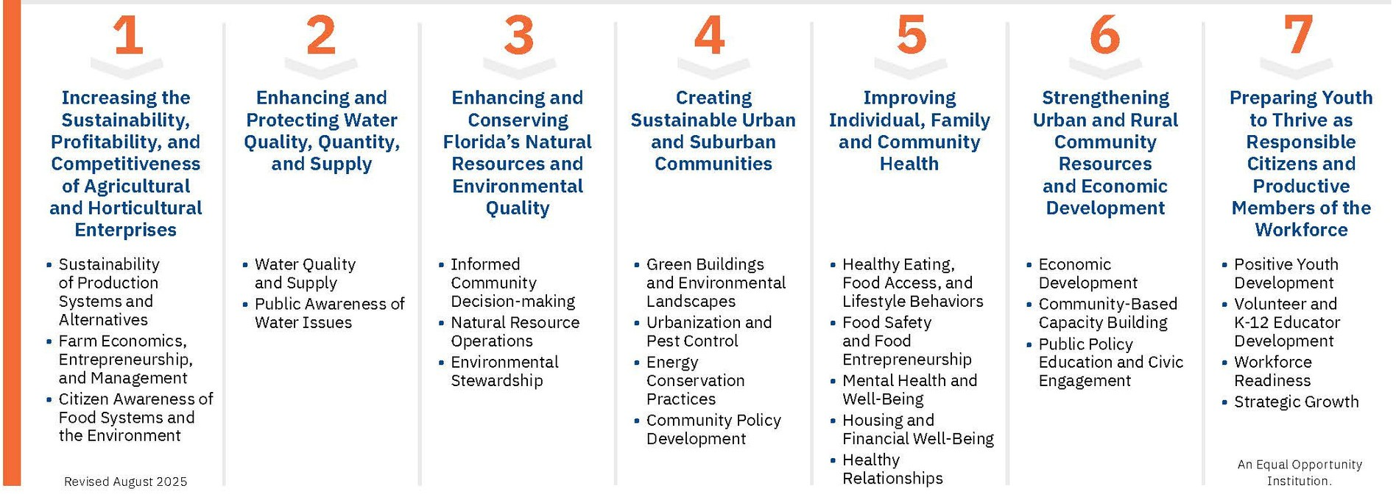


Slide 7
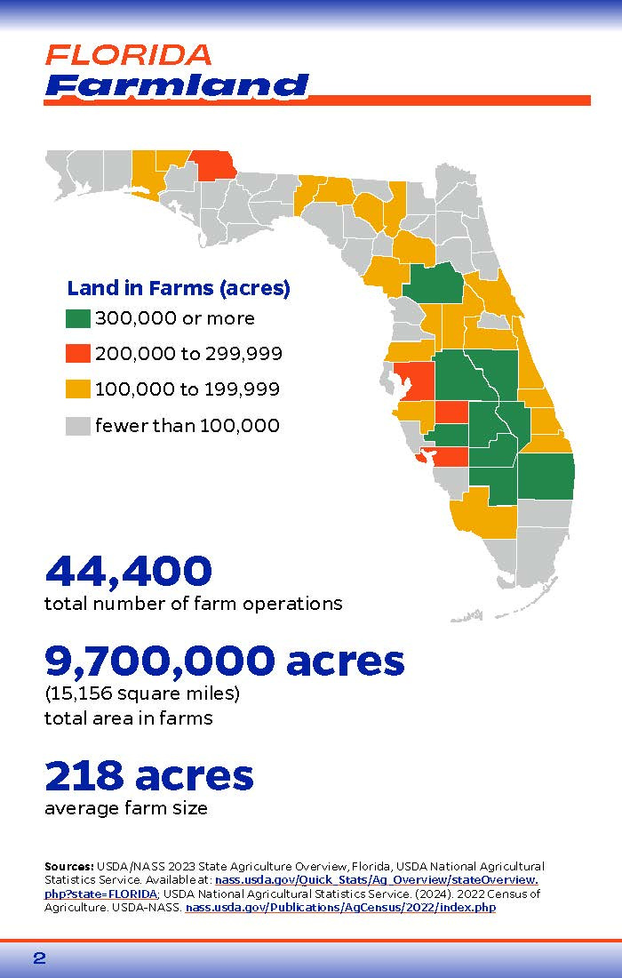
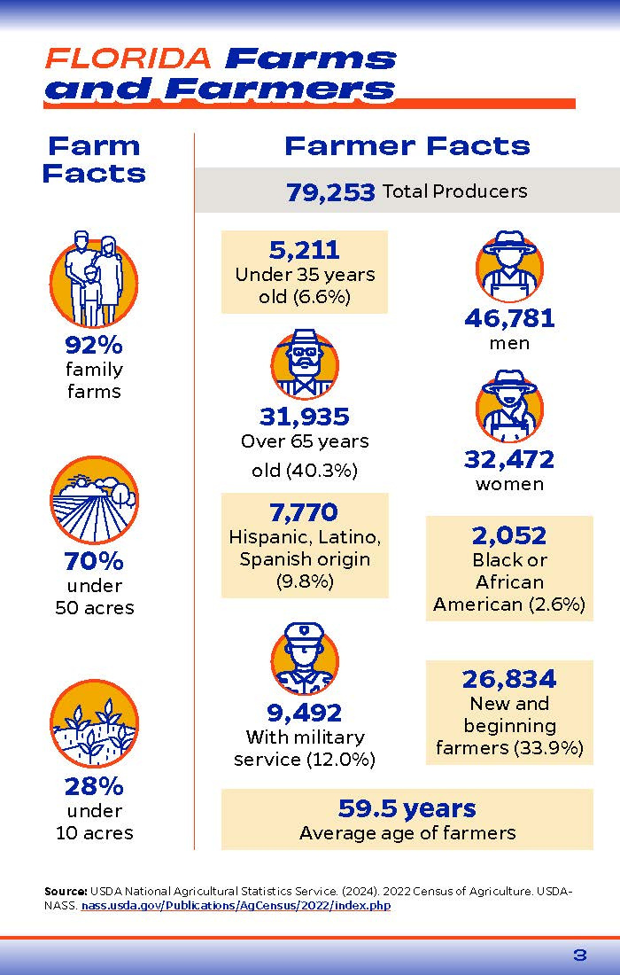

Slide 8
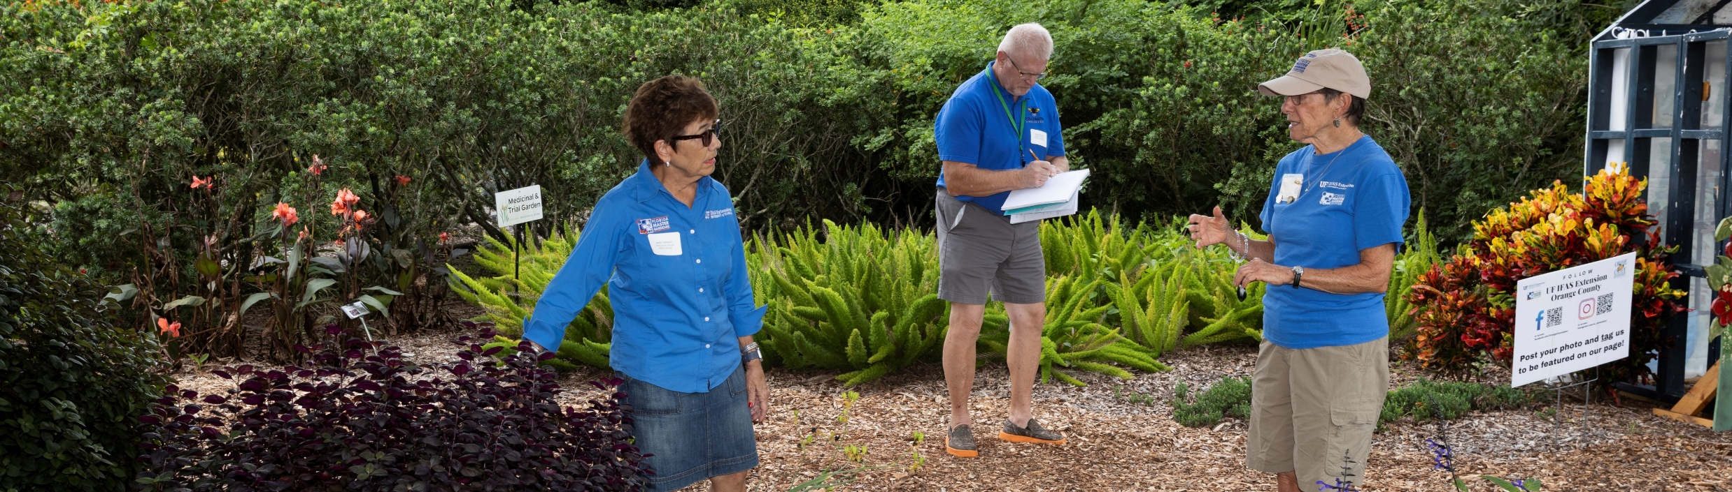
A Robust Menu of Services
Summary of our services to be tailored to your county needs
4-H Youth Development
Youth Workforce & Career Readiness
STEM & Agri-Science Youth Education
Family & Consumer Sciences
Community Health & Wellness
Nutrition & Food Security Education
Financial Capability & Household Stability
Community Resource & Economic Development
Agriculture Production Systems
Livestock & Forage Systems
Horticulture & Specialty Crop Systems
Beginning Farmer & Agribusiness Development
Agricultural Safety, Compliance & Certification
Water Quality & Hydrology Programs
Natural Resources & Conservation Programs
Climate, Carbon & Environmental Resilience
Invasive Species & Ecosystem Management
Residential Horticulture
Urban & Community Landscapes
Integrated Pest Management

Slide 9
20:1
RETURN ON INVESTMENT

