Slide 1


Slide 2


Slide 3

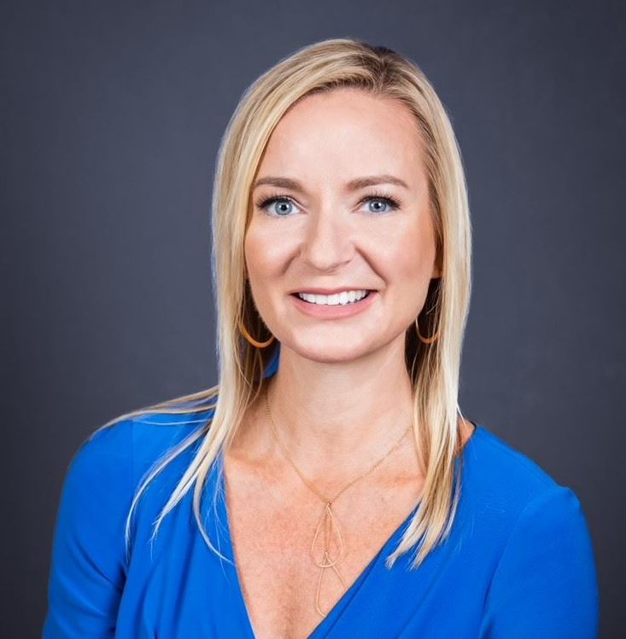
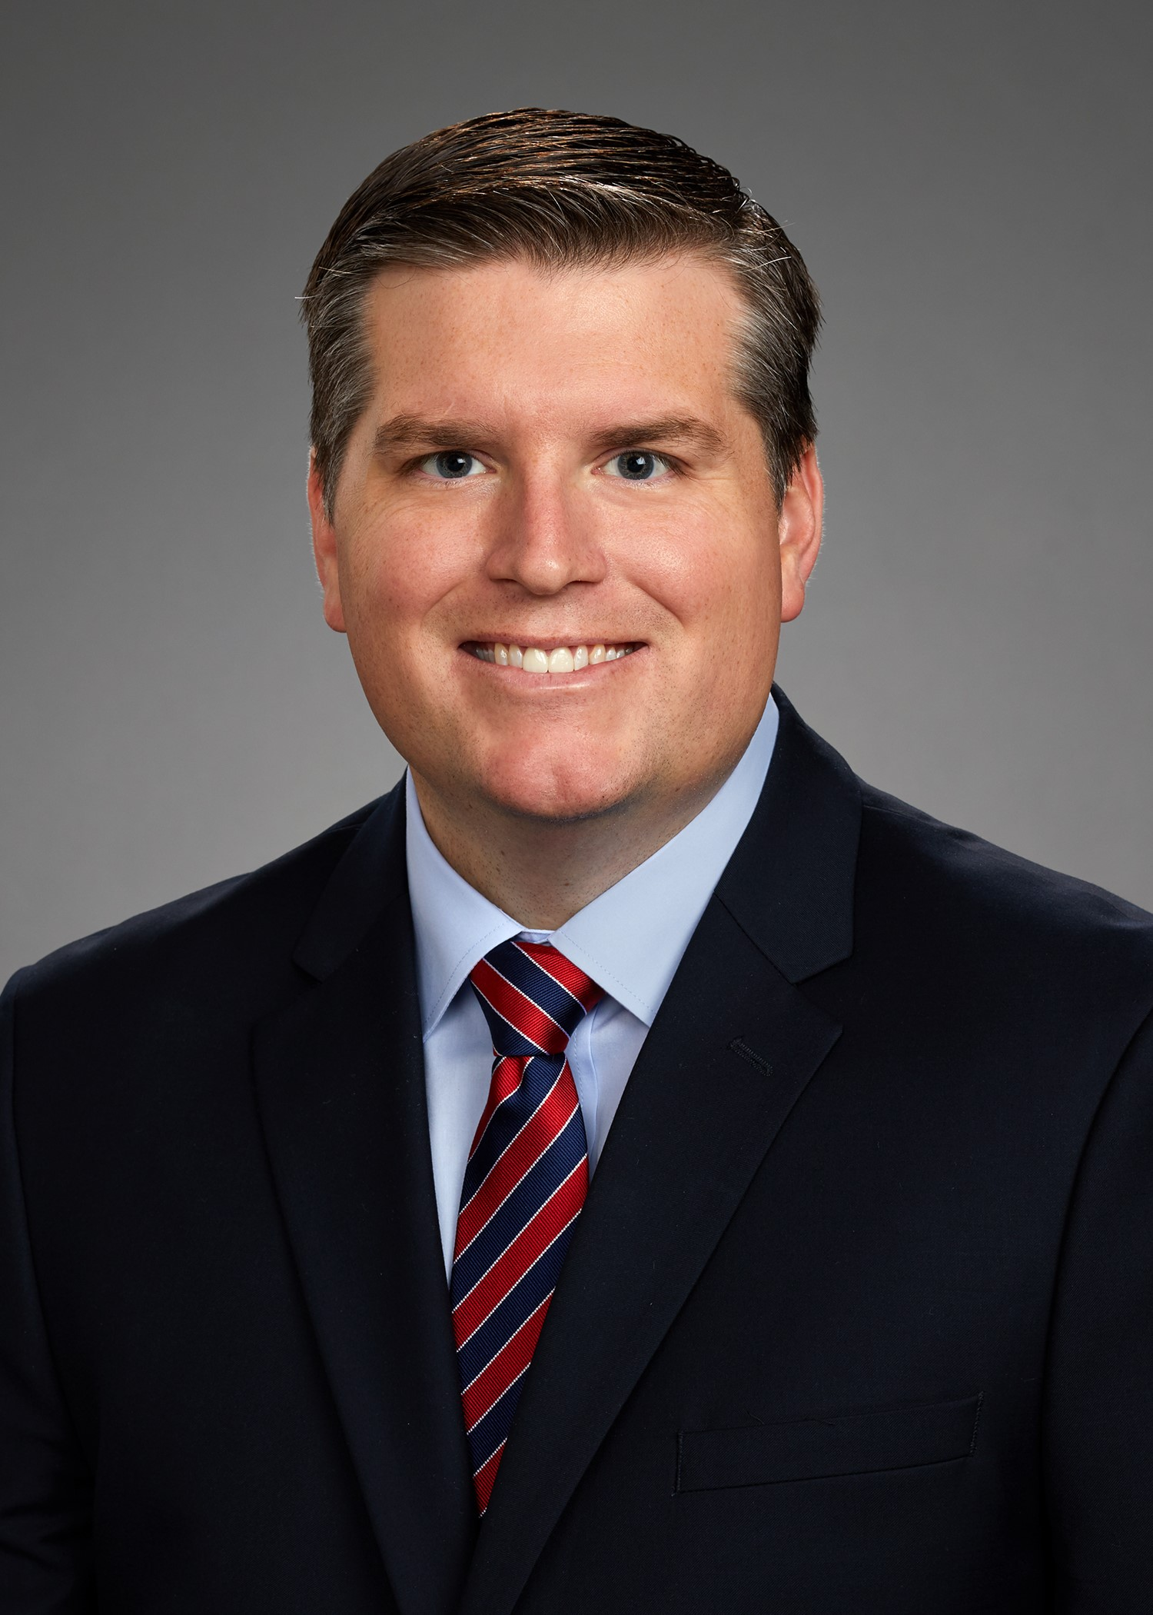
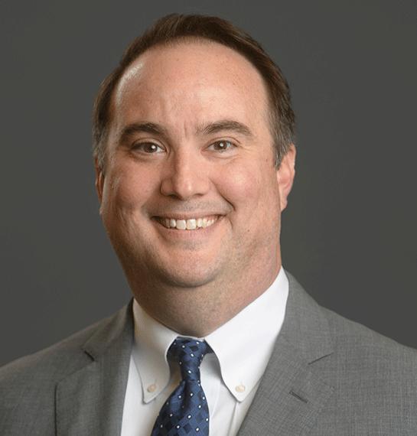
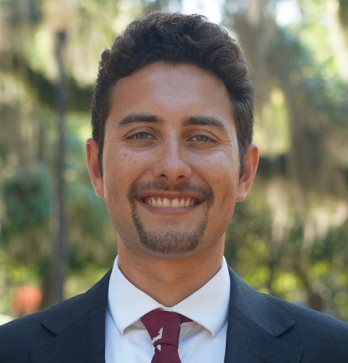
Water & Environmental Sustainability
Holly Raschein
Brian Hamman
Christian Whitehurst
Peter Abello
Monroe County
Lee County
St. Johns County
FAC Staff

Slide 4


Slide 5

Review, Discuss, Action​
Proposed Policies
Guiding Principles
Other Business

Slide 6
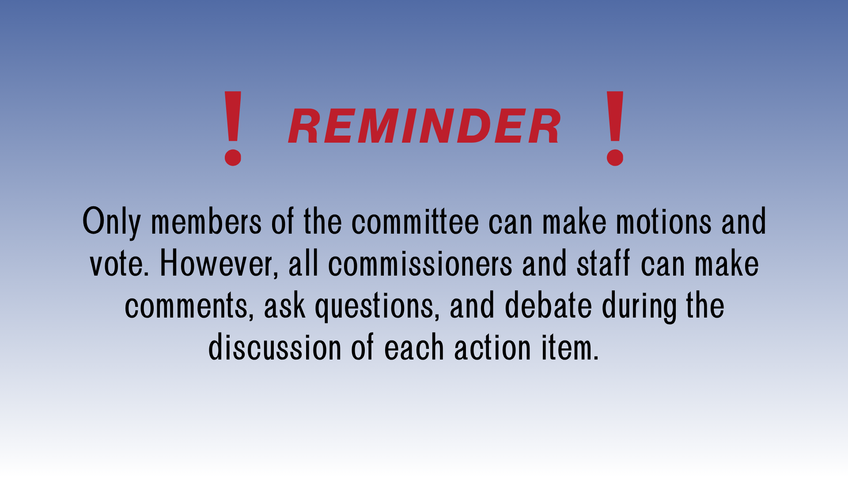

Slide 7


Slide 8


Slide 9
CONSENT AGENDA
Adopt ​
  WES-3: Alum Treatments on Sovereignty Submerged Lands
  WES-4: Beach Renourishment and Shoreline Protection
Not Adopt
  WES-6: Onsite Sewage Treatment Program
Guiding Principles
​

Slide 10

WES-1: PAYMENT FOR ECOLOGICAL SERVICES TO AGRICULTURAL LANDOWNERS
Submitting County: Lake
Committee Recommendation: Defer to Legislative Conference

Slide 11
WES-2: SEPTIC TANKS AND BMAP AREAS
Submitting Counties: Columbia and Lake
Committee Recommendation: Defer To Legislative Conference
SEPTIC TANKS AND BMAP AREAS
WES-2 SEPTIC TANKS AND BMAP AREASWES-2 SEPTIC TANKS AND BMAP AREAS

Slide 12
WES-5: BIOSOLIDS
Submitting County: Hernando
Committee Recommendation: Defer to Legislative Conference

Slide 13


Slide 14


Slide 15


Slide 16


Slide 17


