Slide 1


Slide 2
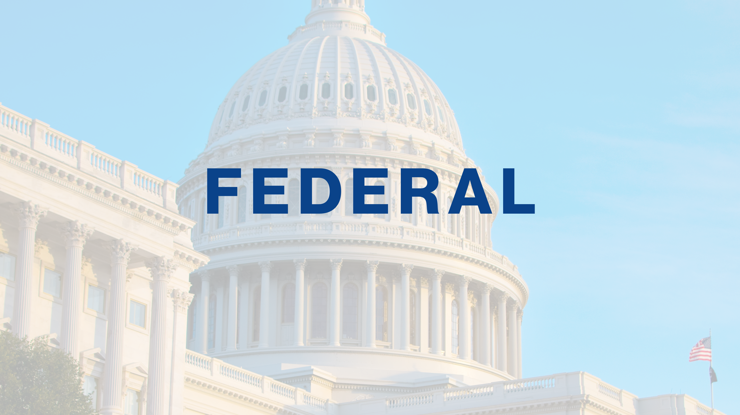

Slide 3

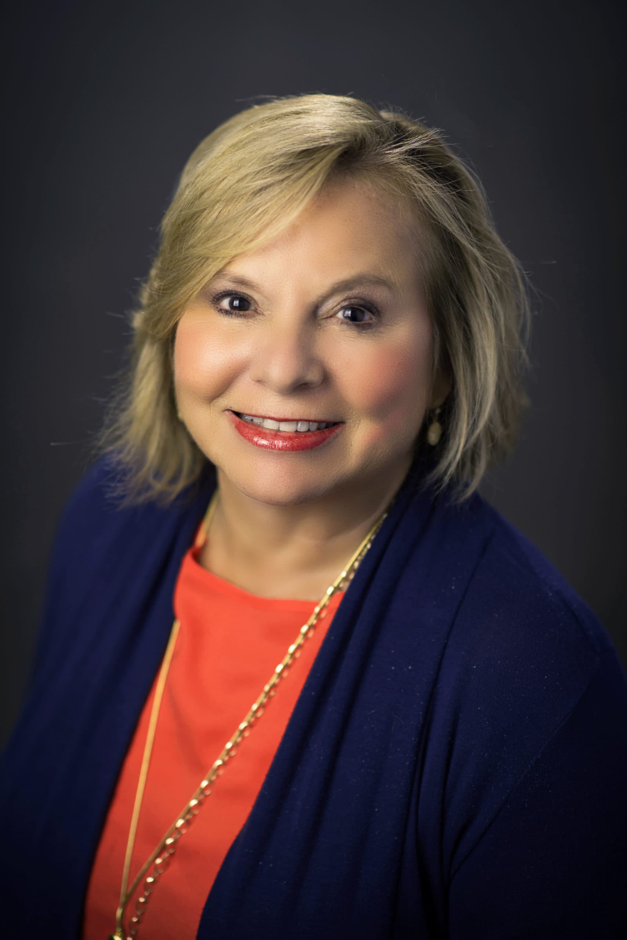
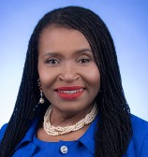
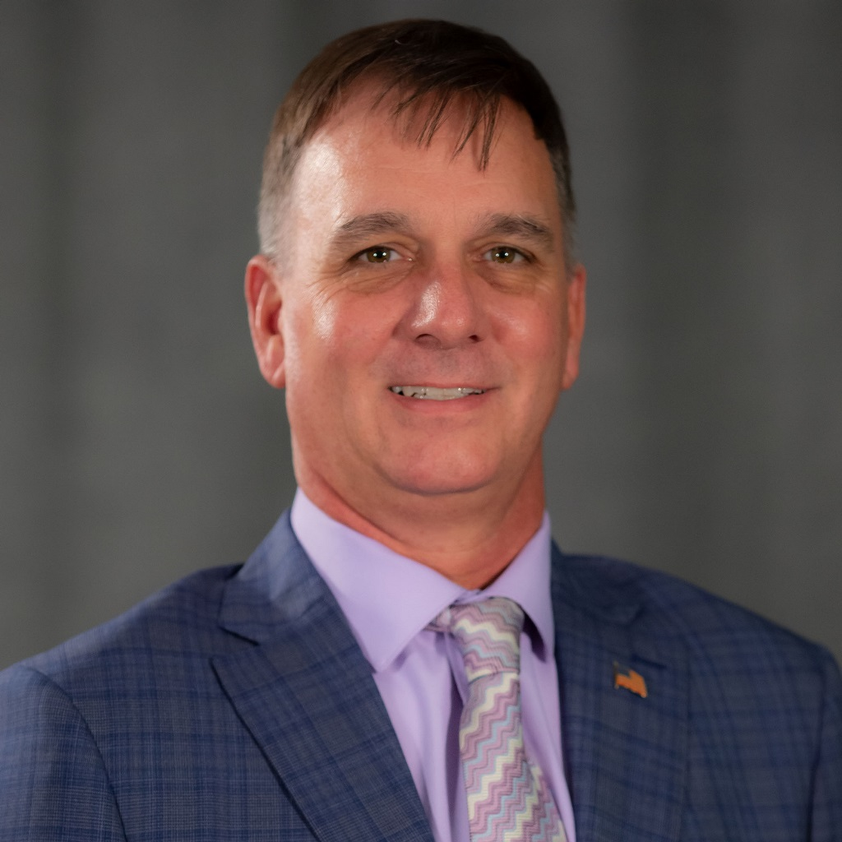

Federal
Chair
Kathryn Starkey
Vice Chair
Marleine Bastien
Vice Chair
Mike Kohler
Tonnette Graham
Pasco County
Miami-Dade County
Escambia County
FAC Staff

Slide 4

Review, Discuss, Action​
Proposed Policies
FAC Federal Update
NACo Update - Jared Grigas
Other Business

Slide 5
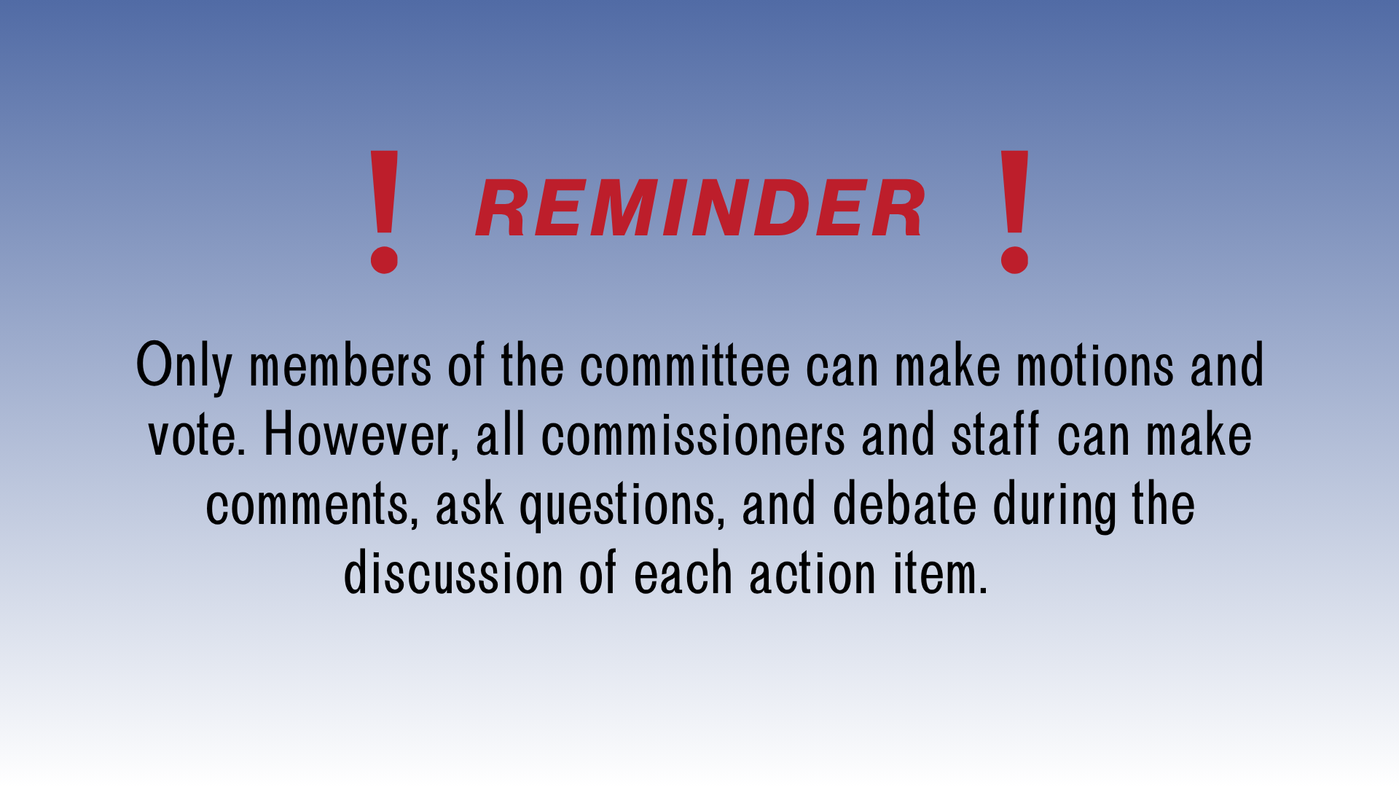

Slide 6
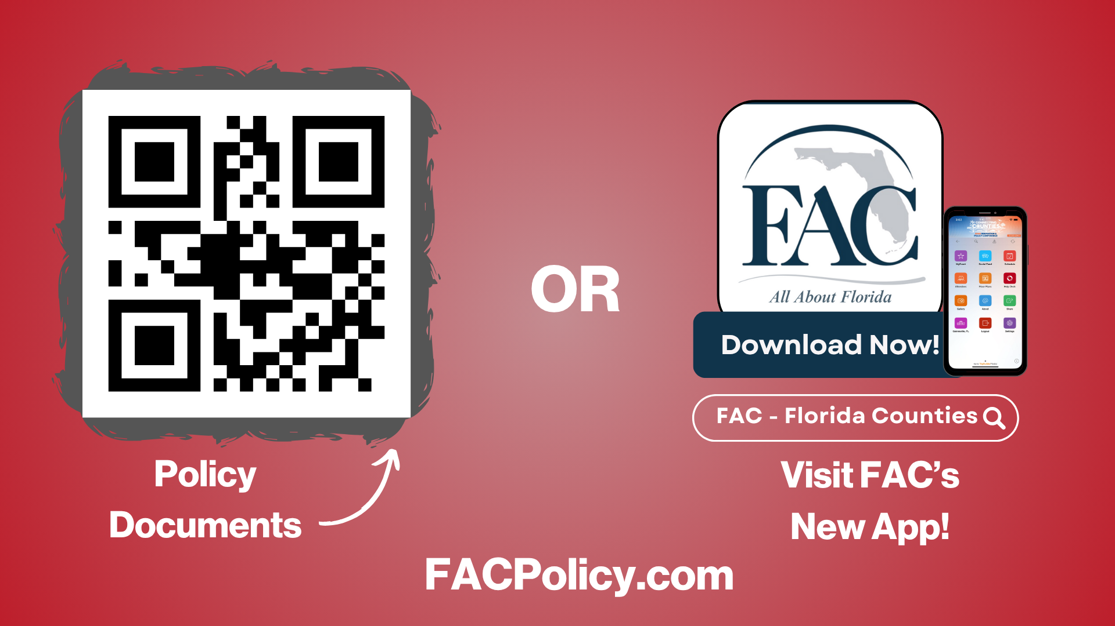

Slide 7


Slide 8

Commissioner Kathryn Starkey, Pasco County, Chair
Commissioner Marleine Bastien, Miami-Dade County, Vice Chair
Commissioner Michael Kohler, Escambia County, Vice Chair
POLICY LEADERS
Chris Constance, Charlotte County
Ken Doherty, Charlotte County
Rebecca Bays, Citrus County
Greg Hansen, Flagler County
Arlene Tuck, Highlands County
Harry Cohen, Hillsborough County
Sean Parks, Lake County
Brian Hamman, Lee County
Nick Maddox, Leon County
Tal Siddique, Manatee County
George Kruse, Manatee County
Craig Curry, Marion County
Rene Garcia, Miami-Dade County
Paul Mixon, Okaloosa County
Mayor Jerry Demings, Orange County
Peggy Choudhry, Osceola County
Maria Marino, Palm Beach County
Jack Mariano, Pasco County
Kathleen Peters, Pinellas County
Lee Constantine, Seminole County
Clay Murphy, St. Johns County
Christian Whitehurst, St. Johns County
James Clasby, St. Lucie County
Dan Curry, Walton County

Slide 9
CONSENT AGENDA
Adopt ​- Retention of Existing Policy Items
National Flood Insurance
Water (WRDA)
Upper Kissimmee Basin Water Storage Projects
Disaster Recovery & Preparedness
Offshore Oil Drilling
Federal Appropriations
Veterans
Health Care for Non-Convicted Persons
Non-Domestic Sand Sources
Low Income Housing Tax Credit
Coral Reefs
Immigration
Truck Weight Restrictions
ARPA Funding Recoupment
Workforce Innovation and Opportunity ACT
Southern Rail Commission
Public Safety Officer Benefit

Slide 10
CONSENT AGENDA
Adopt ​- Revision of Existing Policy Items
Housing Choice Vouchers Portability
WRDA Beach Renourishment Projects
Adopt ​- Not Retain Existing Policy Items
COVID - 19
Opportunity Zones
Adopt ​- Adoption of NACo Resolutions (Florida)
Included in Digital Materials

Slide 11
FEDERAL UPDATE
NACo Intergovernmental Disaster Task Force Federal Fly-In
October 27-28, 2025 | Washington, DC
Task Force Members:
Commissioner William “Bill” Truex (Charlotte County)
Ken Burke – Comptroller, Pinellas County
Eric Poole – Executive Director, FAC Institute for County Government

Slide 12
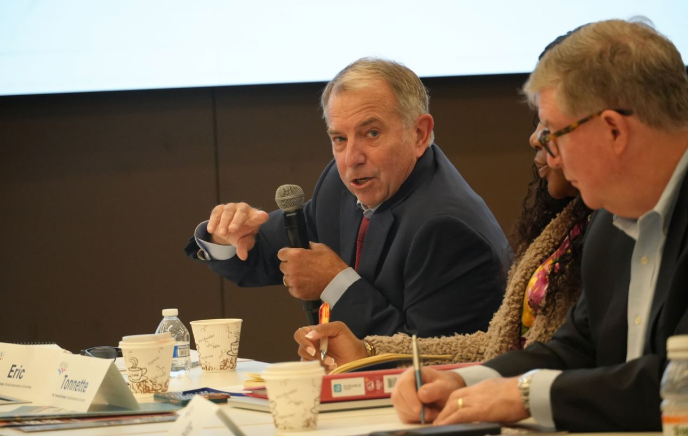
FEDERAL UPDATE
Overview
Support for the FEMA Act (H.R. 4669)
Key Reforms Emphasized
Senate Legislative Landscape
Next Steps

Slide 13

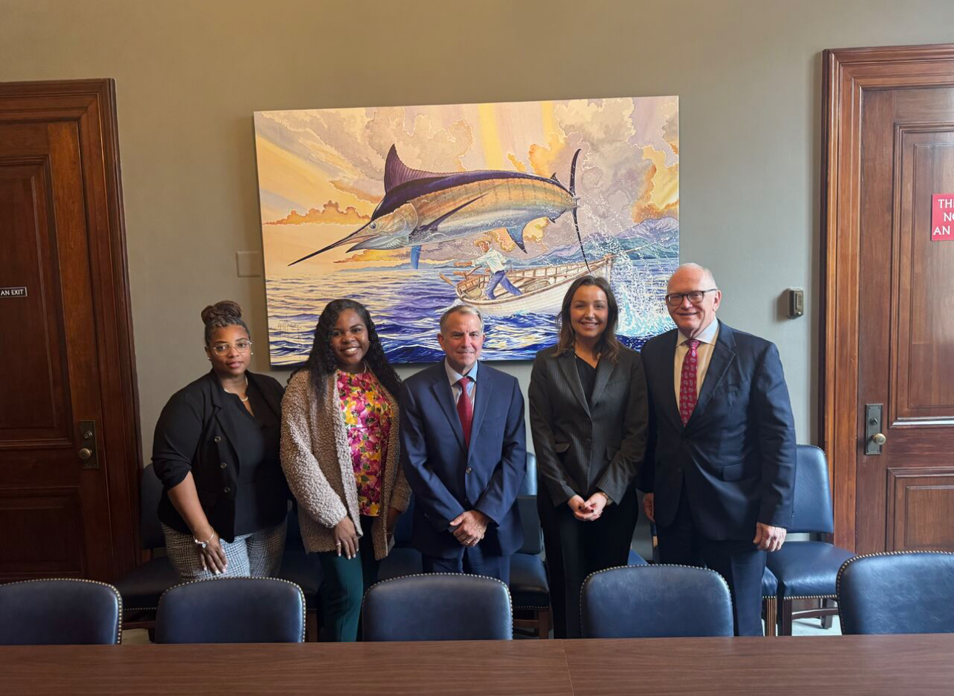
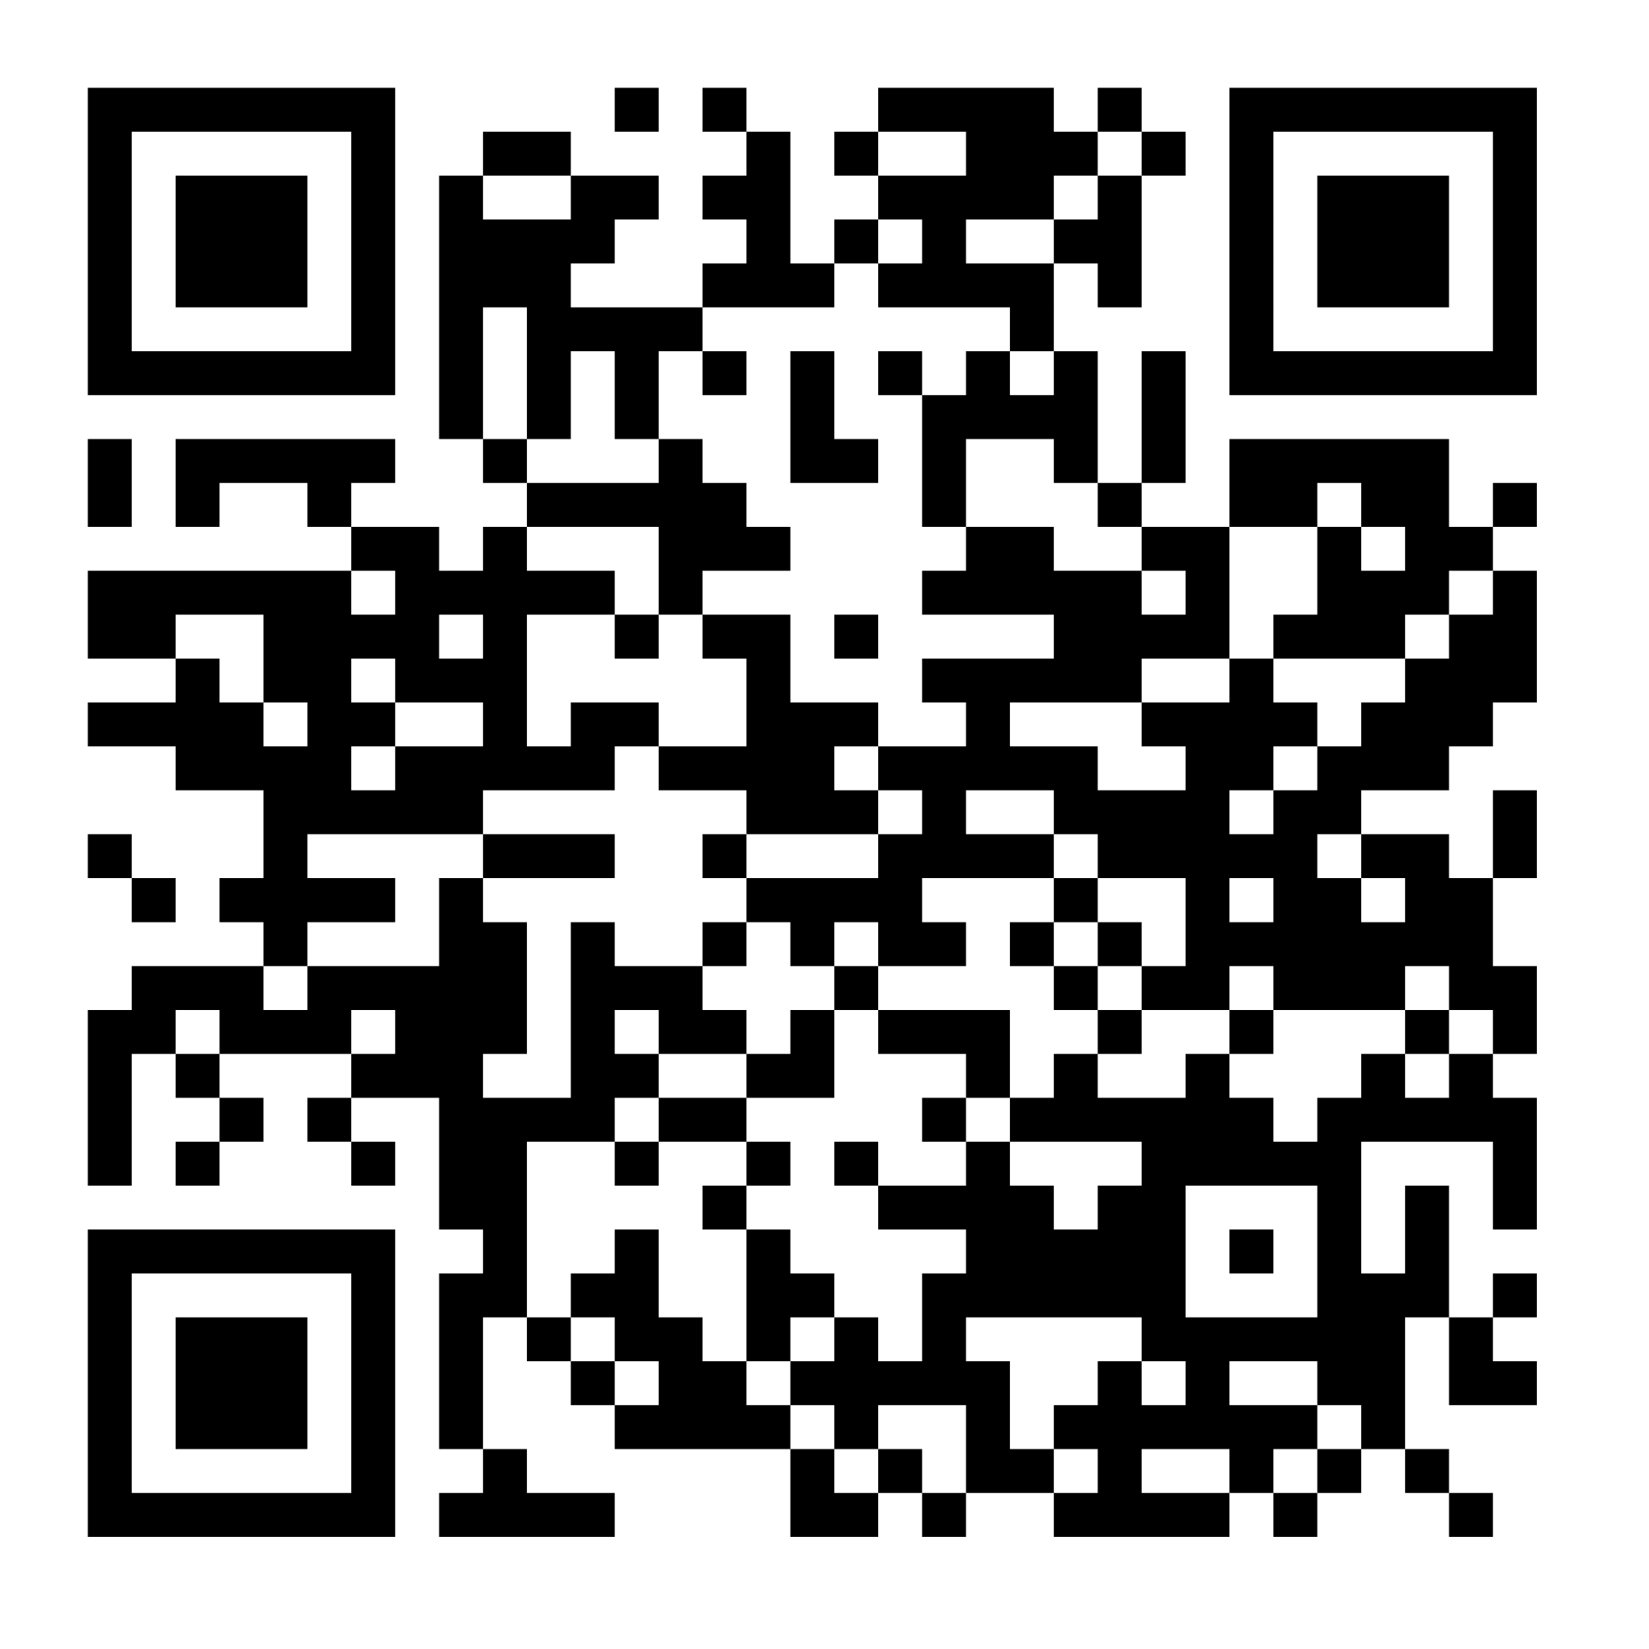
SAVE THE DATE – NACo LEGISLATIVE CONFERENCE
2026 NACo Legislative Conference
February 21-24, 2025 Washington, DC
Join a NACo Committee Today!

Slide 14
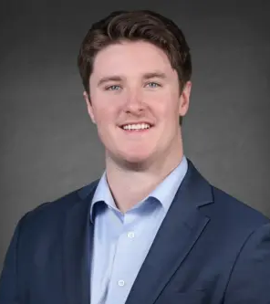
Jared Grigas
NACo Associate Legislative Director, Community, Economic & Workforce Development

Slide 15

WASHINGTON UPDATE
Jared Grigas
Associate Legislative Director
Community, Economic, & Workforce Development
Stronger Counties. Stronger America.

Slide 16

Government Shutdown in Review:
Began on October 1
43 days in total—the longest in history
County Impacts
Counties receive more than $62 billion in intergovernmental revenue
Agency programs largely scaled-back or frozen
Urged Congress to reach a bipartisan resolution
NACo joins “Big 7” Letter
States and local governments forced to backfill federal funding
Highlighted the strain of a protracted shutdown on state and local budgets and service delivery

Slide 17
Continuing Resolution
November 12: Signed into law
60-40 in Senate, 222-209 in House
Three-Bill “Minibus”
Agriculture, MilCon/VA, Legislative Branch
Framework for state and local reimbursement
Additional Provisions
Funds most agencies through January 30, 2026
Rescinds recent RIFs
Extends State and Local Cybersecurity Grant program through Jan. 30
Additional funding: $107B for SNAP; $8.2B for WIC; $50M for ReConnect; $17M for Community Connect

Slide 18
Continuum-of-Care Grants
Continuum of Care Program
Approximately $3.9B to over 400 regional consortiums
Congress authorized a two-year program cycle; current year grants expire in January
Timing
Homelessness services and housing
HUD moving forward with a new program NOFO, in lieu of second 12-month cycle
Unlikely HUD able to conduct full awards cycle before funding lapses

Slide 19
Continuum-of-Care Grants (cont.)
Advocacy Notes
NACo issued letter to HUD
New program NOFO in lieu of the second 12-month cycle
Program Changes
30 percent cap on permanent supportive housing expenditures
Down from 87 percent
Shift toward short-term programs with strings attached
Direct Impact: 170,000 residents
Indirect Impact: Additional strain on local services—$15,000/person
Loss of “protected” Tier 1 funds
House Republicans, Senate Democrats issued similar letters to HUD

Slide 20
ROAD to Housing Act
Most significant housing package in over a decade
Unanimous passage in Senate Banking; contributions from every member
Build Now Act
Ties CDBG allocations to housing growth
Directs HUD to develop model zoning frameworks for states/local governments
Model Zoning Frameworks
County Wins
Reauthorizes HOME Program
Passed as floor amendment to NDAA
Permanent authorization for CDBG-DR
Reduces administrative barriers: streamlined inspection requirements for HCV
Double-edged sword: technical assistance vs. preemption potential
Risk-reward system

Slide 21

FEDERAL PERMITTING REFORM OUTLOOK
Congress
Single permitting provision included in OBBBA
Top legislative priority this fall
Administration
CEQ NEPA authority rescinded sending process to individual agencies
Decentralizes process and makes role of local governments unclear
NACo submitted comment letters to 5 agencies that recently released new NEPA regulations
NACo Permitting Blog
Notes:
FERC was not accepting comments, issues a final rule instead of an interim final rule.

Slide 22
NACO’s PERMITTING REFORM PRIORITIES
Preserve county authority over siting and permitting without federal and state preemption
Increase county consultation with federal agencies throughout permitting process
Restore clear, enforceable regulatory provisions defining cooperating agency roles for counties
Ensure financial benefits for counties hosting permitting projects.
NACo Permitting Blog

Slide 23
Questions?
Jared Grigas
Associate Legislative Director
E: jgrigas@naco.org
C: (850) 322-0229
Stronger Counties. Stronger America.

Slide 24


Slide 25


Slide 26


Slide 27
