Slide 4
Florida Affordable Housing Trends
Shimberg Center for Housing Studies
June 2024

Slide 5
Home prices increased sharply in 2020-2022. Median single family home prices have surpassed mid-2000s boom-era levels.
Median Single Family Home Sale Price, 2003-2023 (2023$)
Source: Shimberg Center analysis of Florida Department of Revenue, Sales Data Files. All values in 2023 dollars to correct for inflation.

Slide 6
Rents increased sharply during the same period.
Median rent for new leases increased 28% during 2021-2022
Rents are more stable now, but at the new higher levels.
Estimated Median Rent for New Leases, 2017-2024
Source: Apartment List Data & Rent Estimates, https://www.apartmentlist.com/research/category/data-rent-estimates. Reflects estimated median rent for new leases in April of each year.

Slide 7
The state added hundreds of thousands of rental units between 2012 and 2022 but lost units renting for $1,200 or less (2022 $).
Net increase 2012-2022: 416,000 rental units
$1,200+ units grew by over 727,000
Units at or below $1,000 fell by over 311,000
Units by Gross Rent Above/Below $1,200 (2022 $), Florida, 2012 & 2022
Source: Shimberg Center tabulation of U.S. Census Bureau, 2012 and 2022 American Community Survey. Year 2012 rents adjusted to 2022 dollars using Consumer Price Index.

Slide 8
Affordable Housing Terminology
Housing is usually considered to be affordable if it costs no more than 30% of household income.
Cost burdened: Paying more than 30% of income for owner or renter costs
Severely cost burdened: Paying more than 50% of income
Area median income (AMI): Used to create standard income measures across places and household sizes, expressed as % AMI

Slide 9
Example: 2024 Orlando Metro Area Income (% AMI) and Housing Cost Limits
Income level | Annual income limit (1-4 person household) | Hourly wage, 1 full-time job | Hourly wage, 2 full-time jobs | Max. affordable monthly housing cost (1-3 bedroom unit)
50% AMI | $33,800-48,250 | $16-$23 | $12 | $905-1,255
80% AMI | $54,080-77,200 | $26-37 | $13-$19 | $1,448-2,008
120% AMI | $81,120-115,800 | $39-56 | $20-$28 | $2,172-3,012
http://flhousingdata.shimberg.ufl.edu/income-and-rent-limits

Slide 10
Very low-income renters and owners make up the largest groups of cost-burdened households.
Cost Burdened Households by Income as a Percentage of Area Median Income (AMI), Florida, 2022
Source: Shimberg Center tabulation of U.S. Census Bureau, 2022 American Community Survey.

Slide 11
Housing costs outpace wages for many occupations.
Florida’s housing wage: $30.59/hour
A full-time worker would need to earn this amount to rent a typical 2BR apartment (HUD Fair Market Rent 2023: $1,591/mo).
Median wage for Florida, 2023: $21.67/hour. A full-time, year-round worker with this wage can afford $1,127 in rent.
Sources: National Low Income Housing Coalition, Out of Reach; Shimberg Center tabulation of Florida Department of Economic Opportunity, Occupational Employment and Wage Statistics

Slide 12
How much can workers afford to pay for housing each month?
$600-799
$800-999
$1,000-1,200
Correctional Officers
Bus Drivers
Bartenders
Dental Assistants
Light Truck Drivers
Median, All Occupations
Painters
Roofers
Secretaries and Administrative Assistants
Cashiers
Childcare Workers
Dishwashers
Farmworkers
Fast Food and Counter Workers
Food Preparation Workers
Hairdressers
Home Health and Personal Care Aides
Hotel, Motel, and Resort Desk Clerks
Janitors and Cleaners
Laundry and Dry-Cleaning Workers
Maids and Housekeeping Cleaners
Preschool Teachers
Retail Salespersons
Security Guards
Waitstaff
Construction Laborers
Restaurant Cooks
Customer Service Reps
Landscaping and Groundskeeping Workers
Medical Assistants
Nursing Assistants
Office Clerks
Pharmacy Techs
Receptionists
Substitute Teachers
Tellers
Veterinary Techs
Source: Shimberg Center tabulation of Florida Department of Economic Security, Occupational Employment Statistics and Wages. Based on median wage for occupations in Florida. Assumes full-time worker, 30% of income spent on housing costs.

Slide 13
Building a Local Housing System: The Affordable Housing Continuum
Supportive Housing (affordable units + services)
Homeless
Affordable rental housing
Public housing
Subsidized (Florida Housing, HUD, USDA)
Affordable home ownership
Shared equity (e.g. community land trust)
Down payment assistance
Older adults
People with disabilities
Other special needs
NOAH (Naturally Occurring Affordable Housing)
Low-interest loans
Affordable construction
Home rehab and weatherization
Vouchers

Slide 14
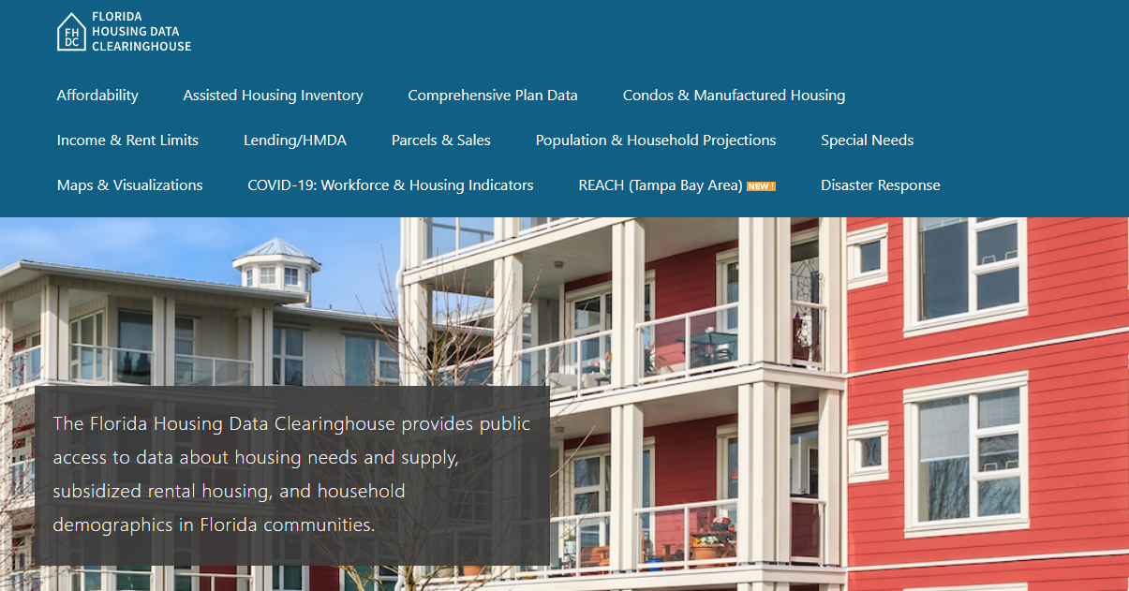
Contact
Anne Ray, Shimberg Center for Housing Studies
aray@ufl.edu
Main site: http://www.shimberg.ufl.edu
Data clearinghouse: http://flhousing.data.shimberg.ufl.edu

Slide 15
Lennar
Headquartered in Miami, Florida
Building in 26 states & largest homebuilder in Florida
Single-family, Townhomes & Condos plus Active Adult Communities and Next Gen Homes
Section title if needed

Slide 16
Why is Senate Bill 812 Needed?
Improve Affordability
Increase supply
Reduce carrying costs to combat:
Higher borrowing costs
Inflation
Increases to impact fees
Increased costs from HUD: IECC and FEMA 2-Feet
Promote collaboration between developers and local government

Slide 17
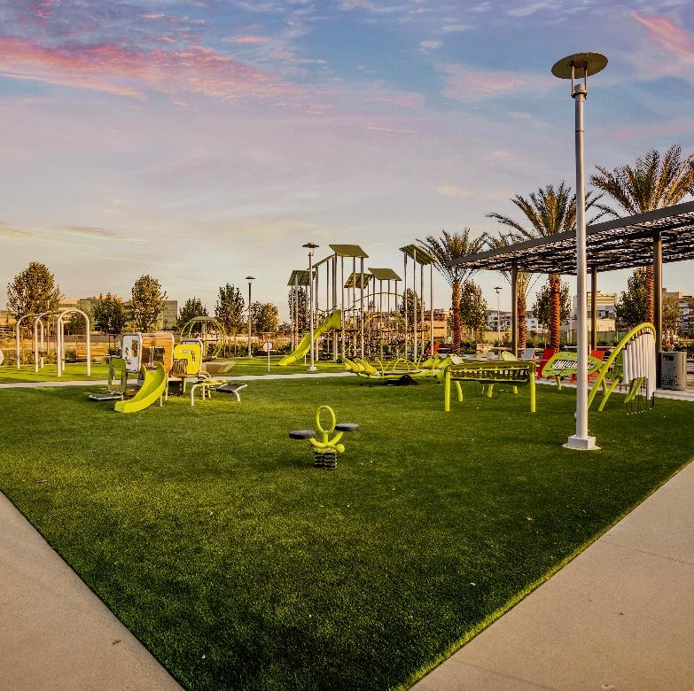
Goal of Senate Bill 812
Designed to improve affordability.
Promote collaboration by allowing early starts (50% of the residential community after an approved preliminary plat).
Leverage the private sector for all regulatory approvals with government oversight.
More efficient process to meet Florida’s affordability issues without sacrificing safety or thorough review.
Grandfathering “Light” of existing programs
Section title if needed

Slide 18
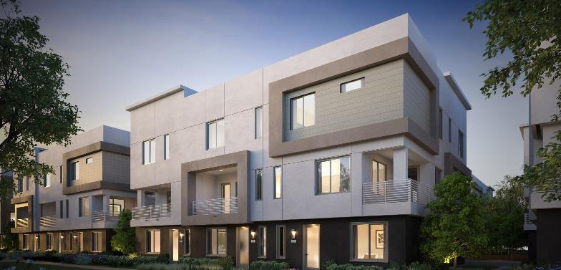
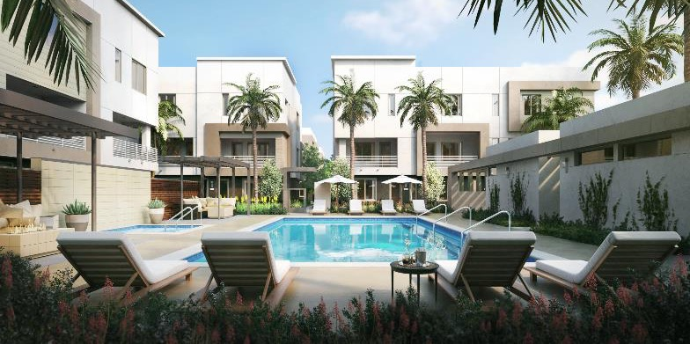
Tenants of Senate Bill 812
Develop Two-step process - preliminary plat and final plat.
Begin permitting for 50 percent of community after preliminary plat is approved.
Leverage the private sector for “plans” review and building permits.
Legally and Financially Indemnify Locals; and
Ensure safety – All construction in accordance with the Florida Building, Fire Code, and no occupancy until a certificate of occupancy has been issued.
Section title if needed

Slide 19
Indemnification & Collaboration
Legal Indemnification
Financially Hold Harmless
Applicant responsible for any damages stemming from building permit issued prior to final plat.
This extends to their agents and employees for any disputes resulting from a home constructed before the approval and recordation of the final plat.
The applicant holds a valid performance bond for up to 130% percent of the necessary improvements, as defined in s. 177.031(9) (streets, gutters, sidewalks, or any improvements required by government)
Master planned community: up to 130% bond required on a phase-by-phase basis
Section title if needed

Slide 20
Ensure Safety & Collaboration
Building Code
Fire Code
Florida Building Code applies to every structure
No shortcuts
No reduced timeframes
No transfer of ownership until a C.O. is issued.
Florida’s Fire Code require fire protection to be on-site before combustible materials are delivered.
Wood frames
drywall
Non-combustible materials and improvements:
Roads, sidewalks
Stormwater systems, gutters
Foundation of home (poured concrete, concrete block walls

Slide 21
Conclusion and Recap
Collaboration is key to Florida’s success
New program in place by October 1, 2024
Allow 50% early permitting after an approved preliminary plat
Grandfathering Light
Leverage private sector for all reviews and approvals
Indemnify local governments
Maintain safety through building code and fire code
No transfer of ownership until a certificate of occupancy

Slide 22
Florida Housing and the Live Local Program Marisa Button Managing Director of Strategic Initiatives The Florida Association of Counties June 26, 2024

Slide 23
Overview of Florida Housing Finance Corporation
Chapter 420, Part V, Florida Statutes governs Florida Housing Finance Corporation (FHFC).
FHFC was created to meet statewide affordable and workforce housing needs through the administration and implementation of programs related to the allocation of resources for the development and preservation of rental housing and homeownership opportunities.
FHFC is governed by an eleven-member Board of Directors. The Governor appoints nine members. The Senate and House appoint one member each.
The 2023 Live Local Act expanded FHFC programming!

Slide 24
Guiding Principles of Florida Housing Finance Corporation
Prioritize mission and strategic plan.
Conduct data-based decision making.
Obtain public and stakeholder feedback and participation.
Operate with transparency.
Administer programs with maximum flexibility for market conditions.
Ensure predictability for private sector financing partners.

Slide 25
Overview of Affordable Housing Delivery System
Private developers seek financing from Florida Housing to build rental housing.
In exchange for the financing, the owner of the development agrees to reserve units to be set aside at certain Area Median Incomes (AMI)s, with associated rents, which are designated by state or federal statute.
The rental units are then required to be set-aside for 30-50 years, depending on the financing program.
Most resources are administered competitively.
Notes:
The area median income is the midpoint of a region's income distribution, meaning that half of the households in a region earn more than the median and half earn less than the median.
HUD publishes annual income limits based on household size that are used to determine the maximum household income.
Both income and rent limits are important.

Slide 26
What is the Difference Between Affordable and Workforce Housing?
Nothing!
Traditionally, workforce housing is considered housing for individuals whose incomes are greater than 60% AMI, but less than 120% AMI.
Affordable housing has been considered housing for individuals whose incomes are at or below 60% AMI; however, data reflects these individuals are part of the workforce.
What AMIs have the greatest need for housing?
How is need determined?

Slide 27
Example Occupation AMIs
Occupation | Collier County AMI 1 Person HH | Orange County AMI 1 Person HH
Childcare Worker | 45% | 45%
Home Health Aide | 45% | 45%
Food Service Worker | 50% | 55%
Hospitality Worker | 45% | 55%
Construction Laborer | 60% | 65%
Customer Service Rep. | 60% | 70%
Auto Mechanic | 70% | 70%
Firefighter | 90% | 80%
Police Officer | 90% | 90%
School Teacher | 110% | 80%
Nurse | 120% | 120%
Source: Shimberg Center, 2023 Wage Data; FHFC 2023 Income and Rent Limits

Slide 28
Overview of the Live Local Act
Provides for a comprehensive, statewide workforce housing strategy, designed to increase the availability of affordable housing opportunities for Florida’s workforce, who desire to live within the communities they serve.
Provides recurring funding for construction of multifamily rental development.
Provides various housing development tax incentives.

Slide 29
Florida Housing Live Local Programs
Florida Hometown Heroes Program
Live Local Program Tax Credit Contribution
Multifamily Middle Market Certification
Additional Innovative and Transformational Live Local SAIL Funding Opportunities

Slide 30
What are SAIL Loans?
The contributions from the Live Local Tax Credit Program will fund State Apartment Incentive Loan (SAIL) program loans. These are low interest loans used to fund rental development cost.
SAIL loans are statutorily limited to covering 25-35% of total development cost, depending on demographic served.
This means developers must obtain other forms of conventional financing and equity investment to produce units.
Florida Housing administers SAIL loans through a competitive Request for Applications (RFA) process that takes the geographic and demographic need throughout the state into consideration.

Slide 31
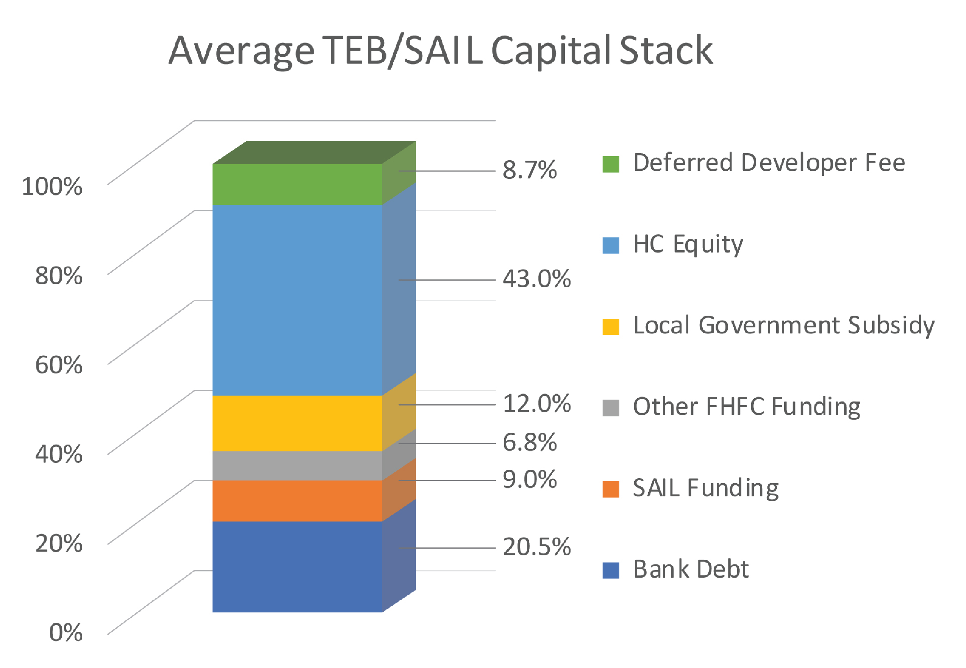
Average Capital Stack
*

Slide 32
Transformational Multifamily Development Proceeds from Live Local Program Tax Credit Contributions
Contributions will fund a specific type of SAIL program to include up to $25 million for financing transformational multifamily developments through competitive Requests For Applications (RFA).
Under the Live Local Act, transformational Multifamily Developments are considered “large-scale projects of significant regional impact”, which are part of a regional or local transformational community development plan.
Funding not used in the Transformational program will be placed in the traditional SAIL program.
Timeline for RFA development is subject to timeline for receipt of contributions.
$50 million RFA will be issued in July 2024.

Slide 33
Florida Housing Data Clearinghouse
Creation:
Created in 2001
Shimberg Center for Housing Studies at the University of Florida.
Response to concerns voiced by the Florida Home Builders Association, the Realtors, the Affordable Housing Study Commission and other stakeholders that data was difficult to access for legislative, policy and other purposes.
Purpose:
Provides the public with access to data on housing need and supply in Florida from a variety of sources.
Functions:
To provide housing data, and build the capacity, or infrastructure, to collect and produce this information.
The Clearinghouse website:
http://www.flhousingdata.shimberg.ufl.edu/

Slide 34
FHFC Live Local Act Listserv
By signing up for the Listserv, you will receive updates via email.
Go to our Live Local Act page, https://www.floridahousing.org/live-local-act, and click on “Sign Up for Each Live Local Act Program’s ListServ.”
Contact:
Marisa Button
Managing Director of Strategic Initiatives
Marisa.Button@floridahousing.org
Notes:
Live Local Listserv

Slide 35
Thank you!

Slide 36
Affordable/Available Units
Compares number of renter households in an income group (0-30% AMI, 0-60% AMI, etc.) with supply of rental units
Affordable: with rent at or below AMI rent limit (30% monthly income)
Available: vacant or occupied by income-qualified household (at or below AMI income limit)

Slide 37
Statewide Affordable/Available Units
Up to 60% AMI: shortage of affordable units
80% AMI: shortage of affordable/ available units
120% AMI: small deficit of affordable/ available units
Varies geographically
Number of Affordable Units, Affordable/Available Units, and Renter Households by Income, Florida, 2022
Source: Shimberg Center tabulation of U.S. Census Bureau, 2022 American Community Survey

