Slide 4
Florida Legislative History

Slide 5
Florida Association of Counties
June 2024

Slide 6
A unique design for superior performance and comfort
High-speed
250 km/h (~155 MPH)
Largest eVTOL cabin with up to
6 passengers
Operating range^{1,2}
175 km (~110 MI)
Commercial airliner safety level³
10⁻⁹
¹Performance targets based on current development status of aircraft. Cruise speed based on Lilium engineering assessment assuming flight at 10,000 ft. ²Operating range refers to service range (after accounting for reserves). ³Lilium’s primary certification authority (EASA) stipulates probability of less than one aircraft loss per billion flight hours; Note: Rendering utilizing computer graphics

Slide 8
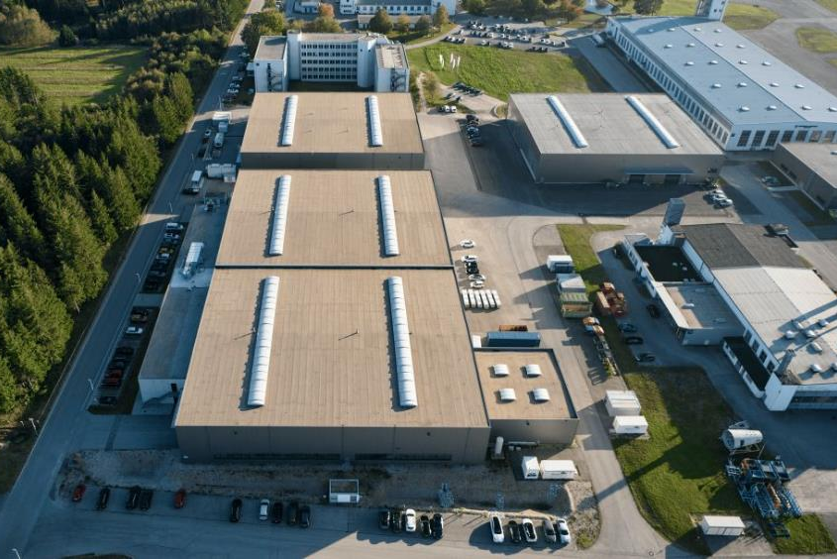
Ability to deliver: leadership, talent, funding partners
LED BY AEROSPACE VETERANS
TALENT FOCUS ON ENGINEERING
STRONG FUNDING PARTNERS
1000
50%
130
~
~
>
employees
in Engineering & Production
patents filed since 2016
$1.4B
>
Tom Enders
Chairman & Investor
Klaus Roewe
CEO
total funds raised
Stephen Vellacott
CTO
Yves Yemsi
COO
Johan Malmqvist
CFO
Sebastien Borel
CCO
Notable investors:
German-based aerospace company founded in 2015 and listed on Nasdaq since 2021

Slide 9
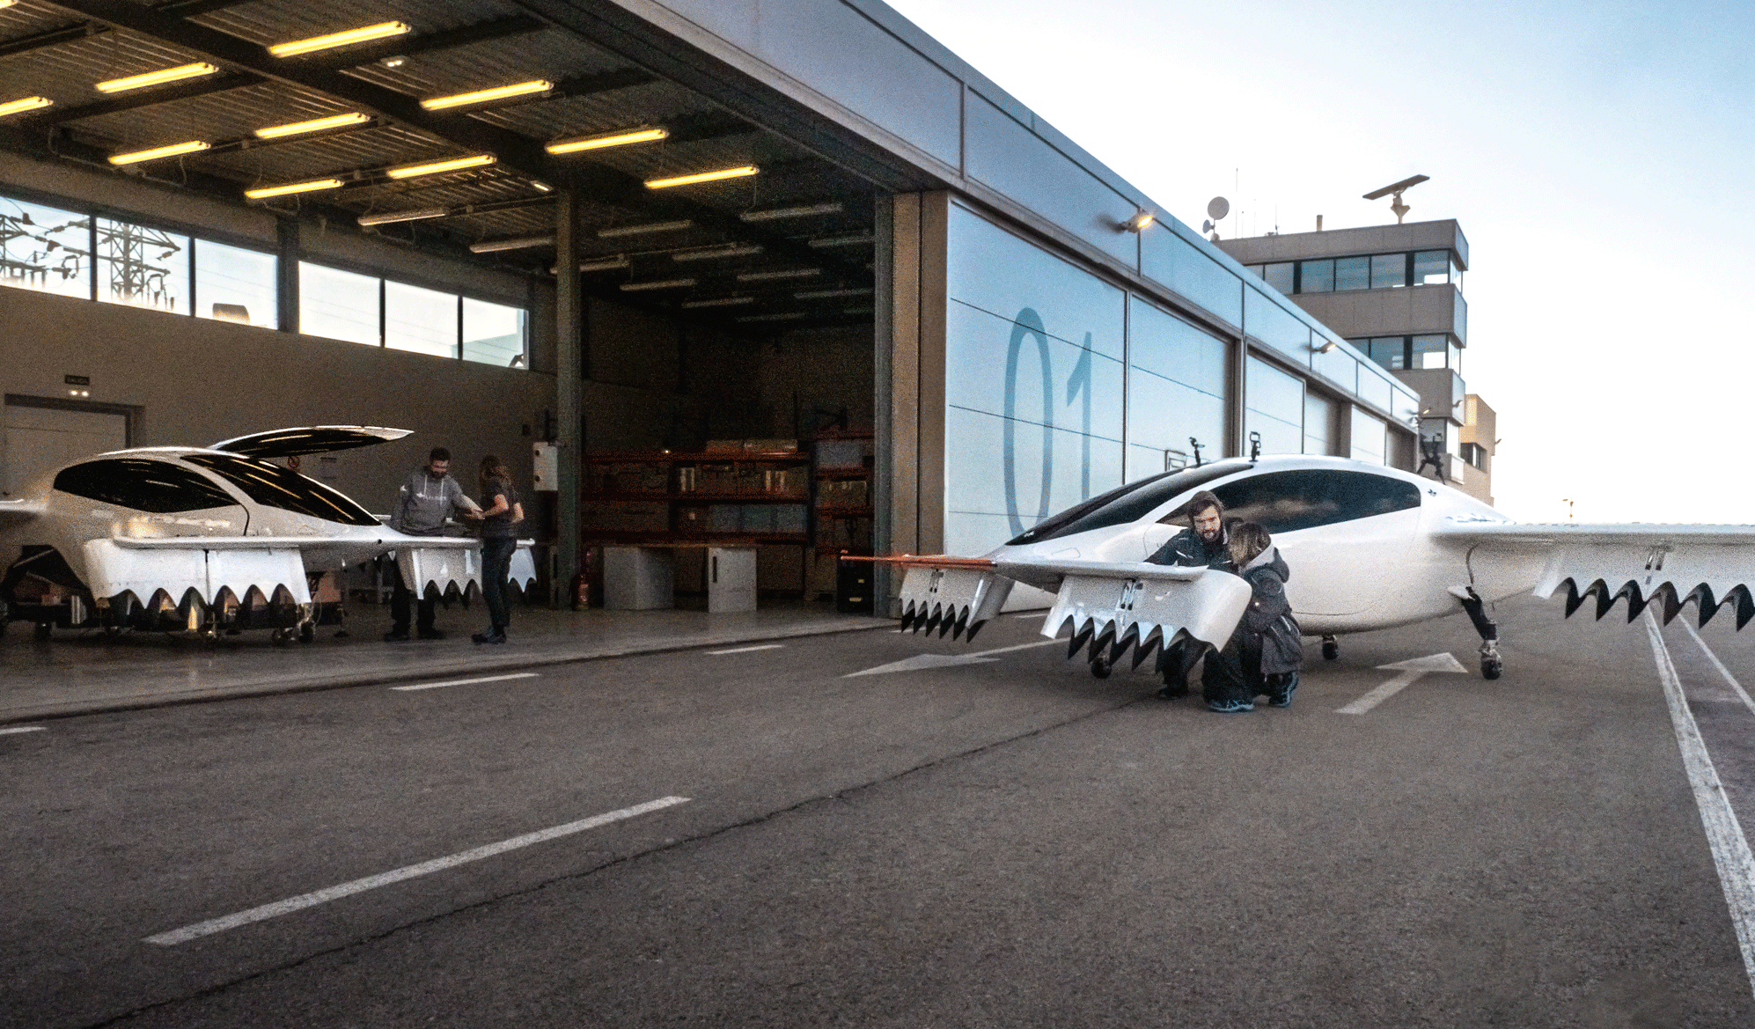
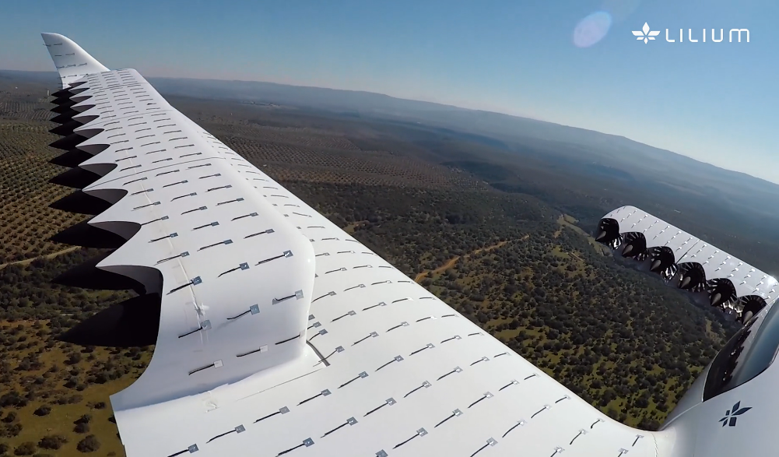
Flight tests validate architecture & support certification
Flight testing with two demonstrator aircraft is taking place in Spain
Flight testing envelope continuously expanded over the past 4 years
All relevant flight-testing conditions have been successfully tested (e.g., transition, High-Speed, System Failures)
Two demonstrator aircraft in Spain validate architecture and flight mechanics
Sources: Company information

Slide 10
Flight tests validate architecture & support certification
Flight testing with two demonstrator aircraft is taking place in Spain
Flight testing envelope continuously expanded over the past 4 years
All relevant flight-testing conditions have been successfully tested (e.g., transition, High-Speed, System Failures)
Two demonstrator aircraft in Spain validate architecture and flight mechanics
Sources: Company information

Slide 11
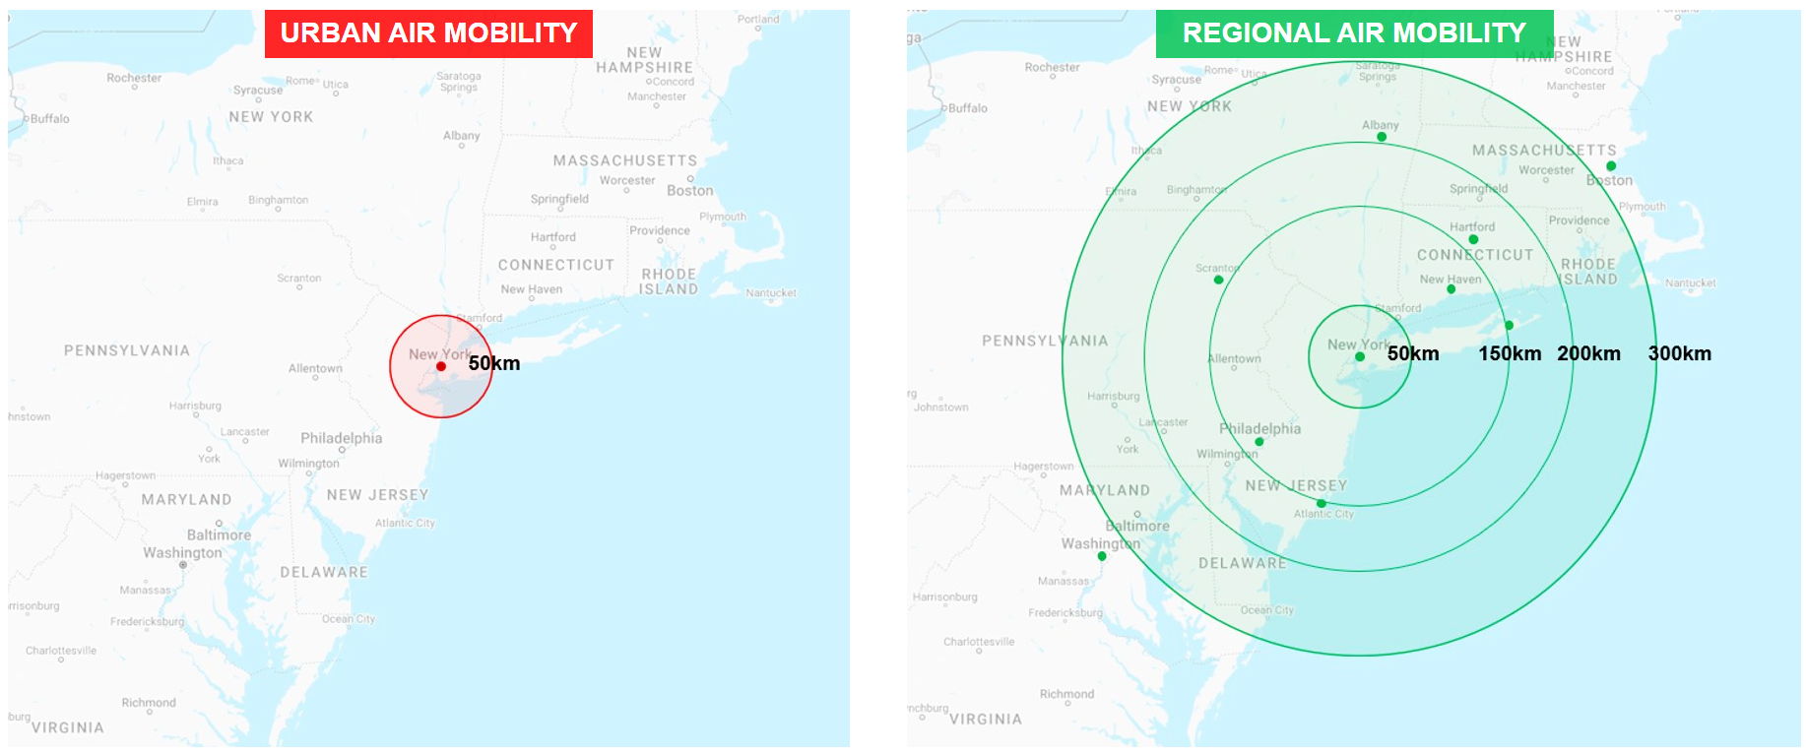
WHY REGIONAL
BIGGER MARKET, BETTER VALUE
45 mins journey time = ~30km
Intercity travel
URBAN
REGIONAL
REGIONAL AIR MOBILITY ADVANTAGE
RAM flight profile is a much better match for our aircraft architecture than UAM flight profiles
More range = more options = bigger market
Meaningful guaranteed time savings for 45+ minutes journeys: greater time saving means lower price elasticity & higher pricing leverage
Viable market demand and avoiding UAM’s high competition

Slide 12
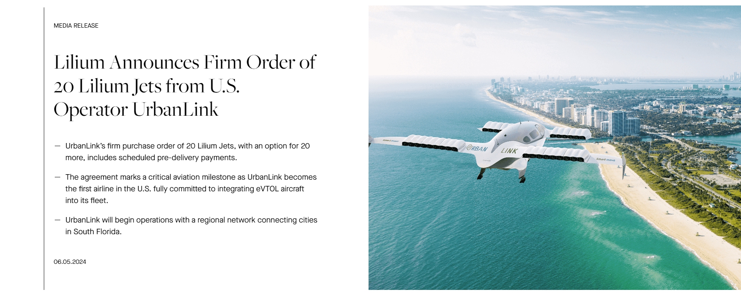
South Florida operator confirmed

Slide 13
x
x
Deltona
Example Route Network
Winter Springs
Central Florida
93 miles
Orlando
(68 miles)
Cape Canaveral
Spring Hill
Kissimmee
Palm Harbor
Lakeland
Melbourne
Tampa
Clearwater
Brandon
St Petersburg
Port St. Lucie
Sarasota
(63 miles)
North Port
Cape Coral

Slide 14
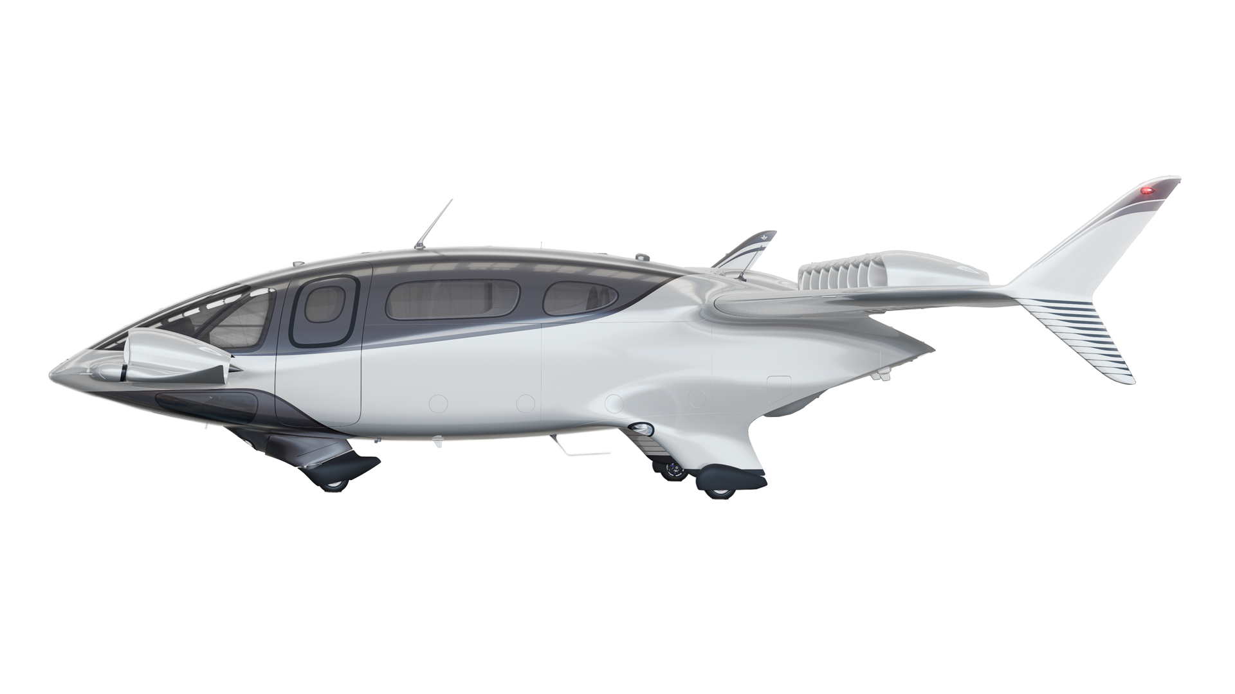
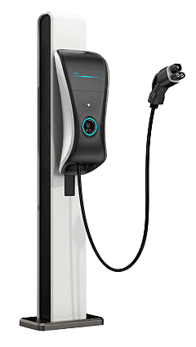
Our aircraft design: Built to scale with battery improvement
ENERGY DENSITY
(Wh/kg)
500
2030
LILIUM JET
Vertical Take-off
Transitions
BATTERY ELECTRIC VEHICLE
2025
300
Cruise Phase
100
Vertical Landing
Reserve
Do Not Touch
2000
2010
2020
2025
2030
STATE OF CHARGE
STATE OF CHARGE
Note: Historical and projected improvement in battery energy density through 2030 estimate based on Roland Berger and Lilium engineering assessment. The illustration regarding the improvement in battery energy density is based on estimates, is forward-looking, subject to significant business, economic, regulatory and competitive uncertainties and contingencies, many of which are beyond the control of the Company and its management and are based upon assumptions with respect to future decisions and events, which are subject to change. Actual results will vary &those variations may be material. Nothing in this presentation should be regarded as a representation by any person that the estimated improvement in battery energy density will occur as described herein.

Slide 15
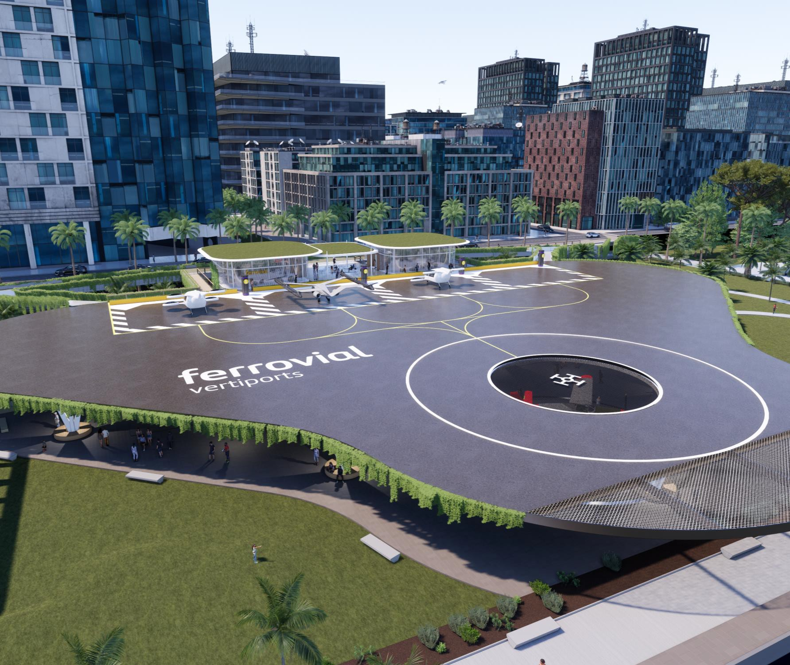

Slide 16
The Challenge and The Race
Today, 4.4 Billion or 56% of the world’s population currently live in cities.
Urban Population is projected to double by 2050, at which time almost 70% of the world’s population will live in cities.
Urban Congestion
The World Bank projects the world’s population to continue its dramatic flight to urban environments. This will inevitably lead to further congestion and traffic delays pushing transportation infrastructure to its limits.
2022
2050
Innovation Race
Innovative companies are rapidly designing, developing, and seeking certification of vertical take-off and landing aircraft (eVTOLS). These aircraft will forever change urban transportation by utilizing technology that will ensure passengers are transported in a safe, quick, quiet, and in a more sustainable way.
4
Basic eVTOL
typologies
640
Designs
120
Active
commercial
projects

Slide 17
The Opportunity
Global Economic Opportunity
U.S. Employment Opportunity
The total global AAM/UAM “base case” market is estimated to reach…
$55 Billion by 2030;
$1 Trillion by 2040; and
$9 trillion by 2050.
By 2035, the U.S. AAM market is estimated to employ more than
280,000 high paying jobs;
generating $30 Billion in wages and
generating over $8 Billion in Taxes.
Global Economic Investment
Global Aircraft
There are more than 250 active AAM projects across the globe with more than $11 billion in disclosed investment over the past five years.
160,000 unmanned aircraft are estimated to be in use globally by 2050

Slide 18
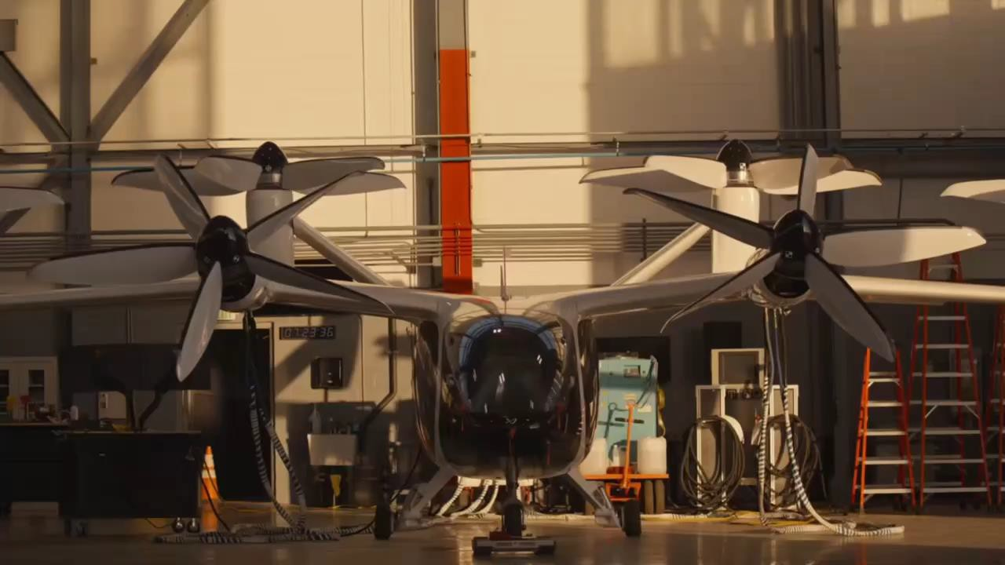

Slide 19
Various eVTOL Business Models
INTERCITY 50-300 km
INTRACITY <50 km
INTRA-AIRLINE <50 to 150 km

Slide 20
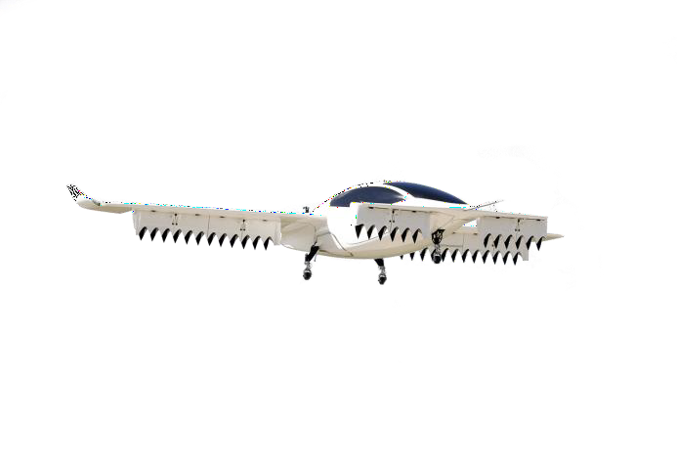
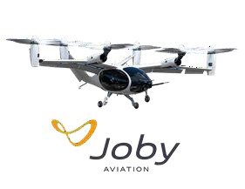
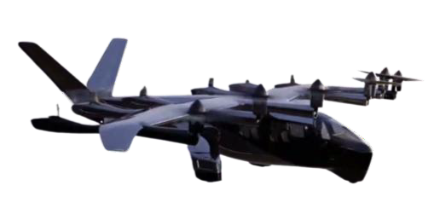
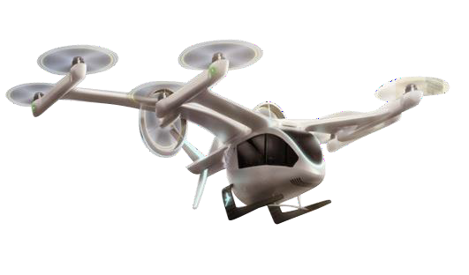
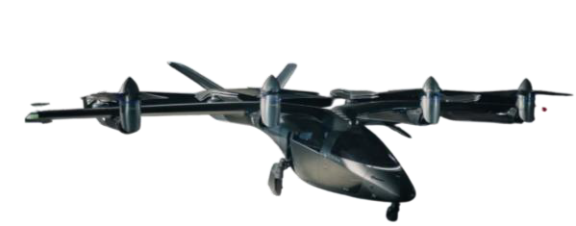
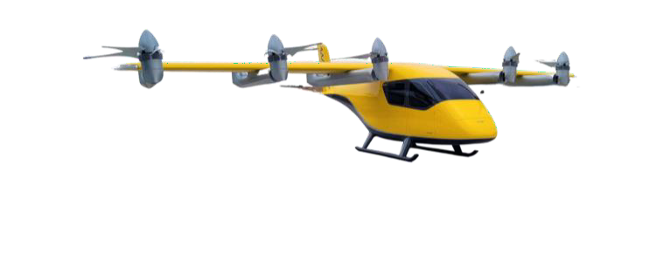
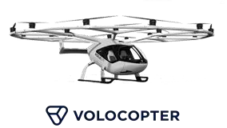
Ferrovial’s Approach

Slide 21
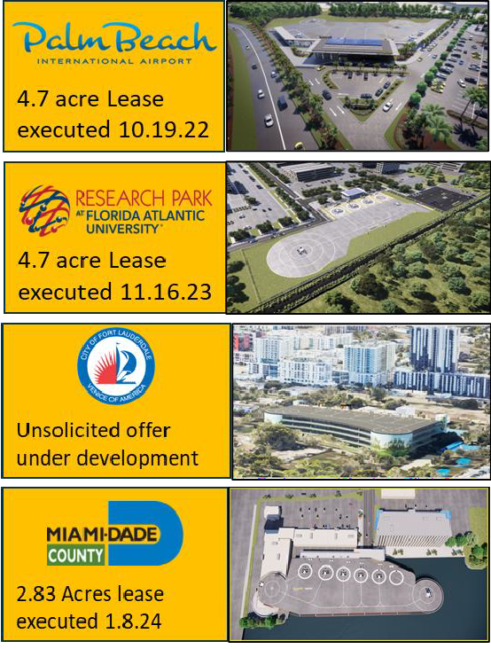
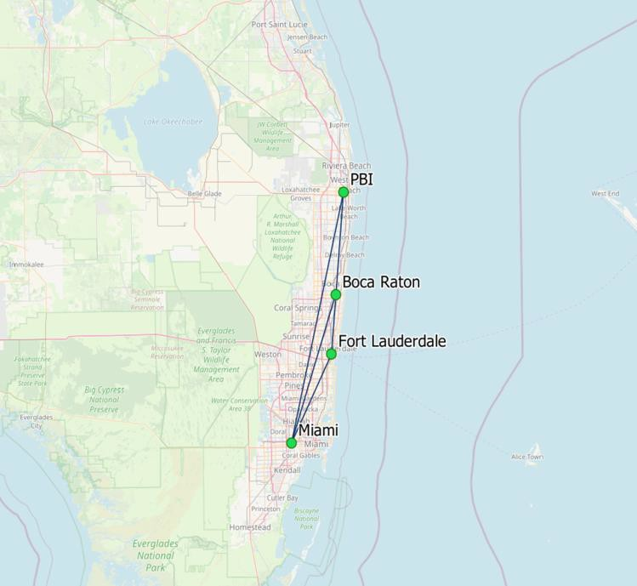
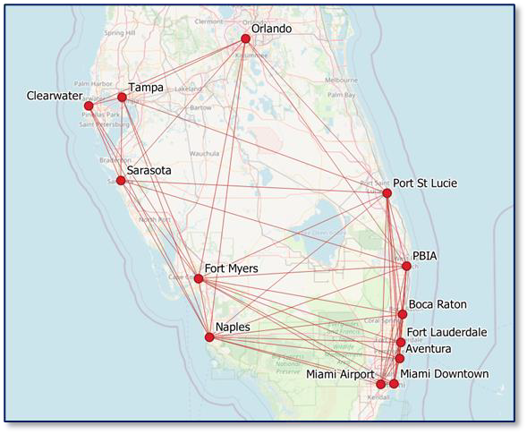
Florida Vertiport Network
Initial Florida Network
Illustrative Florida Network

Slide 22
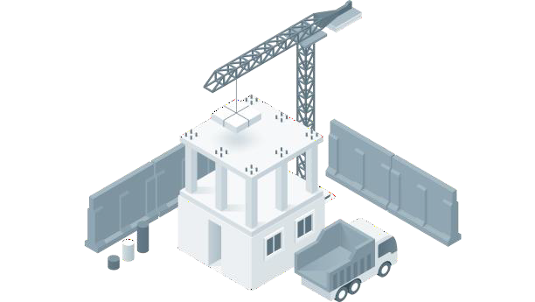
Success of this industry is highly
dependent upon…..
Sites and
Networks
Community
Integration
Government
Collaboration
Customer Acceptance
The proper siting, investing, developing, constructing, and operating a series of agnostic vertiport networks
Collaborating with the federal, state, and local communities who have approvals over airspace, zoning, and building permits
Building a customer base who embraces advanced air mobility as safe, reliable, sustainable, affordable, and efficient mode of transportation
Seamlessly integrating vertiports into the fabric of their surroundings.

Slide 23
Advanced Air Mobility Planning
June 2024

Slide 24
Potential AAM Development Opportunities (MCO)
N
VISION A:
Initial vertiport & technology incubator and research & development
East Airfield
VISION A:
The Authority has identified the east airfield, an undeveloped parcel on the northeast side of the airport property, as the preferred location for the development of initial AAM facilities.
VISION B:
Transform the train station into the next-generation multimodal hub
VISION B:
Ultimately, AAM operations will be integrated into the multimodal environment at MCO, with connections to the Passenger Terminal and Train Station.
24

Slide 25
IMPLEMENTATION CHALLENGES
Terminal Connectivity
Passenger Experience
Remote Baggage Handling
VISION A:
Advanced Air Mobility Vertiport (East Airfield)

Slide 26
Benefits of East Airfield
East Airfield Site & Airspace Integration
Land Asset / Expandability:
1,200 acres of contiguous undeveloped property designated for aeronautical use
Opportunities for future incubator space, research and development facilities, maintenance/repair, or production/assembly facilities
North Flow
AAM
Site
Minimal Impact to MCO Operations:
Adequate separation from existing flight paths and runway approaches per EB 105
Advanced Planning:
South Flow
Aviation Authority staff coordination with airport stakeholders to prepare the site for AAM ecosystem development
SOURCES: Esri, 2020 (airport); US Census Bureau, 2020 (roads, counties); Greater Orlando Aviation Authority, May 2023; Ricondo & Associates, Inc., March 2024.
NOTES: The MCO Class B Airspace is identified on the exhibit by the 5-nautical-mile radius, the innermost section from the surface of the ground; the outer sections of the Class B Airspace are not represented.

Slide 27
IMPLEMENTATION CHALLENGES
Airspace Integration at Main Terminal
Passenger Experience
Baggage Handling
VISION B:
Multimodal Hub

Slide 28
On-Going Community Activities
Briefings to HOAs Adjacent to Airport
Coordination with City and County Commissioners
Participant in City of Orlando AAM Tabletop
Coordination with FDOT and other stakeholders
Part of FDOT AAM Advisory Committee (AAMAC)
Extensive engagement with industry partners, OEMs, educational institutions, and infrastructure and system developers
eVTOL Insight Finalist, AAM Community Engagement
Team of the Year
28

Slide 29
Thank you!
Kevin A. Thompson, C.M., ACE Assistant Vice President of Planning orlandoairports.net
2023 Strategic Plan:
To access the 2023 Strategic Plan document,
please use the QR code provided below.
29

