Slide 2
The 2024 regular Legislative Session included: ​
1902 Bills and PCBs filed​
325 Bills passed both chambers​
17.1% of total bills passed this session
450+ Bills in FAC Bill Tracker​
Nearly 100 Preemptions/Mandates​

Slide 3
2024 Legislative Action Plan
SIGNED BY GOVERNOR
Public Records/County Attorneys—HB 103
Regional Rural Development Grants Program—HB 141
Prohibiting Human Trafficked Labor in Government Contracts—HB 7063
Continuing Contracts—HB 149
PACE Program Clarification—SB 770
Affordable Housing/TDT in Monroe County—SB 1456
Funding for Environmental Resource Management—SB 1638
Local Occupational Licensing Extension—SB 1142

Slide 4
Preemptions & Mandates
FAILED​
County Commissioner Term Limits—HB 57/SB 438
House: 8-year term limit
Senate: 8-year term limit through county referendum
Sovereign Immunity—HB 569/SB 472
Increased caps to 300k, 500k
County Budget Officers—HB 1553/SB 1520
Local Business Taxes—HB 609/SB 1144

Slide 5
Preemptions & Mandates
FAILED​ (continued)
Land and Water Management—HB 527/SB 664
Fertilizer Application Ordinances—never filed
Monument Protection—HB 395/SB 1122
Agritourism—HB 339/SB 696
Soil and Water Conservation Districts—HB 1075/SB 1772
Enhanced Firearms Training Facility Zoning—HB 831/SB 1586
“Re-emption” of Regulation of Auxiliary Containers—HB 1641/SB 1126
Artificial Intelligence Systems—SB 972
Flags—HB 901/SB 1120
And more…

Slide 6
Preemptions & Mandates
HB 705 Public Works Projects (Shoaf) SIGNED (amended)
Modifies the definition of "public works project" and revises the applicability of prohibitions on restrictive bidding practices by the state or its political subdivisions.
Under current law, a “public works project” includes construction projects funded in part or whole by state-appropriated funds. The bill revises the definition to also include projects paid for with local funding.
Current law also preempts certain “local preferences” within the procurement phase of a public works project. This includes consideration of geographic location, wage rates, benefits, staffing levels, and recruiting or hiring from preferred sources.
The bill would expand these preempted activities to projects involving local funds—however, a local government may still practice geographic preferences if it is the sole funding source of the project. Currently, goods, services, or work that is incidental to the public works project and other such incidental service items are excluded from this preemption.

Slide 7
Preemptions & Mandates
HB 433 Employment Regulation (Esposito) SIGNED (amended)
Prohibits a county, municipality and other political subdivisions from using its purchasing or contracting processes to control or affect the wages or employment benefits provide by its vendors, contractors, service providers, and other parties doing business with such political subdivisions.
Prohibits local governments from using evaluation factors, qualification of bidders, or otherwise award preferences on the basis of the wages or employment benefits provided by vendors, contractors, service providers, and other parties doing business with such political subdivisions.
Does not impair any contracts entered into before September 30, 2026.
Prohibits local government from adopting or enforcing any ordinance, resolution, order, rule, policy, or contract requirement regulating scheduling, including predictive scheduling, by a private employer, except as expressly authorized or required by state or federal law, rule, regulation, or federal grant requirements.
Preempts the regulation of workplace heat exposure requirements

Slide 8
Preemptions & Mandates
SB 1628 Local Government Actions (Collins) SIGNED (amended)
Modifies the exemption in s. 125.66(3) and s. 166.041(4), F.S., relating to Part II of Chapter 163, F.S.
Exempts from the preparation of a business impact estimate county and municipal ordinances that implement development orders, development permits, development agreements, and comprehensive plan amendments and land development regulation amendments initiated by an application of a private party instead of a county.
The effect of the bill is to require a business impact estimate to be prepared for any ordinance that implements other growth-related activities.
Severely paired back from original bill which would have:
Created a process through which various agencies may be requested by affected private parties to review local government actions which affect certain economic sectors of the state such as agriculture, energy, and transportation
Subjected the above local ordinances to lawsuits brought by any party to challenge the validity of the local ordinance as arbitrary or unreasonable

Slide 9
Preemptions & Mandates
SB 280 Vacation Rentals (DiCeglie) Presented to Governor (amended)
Requires Advertising Platforms to collect and remit tax
Requires counties that Self-Administer Tourist Development Taxes to allow advertising platforms register, collect and remit the tax
Allows for ordinances adopted prior to June 1, 2011 to be amended to be less restrictive
Provides for new requirements for local registration of Vacation Rentals
Allows local government to require registration of vacations rentals
Allows for reasonable fees per unit to process or renew a registration
As part of the registration, a local government may require:
Identifying information about the owner and the operator of the vacation rental and designate and maintain at all times a responsible contact available 24 hours a day
Proof of license issued by DBPR and that all required tax registration has been obtained
Payment in full all outstanding code liens
maximum occupancy not to exceed two persons per bedroom plus an additional two persons per common area.
These requirements do not apply to a county that had adopted an ordinance prior to January 1, 2016
Allows for the fining and suspension of a local registration under certain conditions

Slide 10
Preemptions & Mandates
PASSED ​
Energy Resources—HB 1645
Electric Vehicle Charging Stations (FDACS package)—SB 1084
Food Delivery Platforms—SB 676
Law Enforcement and Correctional Officers—HB 601
Local Regulation of Nonconforming and Unsafe Structures—SB 1526

Slide 11
Growth Management
HB 267 Building Regulations (Esposito) SIGNED (amended)
Provides for one statutory framework for the approval of building permits. A local government must approve, approve with conditions, or deny a building permit application after receipt of a completed and sufficient application within certain timeframes or “shot clocks”
Establishes a new “Curing Process” for insufficient applications
Provides framework for responding to insufficient application within 10 business days
The curing process will provide 10 days for applicant to respond AND final 10 days for local government approve or deny the permit
Provides for upgrading hardware and software technology with excess carry-forward funds to assist with enforcement of the building code
Modifies provisions requiring local governments to refund permit fees
Requiring local governments to adopt standard operating audit procedures regarding private provider audits.

Slide 12
Growth Management
SB 812 Expedited Permitting of Residential Building Permits (Ingoglia) SIGNED (amended)
Requires a governing body of a county that has 75,000 residents or more to create a program to expedite the process for issuing building permits for residential subdivisions or planned communities
Establish a two-step application process for the adoption of a preliminary plat and for a final plat
The governing body must issue 50% of the building permits for the residential development
The governing body must maximize administrative processes to expedite review and approval
Allows an applicant to use a private provider to expedite the application process and establish a registry of at least three qualified contractors to supplement staff resources for processing and expediting the review of an application for a preliminary plat or related plans.
Final certificates of occupancy must be issued prior to the issuance of a final plat
Applicants must maintain ownership until the final plat is issued
Provides indemnification of the local government by the applicant and requires performance bonds
Provides vested rights in a preliminary plat upon conditions met by the applicant

Slide 13
Growth Management
HB 479 Alternative Mobility Funding Systems (Robinson) SIGNED (amended)
The bill affects mobility fee, impact fee and concurrency provisions:
The bill mandates that local governments use recent and localized data for determination of impact fees in the authorizing study.
Projects can proceed after fulfilling their contribution or proportionate share requirements.
The bill requires coordination of transportation impact fee calculations and collections among local governments where a city and a county impose fees on a development:
Requires an interlocal agreement to be in place and establishes certain required elements of the agreement
Outlines collection and distribution methods, including penalties for noncompliance with interlocal agreements.
Exempts the requirement where an interlocal agreement is already in place between the city and county
Exempts Miami-Dade County
Additionally, holders of transportation or road impact fee credits predating a mobility fee system are entitled to the full benefit of prepaid intensity and density.

Slide 14
Agriculture & Rural Affairs
SB 1082 Housing for Legally Verified Agricultural Workers (Collins) Presented to Governor
Precludes a government entity from restricting the construction or installation of housing for agricultural workers on land classified as agricultural.
Local governments are authorized to require the following “reasonable guardrails” of a housing site:
Meets all federal, state, and local building standards, including Department of Health (DOH) migrant farmworker living standards
Must be maintained in a neat, orderly, and safe manner;
May not exceed the lesser of 1.5 percent of the property’s area or 35,000 square feet
50-foot setbacks on all sides
May not be located less than 250 feet from a property zoned for residential use;
Provide screening consisting of tree, wall, berm or fence coverage at least six feet in height, if the structure is within 500 feet of a residential-zoned parcel

Slide 15
Agriculture & Rural Affairs
SIGNED
HB 141 Economic Development
SB 644 Rural Hospitals

Slide 16
Water & Environment
SB 7040 Ratification of the Department of Environmental Protection’s Rules Relating to Stormwater Presented to Governor
Ratifies the DEP’s proposed stormwater rule with modifications
The 2020 Clean Waterways Act directed DEP and the water management districts to initiate rulemaking regarding stormwater infrastructure and the associated environmental resource permitting process.
Proposed rules with an aggregate 5-year economic impact estimate over $1 million trigger the statutory requirement for legislative ratification—the 5-year impact of this rule is estimated to be over $1 billion.

Slide 17
Water & Environment
SIGNED
SB 1532 Mitigation
HB 1557 Department of Environmental Protection
VETOED
HB 165 Sampling of Beach Waters & Public Bathing Spaces
FAILED
HB 789/SB 738 Environmental Management
HB 1665/SB 1692 PFAS
HB 1079/SB 298 Coastal Construction and Assessments

Slide 18
Health, Safety, & Justice
HB 1567 Qualifications for County Emergency Management Directors PASSED/SIGNED (amended)
Creates minimum education, experience, and training standards for all county emergency management directors (directors) which include:
50 hours of training in business or public administration, business or public management, or emergency management or preparedness or a bachelor’s degree.
4 years of specified experience in comprehensive emergency management services with direct supervisory responsibility for responding to at least one emergency or disaster.
A master’s degree in certain fields may be substituted for 2 years of the required experience
150 hours in comprehensive emergency management training provided through or approved by the Federal Emergency Agency (FEMA) or its successor, including completion of certain National Incident Management System (NIMS) courses, or equivalent FEMA courses through the Emergency Management Institute (EMI).
County Emergency Management Directors who do not satisfy the training or certification requirements have until June 30, 2026, to complete such requirements

Slide 19
Health, Safety, & Justice
SIGNED
SB 1380 Special Transportation Services for Persons with Disabilities
HB 1425 Juvenile Justice
SB 7002 Deregulation of Public Schools (Hurricane Shelter Staffing)
HB 7021 Mental Health & Substance Abuse
SB 7028 My Safe Florida Home Program

Slide 20
Finance, Tax, & Administration
HB 7073 Tax Package SIGNED (amended)
Revises the “Missing Middle” Property Tax Exemption authorized in s. 197.1978(3) to allow a taxing authority to opt out of the exemption for its levy by a two-thirds vote if:
A finding is made by a taxing authority that the most recently published Shimberg Center for Housing Studies Annual Report identifies that a county that is part of the jurisdiction the taxing authority is within a Metropolitan Statistical area or region where the number of affordable and available units is greater than the number of renter households for the category entitled “0 -120 percent AMI”
The opt out is good for two years and may be reenacted if the above conditions are again met
Any property that has received the exemption prior to a local government opting out will continue to receive the exemption
Creates a new Property Tax Exemption for Affordable Housing Properties (s. 197.1978 (4)). The exemption is available to properties that all the following conditions:
Properties that contain 70 or more units
Subject to a land use restriction requiring the units are to provide affordable housing to persons or families meeting the extremely low, very low or low income for a period of 99 years
Must be substantially completed within 2 years of the date of application
Must be composed of an improvement to land where no previous improvement existed or an old improvement was removed.

Slide 21
Finance, Tax, & Administration
HB 7073 Tax Package (Continued) PASSED/SIGNED (amended)
Additional Provisions Impacting Counties:
Redefines “Construction Work in Progress” with regard to Certain electric utility constructed or installed Tangible Personal Property
Revises the conditions under which back taxes, penalty and interest are due for certain improperly received exemption or assessment limitations
Adds certain equipment used for Biogas to the list that may be assessed as Renewable Energy Source Devices
Extends the period within which a homestead property must be rebuilt following a disaster to retain the Save our Homes differential from 3 years to 5 years
Expands the Indigent Care and Trauma Center Surtax (s. 212.055(4)) to allow Jacksonville-Duval County to impose the surtax but removes the ability to enact the tax with an extraordinary vote.
Provides for two 14 day Disaster Preparedness Holidays; a 14 day Back to School Sales Tax Holiday, a 7 day Tool Time Holiday, and a Freedom Month Holiday where sales tax will not be due on certain admissions or outdoor recreational items for the month of July 2024
The final bill passed by the House and Senate does not include:
6-year Repeal and Reauthorization of Tourist Development Taxes
10-year Repeal and Reauthorization of Local Option Sales Taxes

Slide 22
Finance, Tax, & Administration
HJR 7017 & HB 7019 Homestead Exemption CPI & Implementation PASSED / HJR 7015 Doubling the Homestead Exemption FAILED
Places a Constitutional amendment (HJR 7017) on the General Election Ballot this November. The amendment:
Increases the second $25,000 Homestead Exemption that applies to non-school levies by to the annual change in the Consumer Price Index
If passed, the increase would first occur with respect to the exemption January of 2025.
Estimated to impact non-school revenues by ($22 M) in 2025-26
Estimated to be ($111.8 M) in 2028-29
HB 7019 implements the proposed constitutional amendment
Provides for a state offset for the impact to Fiscally Constrained Counties
HJR 7015 would have doubled the second $25,000 Homestead Exemption that applies to non-school levies to a $50,000 exemption, effective January 1, 2025.
This Joint Resolution was introduced following a hearing in House Ways & Means but was never heard again.

Slide 23
Finance, Tax, & Administration
HB 151 Florida Retirement System SIGNED –
No Cost-of-Living Adjustment (COLA)
Senate and House agreed to not adopt changes to COLA for the Florida Retirement System Defined Benefit Program
Bill provides for revised FRS Normal Rates and Unfunded Liability Rates
Decreases the required termination period for an employee that has completed DROP to be able be rehired and be able to receive retirement benefits from 1 year to 6 months.

Slide 24
Finance, Tax, & Administration
FAILED
Millage Rates—HB 1195/SB 1322
Tangible Personal Property Exemption—Both Agricultural TPP & Increase
HB 1251/SB 1560 & HB 7075/HB 7077
Fees for Virtual Offices—HB 503/SB 578
Government Accountability—HB 735/SB 734
Tourist Development Tax (Municipal Share)—HB 1081/SB 1072

Slide 25
Community & Urban Affairs
HB 1365 Unauthorized Public Camping and Public Sleeping SIGNED (amended)
The bill prohibits public camping or sleeping on public property, including buildings and rights-of-way, unless designated by the county or municipality.
Counties can approve designated camping areas for up to one year, subject to department certification, based on criteria like insufficient shelter beds and minimal impact on property value and safety.
Designated areas must meet sanitation, security, and behavioral health service standards and be posted on the entity's website.
Failure to comply may result in property closure upon inspection by the Department of Children and Families (DCF) Secretary.

Slide 26
Community & Urban Affairs
HB 1365 Unauthorized Public Camping and Public Sleeping SIGNED (amended)
Fiscally constrained counties are exempt from certain standards.
Civil actions can be brought against counties or municipalities for violations, with recovery of incurred expenses.
Injunctions require notice to the county or municipality and a five-day cure period before filing.
Exceptions apply during declared states of emergency.
The bill aims to balance community welfare with homeless population needs.
Effective date: October 1, 2024, with the injunction provision effective January 1, 2025

Slide 27
Community & Urban Affairs
SB 328 Affordable Housing (Calatayud) SIGNED
As it pertains to the act’s preemption of certain local zoning and land use regulations to expedite the development of affordable housing, the bill further modifies the 2023 Live Local Act.
Prohibits local governments from restricting the intensity of a proposed development below 150 percent of the highest currently allowed Floor Area Ratio under the local government’s land development regulations.
Provides the ability of a local government to restrict the height of a development when the development is adjacent on two or more to a single-family residential use with 25 or more units to 150 percent of the tallest building on any property adjacent to the proposed development, the highest currently allowed height for the property, or three stories, whichever is higher.
Does not allow for administrative approval when the proposed development is within ¼ mile of a military installation
Clarifies that a local government’s “currently allowed” density, height, and floor area ratio does not include any bonuses, variances, or other special exceptions provided in their regulations.
Requires developments authorized under the act to be treated as a conforming use even after expiration of the development’s affordability period and after the expiration of the applicable statutes.
Modifies parking reduction requirements for qualifying developments located near certain transportation facilities.
Provides that the zoning and height preemptions do not apply to certain developments in proximity of an airport

Slide 28
Community & Urban Affairs
FAILED
HB 7049/SB 1032 MPO Reform
HB 1221/SB 1184 Land Use and Development Regulations
HB 791/SB 1150 Development Permits and Orders
HB 1177/SB 1110 Land Development
SIGNED
SB 1464 Traffic Enforcement
SB 1420 Department of Commerce
HB 179 Towing and Storage
HB 1301 Department of Transportation
HB 287 Transportation

Slide 29
Technology
HB 473 Cybersecurity Incident Liability VETOED
Provides that a county may not be held liable for a cybersecurity or ransomware incident, provided that the county has “substantially complied” with the statutory guidelines and best practices on the matter.
The bill does not create a cause of action, and expressly clarifies that failure to comply with these guidelines does not, in itself, constitute negligence on the part of the county. However, in any legal action connected to a cybersecurity incident, the county has the burden of proof to establish “substantial compliance

Slide 30
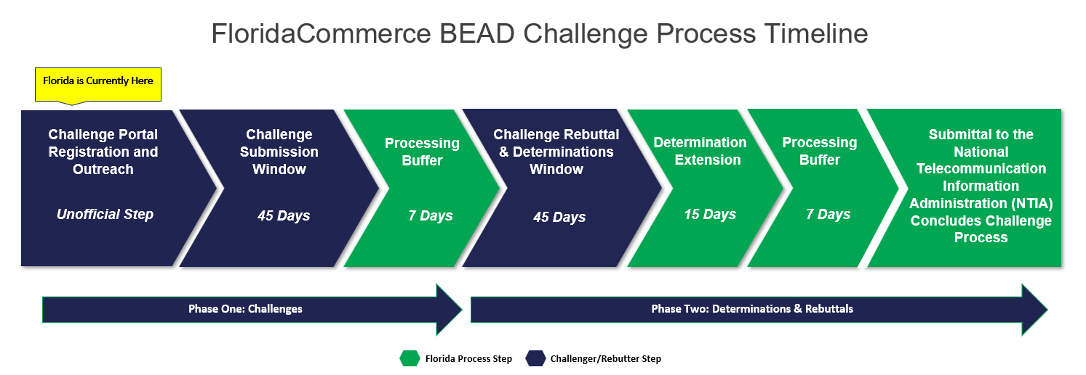
Technology
NTIA Broadband Grant

Slide 31
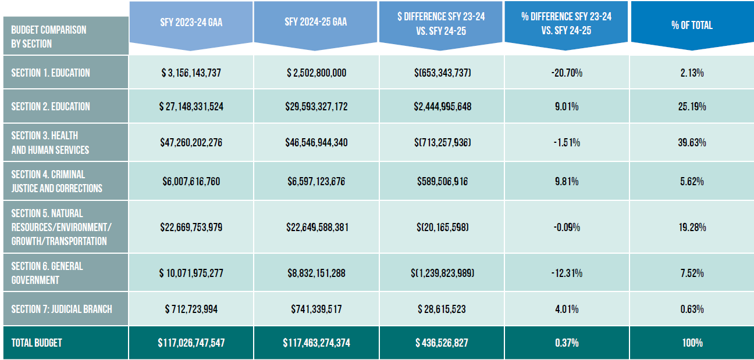
2024-25 Budget

Slide 32
County Funding Highlights
Community Substance Abuse and Mental Health Services: $1.327 billion​
Septic-to-Sewer/Wastewater Improvements: $135 million​
Resilient Florida Trust Fund and programs: $145 million​
Everglades Restoration: $614 million ​
State Housing Initiatives Partnership (SHIP): $174 million
Affordable Housing Programs:$234 million ​
Florida Hometown Hero Housing Program: $100 million​
Small County Outreach Program (SCOP): $88.6 million
Small County Road Assistance Program (SCRAP): $26.5 million​
Transportation Disadvantaged Grants and Aids: $62.4 million ​​
Fiscally Constrained Constitutional Amendment Offset: $70.7 million
Visit Florida:$80 million
Rural Infrastructure Fund: $27 million​​
Cybersecurity: $40 million carry-forward from previous year

Slide 33
Davin Suggs | Deputy Executive Director | dsuggs@fl-counties.com​
Bob McKee | Deputy Director of Public Policy | Bmckee@fl-counties.com​
Eddy Labrador | Senior Legislative Counsel | elabrador@fl-counties.com​
Jeff Scala | Senior Associate Director of Public Policy | jscala@fl-counties.com​
Jared Grigas | Policy Analyst | jgrigas@fl-counties.com ​
Courtney Mooney | Policy Analyst | cmooney@fl-counties.com
Amir Warren | Policy Analyst | awarren@fl-counties.com
Jason Mann | Public Policy Coordinator | jmann@fl-counties.com
Christopher Mathews | Public Policy Intern & ICG Video/Audio | cmathews@fl-counties.com​

Slide 34
Questions?

Slide 35
TO VIEW FAC'S FINAL REPORT, PLEASE VISIT FACPOLICY.COM

