Slide 1
Risk-Resilient Retirement:
Helping employees build protected retirement income
June 26, 2024
For Plan Sponsor Use Only

Slide 2
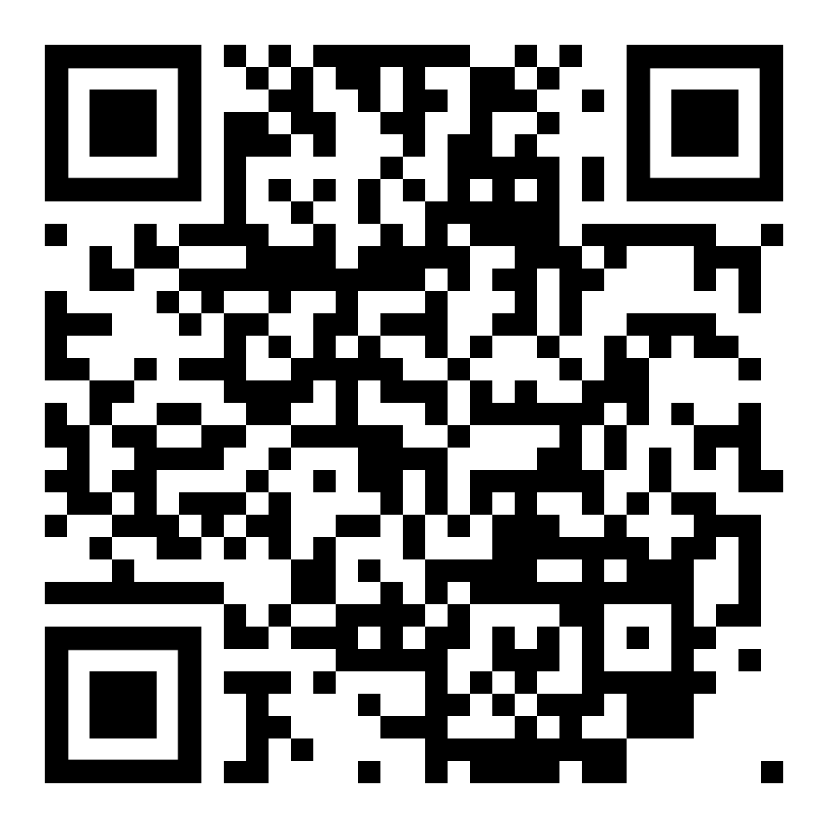
Today, we’ll cover:
Addressing the fears of employees
How you can partner with Nationwide to offer protection in retirement
Giving participants the confidence of a holistic income plan – that’s protected
Download
today’s
presentation:

Slide 3
Addressing the fears of employees

Slide 4



Plan participants look to employers for support and options they need
Yet traditionally, retirement savers are missing crucial elements that can help them feel more secure:
Guaranteed Lifetime Income¹
^{nearly 7 in 10}
^{employees}
believe they need their employer’s help to be healthy and financially secure.²
¹ Guarantees are subject to the claims-paying ability of the issuing insurance company(ies).
² “2023 Workplace Wellness Study,” EBRI, https://www.ebri.org/docs/default-source/wbs/wws-2023/wws-2023_short-report.pdf?sfvrsn=f55f062f_2
4
Notes:
Plan participants look to employers for support and options they need.
Yet traditionally, retirement savers are missing crucial elements that can help them feel more secure: Guaranteed Lifetime Income.
In fact, 7 in 10 employees believe they need their employer’s help to be healthy and financially secure.

Slide 5
Addressing the fear of outliving retirement savings
  Setting Every Community Up for Retirement Enhancement Act (SECURE Act)
  Primarily designed to:
Encourage more employers to offer a qualified retirement plan for their employees
Mitigate challenges in offering guaranteed lifetime income solutions within their investment line-up
Help address the retirement income challenge
^{78%}
of participants
continue to say they can do all the right things to manage their finances, yet still be blindsided
by outside events.¹
¹ Nationwide Advisor Authority Survey (August 2022).
Notes:
[Read slide]

Slide 6



SECURE Act: Passed in December 2019
  Section 204. Fiduciary Safe Harbor for
  Selection of Lifetime Income Provider
The legislation provides greater comfort for plan sponsors in the selection of lifetime income providers, a fiduciary act under ERISA. Under the SECURE Act, fiduciaries are:
  Afforded an optional safe harbor to satisfy the prudence requirement
  with respect to the selection of insurers for a guaranteed retirement income contract
  Protected from liability for any losses that may result to the participant or beneficiary due to an insurer's inability in the future to satisfy its financial obligations under the terms of the contract
Removing ambiguity about the applicable fiduciary standard eliminates a roadblock to offering lifetime income benefit options under a defined contribution plan.
Notes:
There were several provisions included in the SECURE Act but for purposes of our discussion today, we will focus on the two addressed on this slide.

Slide 7


Savers are looking to restore their confidence
40% of older American employees expect to retire later than planned due to inflation and rising living costs. Of those who are now expecting to retire later:
47% say recent market volatility
has diminished their savings
73% are worried they won’t have enough income in retirement
Market Risk
Outliving Savings
Source: Nationwide Retirement Institute’s In-Plan Lifetime Income Survey, September 2022
Notes:
[Read slide]
Sequence of return risk, or the risk of market volatility and experiencing an unrecoverable loss leading up to or early on in retirement.
Outliving their savings: Traditional TDFs offer no income guarantees and many people fear their retirement savings will not last

Slide 8
How you can partner with Nationwide to offer protection in retirement

Slide 9
Delivering confidence through our Protected Retirement Solutions¹
Our suite of solutions offers two types of protection:
Protected Lifetime Income Solutions
Principal Protection
Lifetime
Income
Strategy³
Target Date Series Solutions²
Group Fixed
Indexed Annuity
Default Friendly
Income America™ 5ForLife
NCIT American Funds Lifetime Income Builder Target Date Series
Nationwide Indexed Principal Protection®
Over 5,400 plan adoptions⁴
Over 1,400 plan adoptions⁴
Over $4.95 billion in AUM as insurer and recordkeeper⁴
¹Guarantees are subject to the claims-paying ability of the issuing insurer(s)
² Income America 5ForLife is a collective investment trust consisting of a series of target date funds and a balanced fund with a 50/50 equity/fixed income portfolio, each providing access to guaranteed lifetime income.
³ AllianceBernstein offers the Lifetime Income Strategy as a flexible solution that combines open architecture, target-date funds with a guaranteed retirement income stream backed by multiple insurers.
⁴As of March 31, 2024
For Plan Sponsor/Consultant Use– Not for Distribution
Notes:
Nationwide offers a full suite of solutions because we are committed to delivering the right thing at the right time – and our protected retirement solutions are another way we remain committed to this mission. You can offer participants a simple way to plan for their unique needs, through guarantees offering two distinct benefits: Principal protection and Guaranteed Lifetime Income.
Our principal protection solution, Nationwide Indexed Principal protection, offers participants principal protection with the opportunity for growth.
We also offer a few Guaranteed Lifetime Income Solutions, so plan sponsors can choose what works best for their plan demographic:
1. Income America 5ForLife, which is a series of funds (held in a Collective Investment Trust) that provides access to guaranteed lifetime income upon reaching age 65 – helping participants to worry less about running out of money in retirement.
2. NCIT American Funds Lifetime Income Builder Target Date Series, a collective investment trust that is designed to help optimize growth potential while delivering lifetime income.
3. Lifetime Income Strategy is offered in partnership with AllianceBernstein as a flexible solution that combines open architecture, target-date funds with a guaranteed retirement income stream backed by multiple insurers. This customized solution is available to the mega-plan market.
[Read stats on slide as appropriate]
**NOTE: To play the Income America video:
Streaming: https://www.nrsforu.com/rsc-web-preauth/articles/incomeamerica5forlife
Download MP4: https://onyourside.sharepoint.com/:f:/r/sites/In-PlanAnnuitiesProgram/Shared%20Documents/Retirement%20Solutions/Income%20America/Product%20Videos?csf=1&web=1&e=xs31FF

Slide 10
Moving Forward:
FAC Plans making income a reality
Notes:
[Placeholder slide for Q&A with Plan Sponsor – no slides for that portion]
NW: Why is protected retirement so important at the NACo level? Plan Sponsor: NACo is always looking for what is next and how to help county employees reach their retirement goals, so they can be financially fit and not stress over their finances. Protected Retirement fits perfectly with NACo's goals to provide solutions that are impactful to counties and county employees.
NW: Do you see this shifting the way Americans prepare for and look at retirement? Plan Sponsor: The 2024 National Institute on Retirement Security study found that, of working age Americans, 79% agree that the nation faces a retirement savings crisis, up from 67% in 2020. We also see more and more participants looking to their plan sponsors for solutions to help prepare them for retirement. Protected retirement solutions help move us from a savings conversation to creating a future retirement paycheck.
NW: Why do you feel it was so important for your plan to adopt a protected retirement solution? Plan Sponsor: We’re dedicated to providing the proper tools and resources for our employees. We see this as the next, and evolution of target date funds, and a key opportunity to help our employees better plan for their retirement with income they cannot outlive.
NW: What is one of the biggest concerns you have for your employees when they retire? Plan Sponsor: We are always worried our employees won't have the resources to retire, and what I love about these Protected Retirement solutions is that we can help participants approach retirement knowing they have an income stream they can’t outlive. That can go a long way in helping folks be confident they are retirement ready.
NW: How do you see these solutions impacting your employees overall retirement preparedness? Plan Sponsor: The 3-legged stool approach gives the framework of: social security, pension and retirement savings to recreate their paycheck. The hard part has always been the third part, turning retirement assets into income. With Protected Retirement Solutions, participant have help in turning their retirements savings into income. The fund does all that hard work for them. And it also prevents them from outliving that income, creating a new source income stability.

Slide 11
Giving participants the confidence of a holistic income plan – that’s protected

Slide 12
When it comes to saving, many don’t have the time or expertise
But we offer simple ways to help deliver retirement readiness:
Auto-enrollment
Leads to higher plan participation¹
^{Two-thirds}
Auto-escalation
Impacts how much workers may save
of plan sponsors
offering auto features see a direct and attributable benefit to their plans’ outcomes¹
Professional management
Outperforms individual investors on average²
1 “Implementation of Auto Features Continues to Rise as Plans Recognize Benefits”, DCIIA, 2020
2 “Made to Stick: The Drivers of Default Investment Acceptance in Defined Contribution Plans”, Morningstar, 2020
Notes:
When it comes to saving, many participants may not have the time or the expertise to get started. That’s why we offer simple ways to help participants get started:
Auto-enrollment: Automatically enrolls new hires into a default fund at a fixed contribution rate, and can lead to higher plan participation
Auto-escalation: Automatically increases participant contribution rates at regular intervals by a predetermined amount; helping to impact how much your participants may save
Professional management, such as a managed account: Offers participants institutional investment expertise; studies show these accounts tend to outperform those who build their own portfolios.
These features have obvious benefits to plan participants, but plan sponsors see benefits as well. Two Thirds of plan sponsors studied by DCIIA say that offering auto solutions provides direct benefits to their plan’s outcomes. Some benefits include ability to grow participation, increase satisfaction, and reduce fees.

Slide 13
Growing participation with default funds
Qualified Default Investment Alternatives offer a path for plan sponsors to designate an investment for participants who fail to choose their own
Traditional Default – Participant is defaulted upon enrollment
Enrollment – Retirement
1 fund for entire lifecycle
The following investments qualify:
Target date funds
(or Lifecycle funds)
Balanced funds
Managed account services
Capital preservation funds¹
1 Capital Preservation Funds can only be used for the first 120 days of participation
Notes:
Qualified Default Investment Alternatives were introduced by the Pension Protection Act in 2006 to help boost employee retirement savings. They offer a path for plan sponsors to designate an investment for participants who fail to choose their own.
Here’s how it works: When a participant enrolls in the plan, either on their own, or through auto-enrollment, an investment must be selected. If the participant fails to select their own investment, they will be placed into the default fund and their assets will remain there unless they take action. This approach can help provide participants with growth opportunity that might have been missed otherwise.
Since the investment needs to serve long-term planning needs, the DOL outlined a few investments that qualify:
Target date funds, or lifecycle funds
Balanced funds
Managed Account Services
Or Stable Value Funds, but these can only be used for 120 days and paired with another QDIA that offers longer term growth potential

Slide 14

Plan Sponsors can help participants by using a Dynamic Default
We continue to innovate for the future
Traditional Default
Enrollment – Retirement
1 fund for entire lifecycle
Vs.
Dynamic Default
Hypothetical example¹
Growth-opportunity
Age 25
Protected retirement solution
Age 50
Transition from 1 fund to another
1 This example shows a protected retirement solution as the second default investment option at age 50; other default investment options could be selected.
Notes:
Default funds are a great way to help participants who may not otherwise have investment expertise, but they have traditionally been limited to a one-size-fits-all approach. We know that investing for the long-term means managing longevity and market risk, and investment needs may change as a participant gets close to retirement. This is why we continue to innovate for the future – we’ve begun testing a new concept that build on the traditional default feature.
[Explain example on slide]

Slide 15


Traditional framework may not guarantee essential income
Generating retirement income has traditionally relied on the three-legged stool approach, but there is no guarantee that income used to cover essential expenses will last:
Pension
income
Social
Security
income
Deferred
Compensation
plan
Notes:
The reality is that traditional framework may not guarantee essential income needed by participants. Generating retirement income has traditionally relied on the three-legged stool approach, but there is no guarantee that income used to cover essential expenses – such as mortgage payments, utilities, and groceries – will last. The three components of this approach are:
Pension income
Social Security income
Retirement savings, and for the purpose of today’s discussion we’ll focus on Deferred Compensation Plans

Slide 16
We believe in guaranteeing essential income
As an industry, we are committed to shifting the mindset from savings-plan to income-plan – all while ensuring it’s protected.
Pension
income
Social
Security
income
Deferred
Compensation
with protected income
Notes:
[Read slide]

Slide 17
Let’s take a look at a holistic income plan that’s protected
In this example, our 65 year old saver is prepared – not just with savings – but with an income plan that is protected for life:
Pension income
Social Security Income
Deferred Compensation
with protected income
$2,400 / month¹
$2,008 / month²
$1,250 / month³
generated from
$300k balance
Total = $5,658 per month for life
This chart is for illustration purposes only and shows the general principles of creating a retirement income plan for a 65 year old. It assumes the amounts receive from pension, social security income, and protected retirement income are protected for life.
1 Assumes 30 years of service in the Florida Retirement Resources Pension plan, with an ending salary of $60,000, assumes pension income does not reduce social security income
2 Assumes social security benefit with DOB: 6/15/1959, retirement year: 2011, ending salary: $60,000, benefits begin at age 64 and 11 months, in today’s dollars
3 Assumes participant invests $300k balance into an in-plan guarantee solution, that this amount is captured as the income base, and that the solution generates 5% of the income base annually at age 65. Features of any given solution may differ.
Notes:
[Read slide]
Nationwide also offers tools that can help participants envision their entire retirement income plan – making it easier to prepare for and live in retirement.

Slide 18
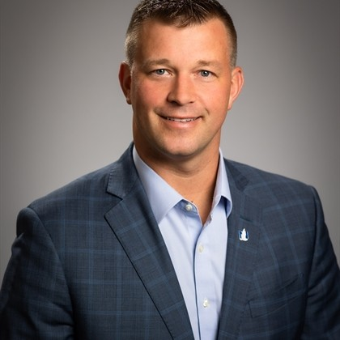
Moving forward: Let’s talk about making protected retirement income a reality
David Bazzel
Download today’s presentation:
813-785-1844
bazzeld@nationwide.com
Schedule time with David Bazzel to help share the importance of
protected retirement solutions within your county
Notes:
[Read slide]

Slide 19
Important information
• Not a deposit • Not FDIC or NCUSIF insured • Not guaranteed by the institution • Not insured by any federal government agency • May lose value
This material is not a recommendation to buy or sell a financial product or to adopt an investment strategy. Investors should discuss their specific situation with their financial professional.
Provisions of these options may vary based on plan selection and/or by state regulation. These investment options may not be available in some states.
Guarantees are backed by the claims-paying ability of the issuing insurance company.
Use of the term "pension-like income stream" refers to the similarity between Nationwide’s Protected Retirement income solutions and a traditional pension plan in the sense that both can provide a stream of income for participants’ lives. However, it’s important to note that these solutions are not pensions. The term “pension-like” is used solely to illustrate the income feature of the solutions and does not imply any other characteristics typically associated with pensions.
Withdrawals are subject to income tax, and withdrawals before age 59½ may be subject to an additional 10% early withdrawal tax.
The entities listed within this document and their affiliates (1) do not provide tax or legal advice; (2) are separate and nonaffiliated companies and; (3) own the intellectual property of their respective marks and logos.
Nationwide, the Nationwide N and Eagle, Nationwide is on your side and Nationwide Indexed Principal Protection are service marks of Nationwide Mutual Insurance Company. © 2024 Nationwide
NRM-22672FL (6/24)
19
Notes:
NOTE!!! All disclosure slides must be presented for a reasonable amount of time for the viewer to read them

Slide 20
Disclosures
Nationwide Indexed Principal Protection:
Nationwide Indexed Principal Protection® is a group fixed indexed annuity issued by Nationwide Life Insurance Company and held in the general account. Transfers out of this contract to other funding providers are subject to certain restrictions. Group fixed indexed annuities are not stock market investments and do not directly participate in any stock or equity investments. It is important to understand that actual returns may be less than the return of the index due to the index cap.
My Investment Planner (MIP) is a non-discretionary investment advice tool provided to Nationwide Investment Advisors, LLC (NIA) by Wilshire®. Investors are responsible for implementing and maintaining the suggested allocations. Wilshire is a service mark of Wilshire Associates Incorporated, which is not an affiliate of NIA or Nationwide.
Guarantees are backed by the claims-paying ability of the issuing insurance company.

Slide 21
Disclosures
Income America Disclosures:
The Income America Funds are Great Gray Trust Company, LLC Collective Investment Funds (“Great Gray Funds”), which are bank collective investment funds; they are not mutual funds. Great Gray Trust Company, LLC (“Trustee”) serves as the Trustee of the Great Gray Funds and maintains ultimate fiduciary authority over the management of, and investments made in, the Great Gray Funds. Great Gray Funds and their units are exempt from registration under the Investment Company Act of 1940 and the Securities Act of 1933, respectively.
Investments in the Great Gray Funds are not bank deposits or obligations of and are not insured or guaranteed by Great Gray Trust Company, LLC, any bank, the FDIC, the Federal Reserve, or any other governmental agency. The Great Gray Funds are commingled investment vehicles, and as such, the values of the underlying investments will rise and fall according to market activity; it is possible to lose money by investing in the Great Gray Funds.
Participation in Collective Investment Trust Funds is limited primarily to qualified retirement plans and certain state or local government plans and is not available to IRAs, health and welfare plans and, in certain cases, Keogh (H.R. 10) plans. Collective Investment Trust Funds may be suitable investments for plan fiduciaries seeking to construct a well-diversified retirement savings program. Investors should consider the investment objectives, risks, charges and expenses of any pooled investment fund carefully before investing. The Additional Fund Information and Principal Risk Definitions (PRD) contains this and other information about a Collective Investment Trust Fund and is available at www.greatgray.com/principalriskdefinitions or ask for a free copy by contacting Great Gray Trust Company, LLC at (866) 427-6885.
Great Gray and Great Gray Trust Company are service marks used in connection with various fiduciary and non-fiduciary services offered by Great Gray Trust Company, LLC.
The Trustee has appointed American Century Investment Management, Inc. as Glidepath Manager to the Income America Funds to assist it in connection with providing strategic asset allocations for each of the vintages of the Income America Funds. American Century Investments® provides underlying sub-asset class management and target date glide path management (when applicable) as well as marketing support for Income America.
The Trustee has appointed Wilshire Advisors LLC (“Wilshire”) as Sub-Advisor to the Income America Funds to assist it in connection with the investment of assets in the Income America Funds. Wilshire serves as the Investment advisor fiduciary under ERISA 3(21) and is responsible for recommending glide path manager, guaranteed lifetime withdrawal benefit providers, underlying fund products and stable value offerings to the trustee from an investment universe selected by the product consultant for each category.
SS&C provides the Retirement Income Clearing and Calculation Platform (RICC), a middleware application designed to facilitate the efficient distribution and servicing of in-plan guaranteed income products across various recordkeepers and participating insurers. The SS&C RICC platform also calculates and maintains the participant guaranteed lifetime withdrawal benefit values for Income America 5ForLife.
This material is not a recommendation to buy, sell, hold or roll over any asset; adopt an investment strategy; retain a specific investment manager; or use a particular account type. It does not take into account the specific investment objectives, tax and financial condition, or particular needs of any specific person. Investors should discuss their specific situation with their financial professional. Diversification does not assure a profit, nor does it protect against loss of principal.
The Income America 5ForLife funds include a group annuity contract, which provides a plan participant with guaranteed annual retirement income that is supported by a contract between the trustee and the following issuing insurance companies:
The Lincoln National Life Insurance Company, Fort Wayne, IN. The Lincoln National Life Insurance Company does not solicit business in the state of New York, nor is it authorized to do so. Lincoln Financial Group is the marketing name for Lincoln National Corporation and its affiliates.
Nationwide Life Insurance Company, Columbus, OH.
Each fund in the series may invest in a fixed annuity contract issued by Nationwide Life Insurance Company and The Lincoln National Life Insurance Company. This fixed annuity contract is separate from the group annuity contracts issued by the same entities which support the guaranteed annual retirement income.
All contractual guarantees, including those for guaranteed income, are funded from the issuing insurance companies’ general accounts and are subject to the claims-paying ability of the issuing insurance company. Neither issuing insurance company is a trustee for any assets held in any of the collective investment funds.
The issuing insurance companies and their affiliates, distributors, respective employees, representatives and/or insurance agents do not provide tax, accounting or legal advice. Please consult your own tax or legal advisor for answers to your specific questions.
All entities listed within this document are separate and nonaffiliated companies.
These investment options may not be available in all states.
The third-party marks and logos listed are the intellectual property of each respective entity and its affiliates.
© 2024, Income America, LLC
Notes:
NOTE!!! All disclosure slides must be presented for a reasonable amount of time for the viewer to read them

Slide 22
Disclosures
NCIT American Funds Lifetime Income Builder Target Date Series:
The Nationwide Collective Investment Trust (“NCIT”) is a bank-sponsored collective investment trust (“CIT”) and not a mutual fund. The NCIT is composed of individual collective funds including the NCIT American Funds Lifetime Income Builder Series (“Series”) of target date funds (“Funds”). Because the CIT is not registered with or required to file prospectuses or registration statements with the SEC or any other regulatory body, neither one is available. Investors should consult the Offering Memorandum for the Series and carefully consider the investment objectives, risk, charges, and expenses of the Funds before investing. It is possible to lose money by investing in the CIT. Global Trust Company (“GTC”), a Maine Chartered Non-depository Trust Bank, is the CIT Trustee and maintains ultimate fiduciary authority over the management of, and investments made in, the CIT. Nationwide Fund Advisors (“NFA”) is an investment advisor to the Series. The CIT is exempt from registration under the Securities Act of 1933, as amended, and the Investment Company Act of 1940, as amended. Neither NFA, nor the Trustee, has any obligation to update this summary. This summary has not been approved by the Securities and Exchange Commission or any other federal or state regulatory agency or foreign securities commission. For further information, qualified plan participants should consult their plan sponsors.
Participation in collective investment funds is limited to qualified defined contribution plans and certain state or local government plans and is not available to IRAs, health and welfare plans, certain Keogh plans, or the general public. Collective funds may be suitable investments for participants seeking to construct a well-diversified retirement savings program, but diversification does not assure a profit, nor does it protect against loss of principal. This material is not a recommendation to buy or sell a financial product or to adopt an investment strategy. Investors should discuss their specific situation with their financial professional. This Series is not available in all states.
Target Date Funds are designed to provide diversification across a variety of asset classes, primarily by investing in underlying funds. In addition to the expenses of the Funds, each investor is indirectly paying a proportionate share of the applicable fees and expenses of the underlying funds. Each Fund is subject to different levels of risk based on the types and sizes of its underlying asset class allocations and its allocation strategy. Although target date portfolios are managed for investors on a projected retirement date time frame, the allocation strategy does not guarantee that investors' retirement goals will be met.
Each Fund in the series invests primarily in underlying funds and one of two group annuity contracts issued by Nationwide Life Insurance Company (“Nationwide”), an affiliate of NFA. All contractual guarantees are backed solely by the claims-paying ability of Nationwide. Any participant withdrawals (other than the guaranteed income payments) or loans (if the plan allows) from the Funds will decrease the value used to calculate the guaranteed lifetime income benefit and will therefore reduce future guaranteed income payments. Capital Group manages the underlying American Funds, but the underlying funds and their allocations in the Investment are determined by NFA, subject to the approval of the Trustee.
Key Risks: Each Fund is subject to different levels of risk, based on the types and sizes of its underlying asset class allocations and its allocation strategy. Each Fund’s underlying funds may be subject to specific investment risks, including but not limited to: stock market risk (equity securities); default risk and interest rate risk (bonds); currency fluctuations, political risks, differences in accounting and limited availability of information (international securities); and derivatives risk (many derivatives create investment leverage and are highly volatile). Please refer to the most recent Offering Memorandum for a more detailed explanation of the Fund’s principal risks. There is no assurance that the investment objective of any fund (or that of any underlying fund) will be achieved or that a diversified portfolio will produce better results than a non-diversified portfolio. Diversification does not guarantee returns or insulate an investor from potential losses, including the possible loss of principal.
Nationwide, Capital Group, home of American Funds, and Global Trust Company are separate and non-affiliated companies.
The third-party marks and logos listed are the intellectual property of each respective entity and its affiliates.
22
Notes:
NOTE!!! All disclosure slides must be presented for a reasonable amount of time for the viewer to read them

