Slide 1
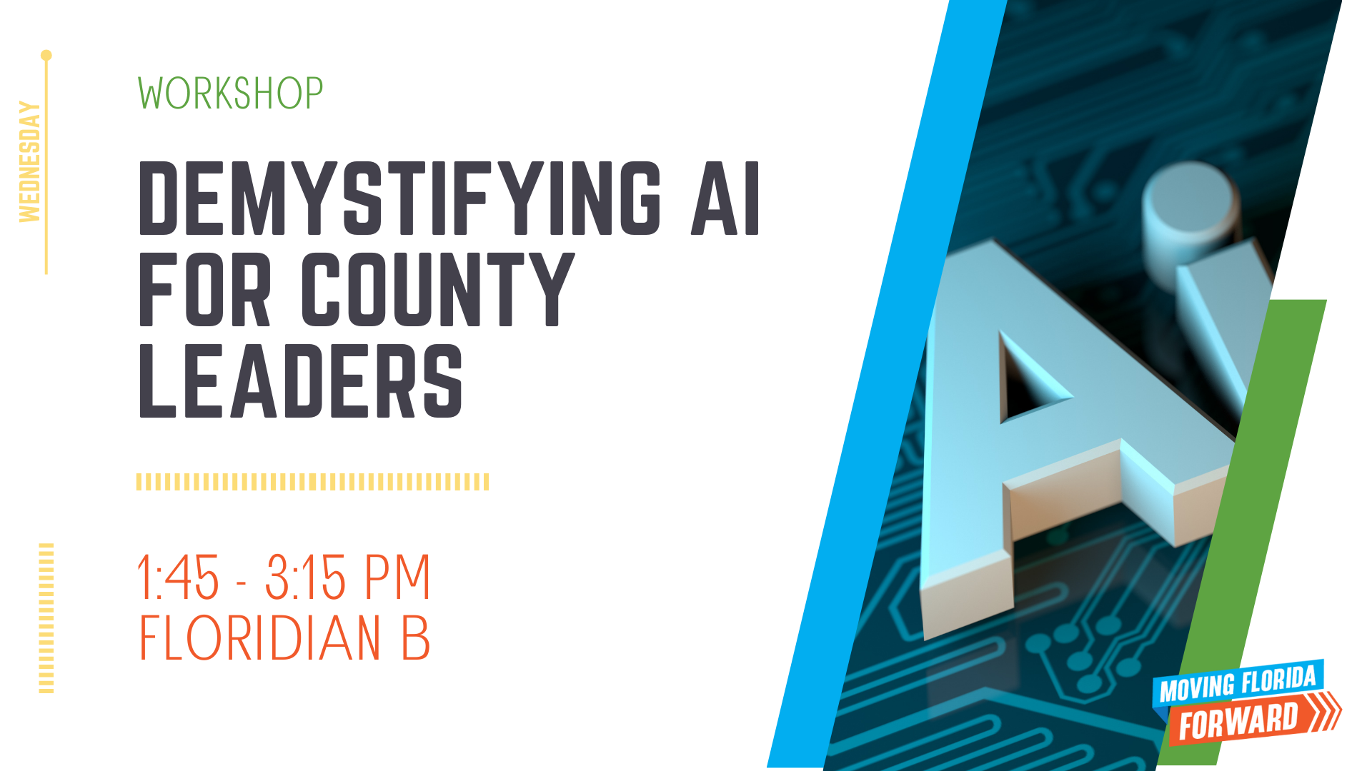

Slide 5
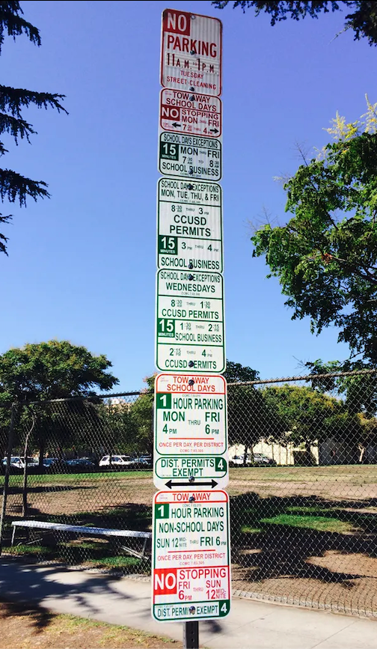
Need help interpreting parking signs?
Let AI
figure it out

