Slide 1


Slide 2






Meet our Panelists
Michele Polgar, RPh
Executive Director, PBM Client Solutions and Commercialization
CVS Health
Christie Morrison, NP
Lead Advanced Practice Provider Oshi Health
Lee Washington, MD
Moderator
Senior Medical Director
National and Public and Labor Accounts
Aetna
Jenn Roberts
VP Health Strategy
Hello Heart
Dr. Salvatore Docimo, Jr., DO
Associate Professor Bariatric Surgery
USF College of Medicine

Slide 3
How glucagon like peptides (GLP-1s) work?
GLP-1 medications treat obesity by acting
on the pancreas, brain and stomach
Pancreas
Increases insulin release
Reduces glucagon release
Brain..
Decreases appetite
Increases nausea
Stomach
Delays digestion
Feel fuller longer
Journal of Internal Medicine, “Glucagon-like peptide-1: Are its roles as endogenous hormone and therapeutic wizard congruent?”,
Volume291, Issue5, May 2022, Pages 557-573. https://onlinelibrary.wiley.com/doi/10.1111/joim.13433, accessed, 6/13/24
Notes:
Glucagon is key to controlling blood sugar levels and is critical to the management of insulin from the pancreas
That is why GLP1s were originally designed for diabetes.
But what we discovered was the impact on the brain and stomach – decrease appetite, makes you feel full – causes weight loss.
Journal of Internal Medicine, “Glucagon-like peptide-1: Are its roles as endogenous hormone and therapeutic wizard congruent?”,
Volume291, Issue5, May 2022, Pages 557-573. https://onlinelibrary.wiley.com/doi/10.1111/joim.13433, accessed, 6/13/24

Slide 4















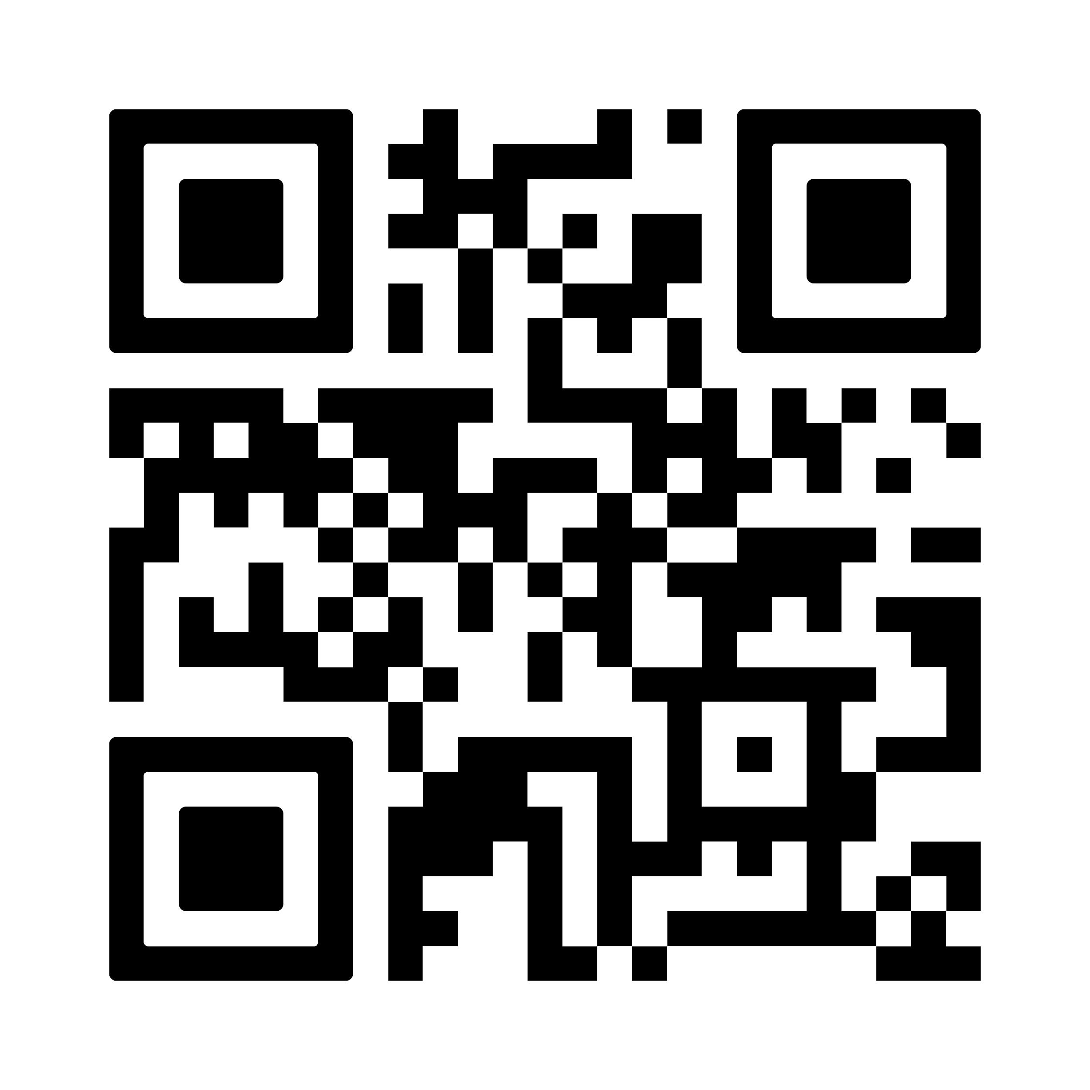


Oshi Health: the first and only virtual medical clinic for total GI care
Multidisciplinary
medical team
Trusted by industry leaders
Partnerships with major health plans and employers
Awards
2023 HPIR Innovator
2024 Best Places to Work
2023 Digital Health 100
2023 Finalist
Validated by the country’s leading GI medical associations

Slide 5




Key GI concerns related to GLP-1s
Oshi GLP-1 population
5%
on GLP-1s
74%
female
Untreated comorbidities (alongside obesity, etc.)
48 yrs
average age
33%
with underlying IBS or other functional GI disorder
GI side effects
GLP-1 adherence
Supporting longitudinal care plan, including dietary and mental health support

Slide 6
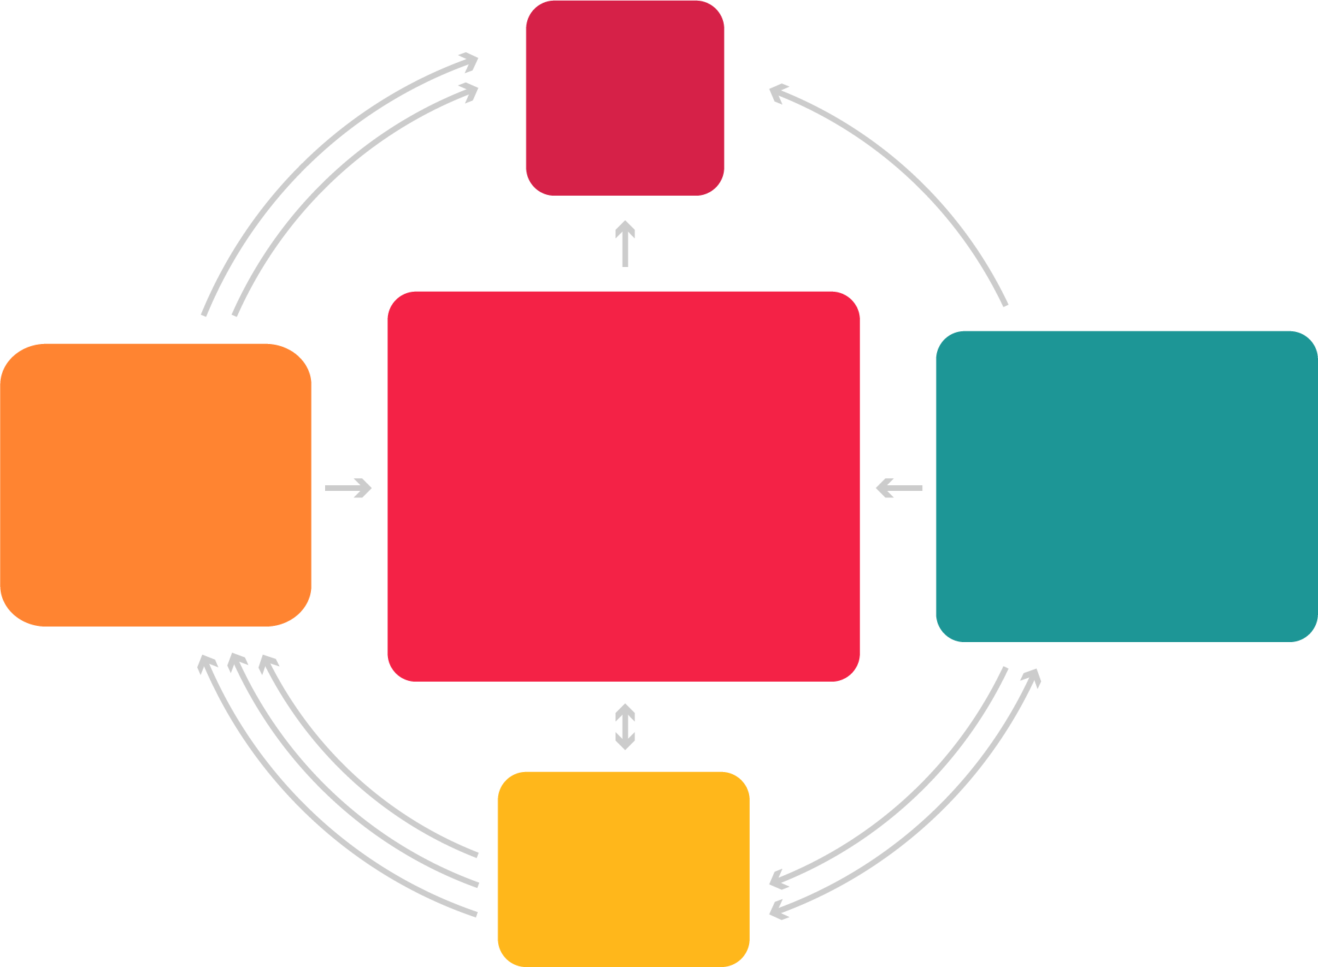

Hypertension, diabetes, high cholesterol, & obesity are interrelated and risk factors for CVD
CVD
9%
Hypertension
48%
Obesity
42%
FDA NEWS RELEASE
High Cholesterol
35%
FDA Approves First Treatment to Reduce Risk of Serious Heart Problems Specifically in Adults with Obesity or Overweight
Diabetes
11%

Slide 7
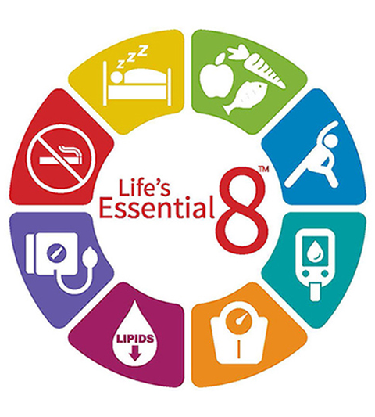
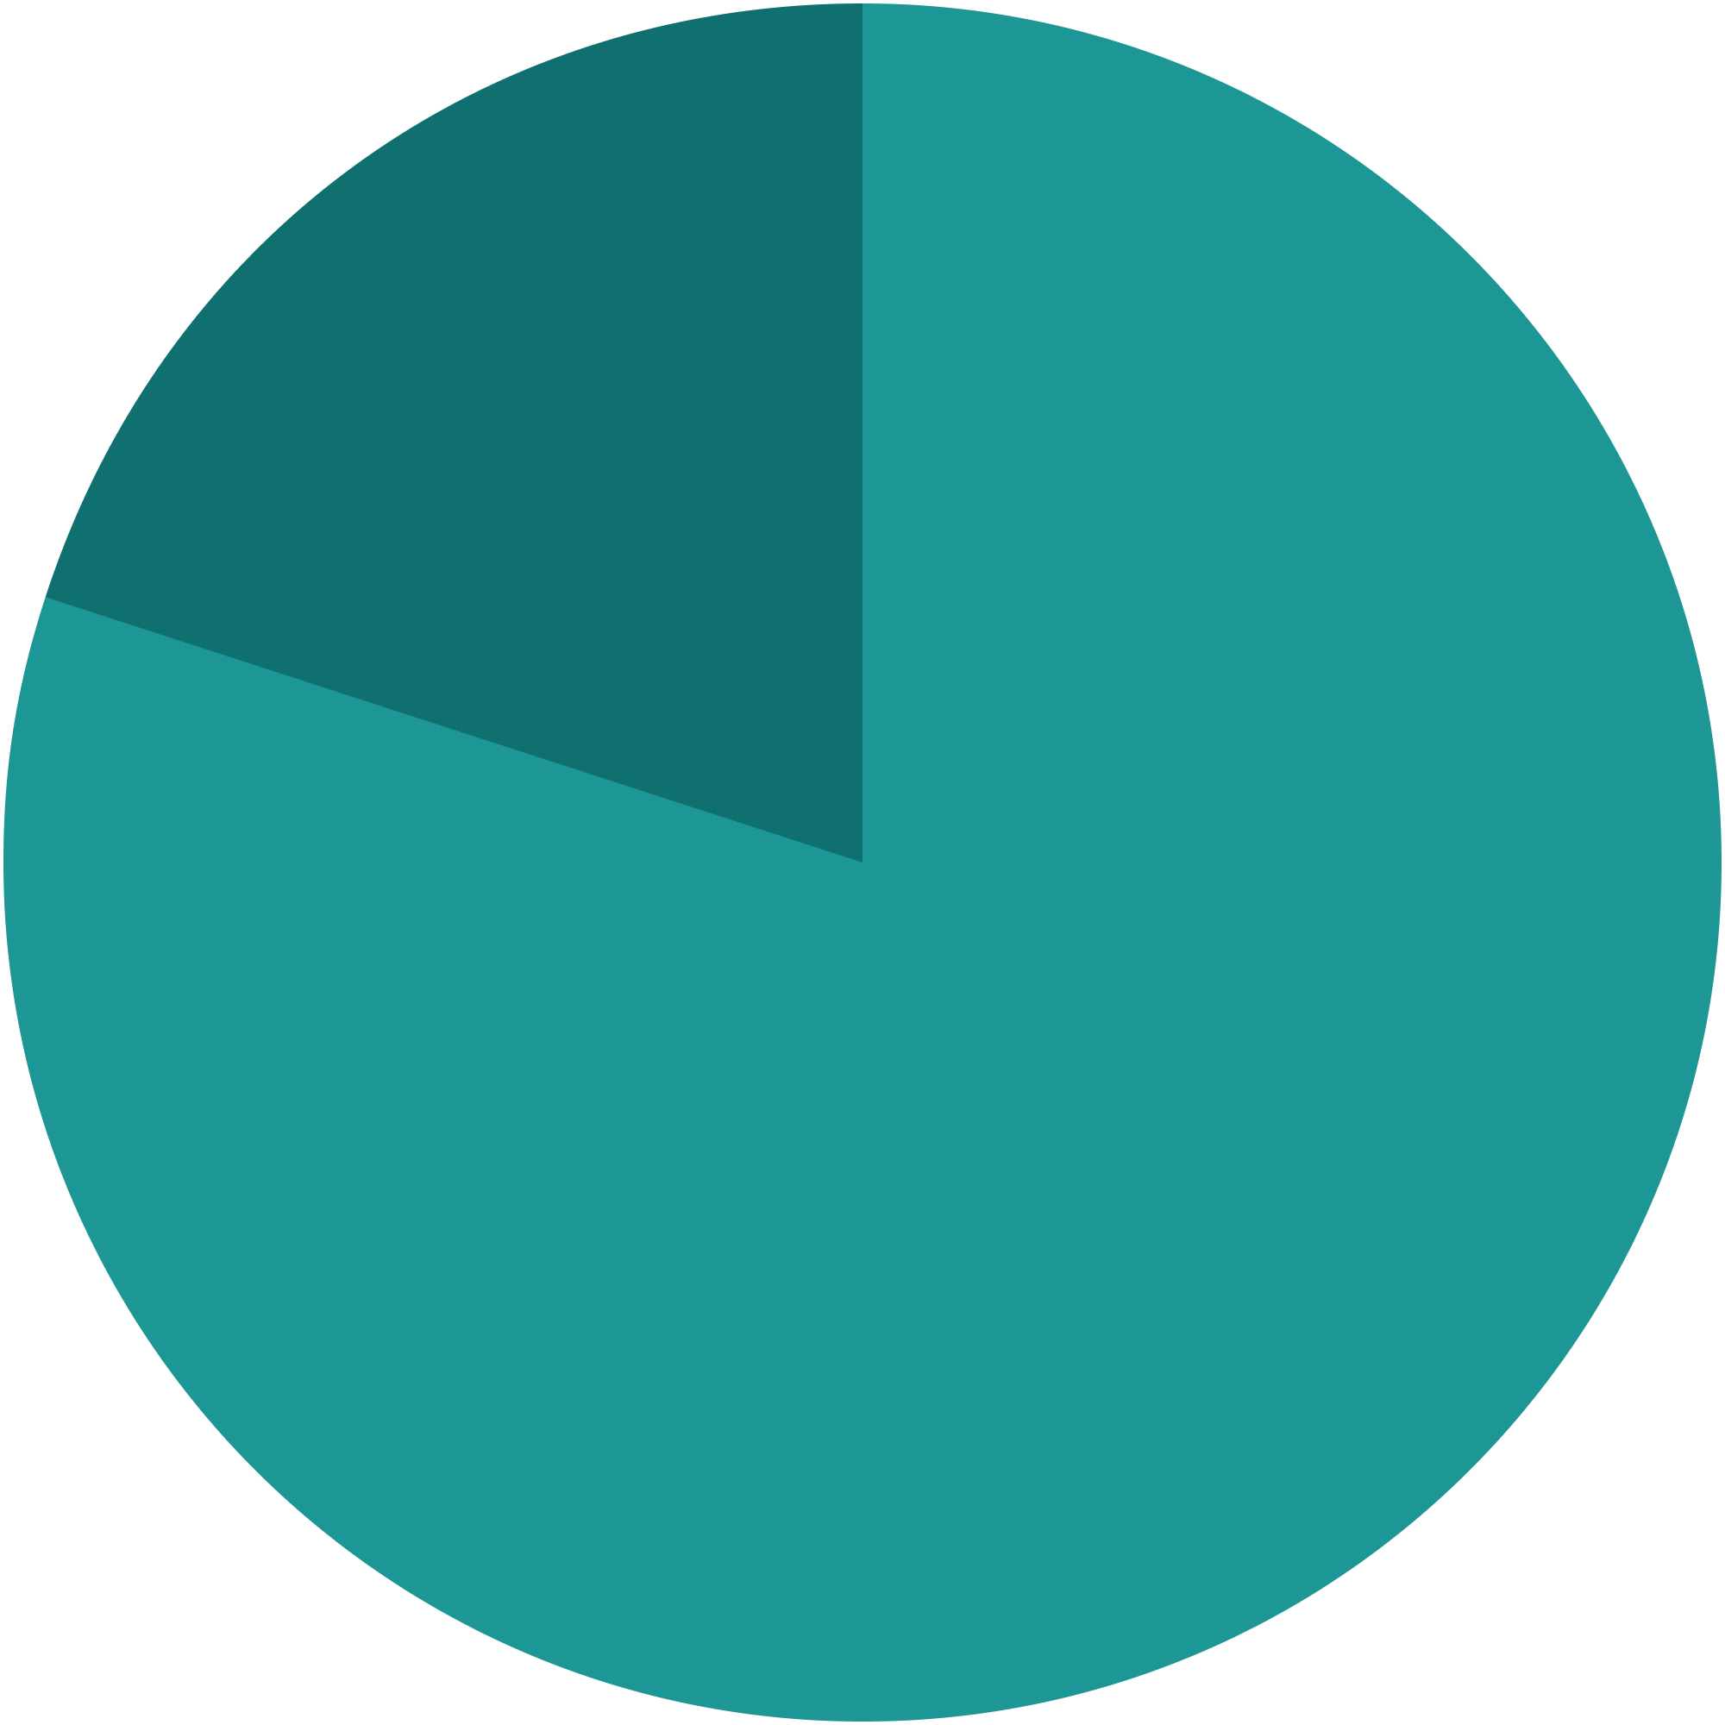
Lifestyle change is key to managing health
The reality is that
80%
of CVD cases are preventable.

Slide 8
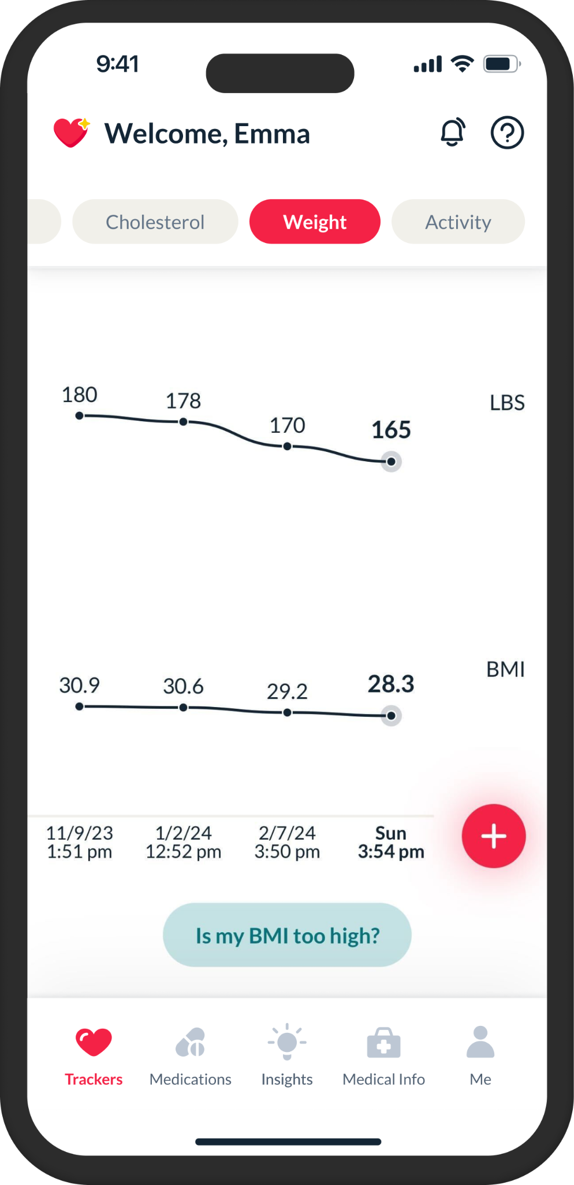
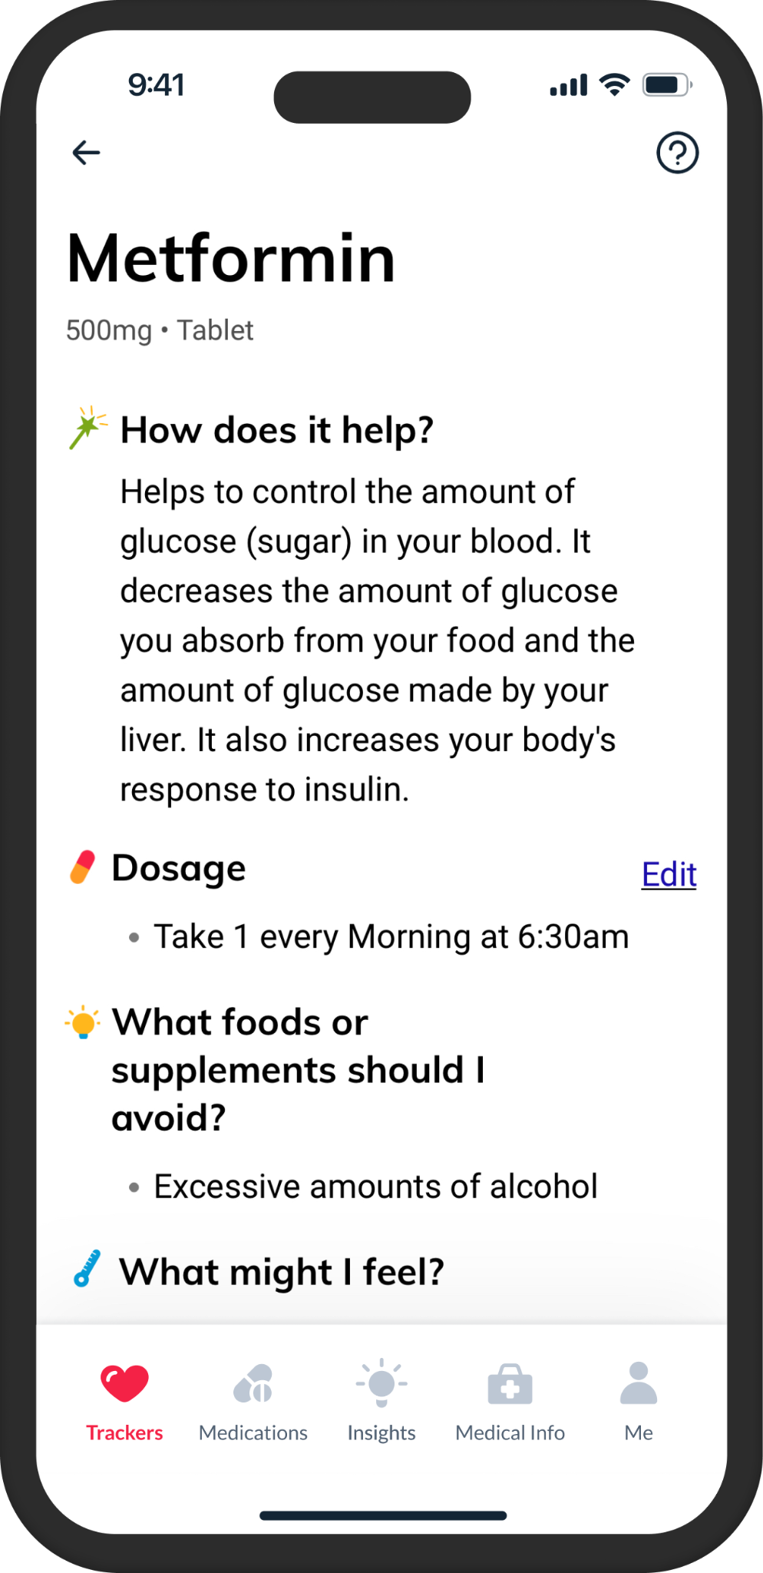
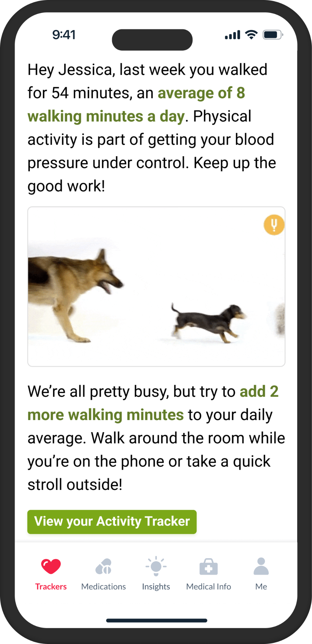








Engagement strategies are key
Medications are only one part of a treatment plan
1
Medication education and support
2
Lifestyle interventions + pharmacotherapy
3
Track outcomes and success metrics

Slide 9
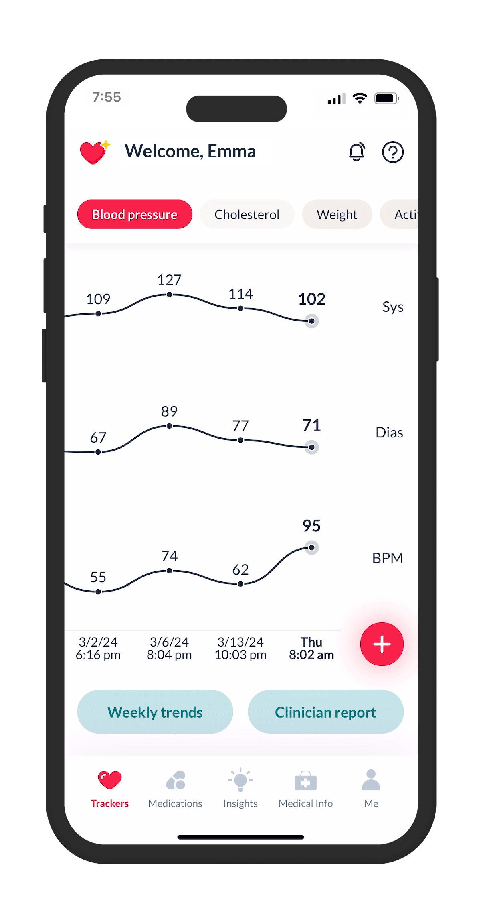

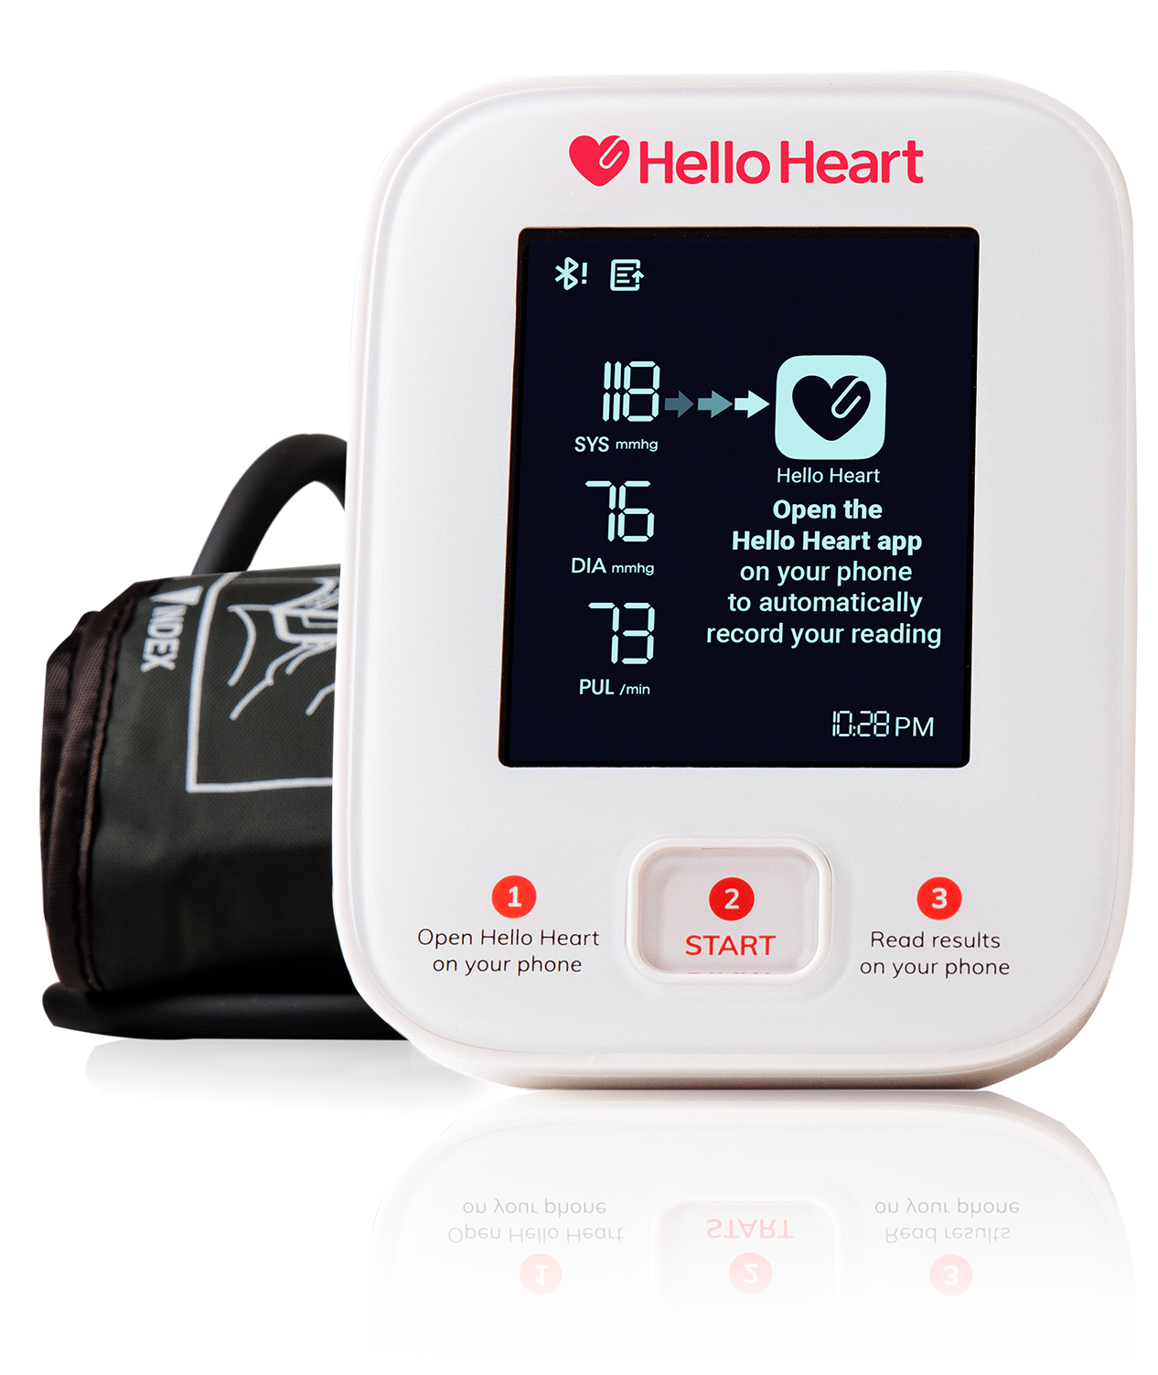





A simple, digital hub to improve heart health
Driving behavior change to lower blood pressure, cholesterol, and other CVD risk factors
Tracking
blood pressure, cholesterol, medication, activity, and weight
Detecting
irregularities in
blood pressure and pulse
Health equity
and women’s heart health
Digital coaching
personalized with AI
Reporting
shareable with physicians and care managers

Slide 10
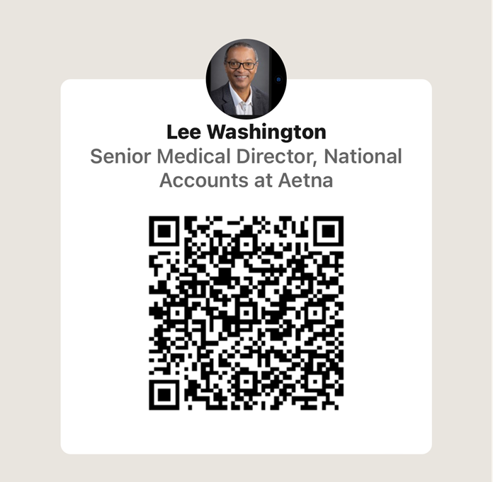
Looking to Connect?
Scan the QR to connect with our Panel Participants!

